Slide 1
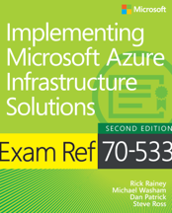
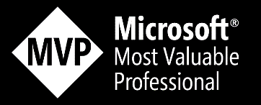
Using the Power of the Darkside to Control Azure An Introduction to the Azure CLI
Dan Patrick
dan@solliance.net
@deltadan

Slide 2
Azure Resource Manager
Deploy, Manage and Monitor all resources in a solution as a group
Repeatedly deploy a solution throughout the development cycle without breaking
Use declarative templates or imperative scripts across public or private cloud
Define dependencies between resources so they are deployed in the correct order
Role based access control with all resources
Use tags to provide further taxonomy of resource groups
Notes:
You have the ability to deploy and manage resources as a group. Previously, with the Azure Classic Deployment model each resource had to be managed and maintained independently. Using tools like PowerShell made this easier, but it will still a pretty monumental task on large deployments.
Using ARM you can generally deploy the same template or script over and over again and have ARM apply the changes to the resource without you writing a bunch of code to only apply changes.
You still have the ability to manage resources from the command line. You also now have the ability to declaratively define resources using a template, this provides a true infrastructure as code experience.
Using ARM Templates, you can define dependencies between resources. This allows you to deploy workloads in the correct order and to pass output values from one resource to another for advanced orchestrations.
ARM natively supports role based access control. This allows you to grant access at an individual resource or resource group level and with fine grained permissions on what the user or group can actually do.
ARM also provides the ability to tag resources at a resource group or even at the resource level to organize your resources to fit your needs. Tagging goes all the way through to your Azure bill as well. This gives you the ability to identify spending by a specific tag if you want to.

Slide 3
Resource Providers
Resources are defined out of resource providers
Resources have properties that can be read and set
The actual resource(s) the template will instantiate
Resources can have dependencies on other resources
Must be Registered in order to provision the resources in subscription
. . . .
Microsoft.Compute/
virtualMachines
Microsoft.Storage/
storageAccounts
Microsoft.Network/
networkInterfaces
Microsoft.Network/
publicIPAddresses
Microsoft.Network/
virtualNetworks
Notes:
Resource Providers are the basis for anything that is to be provisioned in an Azure environment. These document the resources you can deploy and manage through Resource Manager. Each resource provider offers operations for working with the resources that are deployed. Some common resource providers are Microsoft.Compute, which supplies the virtual machine resource, Microsoft.Storage, which supplies the storage account resource, and Microsoft.Web, which supplies resources related to web apps.

Slide 4
Declarative or Imperative
Imperatively with PowerShell or CLI
New-AzureRmResourceGroup -Name $rgName `
-Location $locName
New-AzureRmStorageAccount -Name $saName `
-ResourceGroupName $rgName `
–Type $saType `
-Location $locName
az vm create -n WebVM1 -g OpsTrainingOSS_RG -l centralus --size Standard_DS1_V2 --availability-set WebAVSET --nics WebVMNIC1 --authentication-type password --admin-username demouser --admin-password Demo@pass123 --image "Canonical:UbuntuServer:14.04.4-LTS:latest" --use-unmanaged-disk --os-disk-name WEBVM1-OSDISK.vhd --storage-account clistorage101 --storage-container-name vhds
"resources": [
{
"type": "Microsoft.Storage/storageAccounts",
"name": "[parameters('StorageAccountUniqueName')]",
"apiVersion": "2015-05-01-preview",
"location": "[resourceGroup().location]",
"properties": {
"accountType": "[variables('storageAccountType')]"
}
Declaratively define using a template
Notes:
When working with Azure scripting you can use either imperative PowerShell Cmdlets or Azure ARM templates.
When working with PowerShell you are “Asking” to do something on your behalf and providing some inputs.
With Azure ARM templates you are specifically telling Azure what, how and where do builds or change your Azure resources.

Slide 5
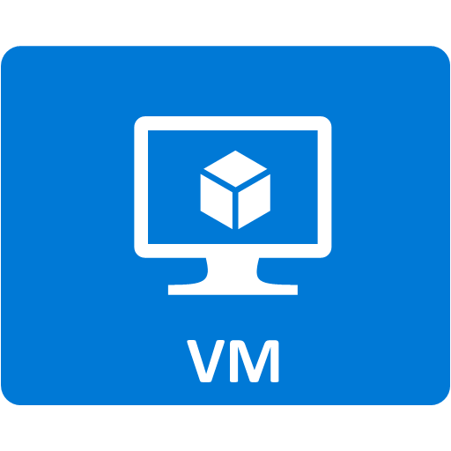
Command Line Options
X
PowerShell
Windows
Create and manage resources
Execute templates
Cross Platform CLI
Windows, Mac, Linux
Create and manage resources
Execute templates
New-AzureRmVM –ResourceGroupName $rg `
-VM $vm
bash-4.3# az vm create -n MyVm -g MyResourceGroup --image UbuntuLTS
Notes:
PowerShell or the Azure CLI can be used to automate just about any task in Azure and are available on multiple platforms.

Slide 6
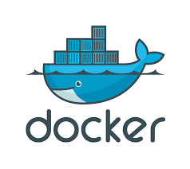
Cross Platform Support
Written in Python
Installed via pip or curl
Windows: MSI file
MAC:
brew update && brew install azure-cli
Linux:
curl -L https://aka.ms/InstallAzureCli | bash
Run as a Docker Container
docker run –it azuresdk/azure-cli-python
https://docs.microsoft.com/en-us/cli/azure/install-azure-cli
Notes:
https://azure.microsoft.com/en-us/documentation/articles/powershell-install-configure/

Slide 7
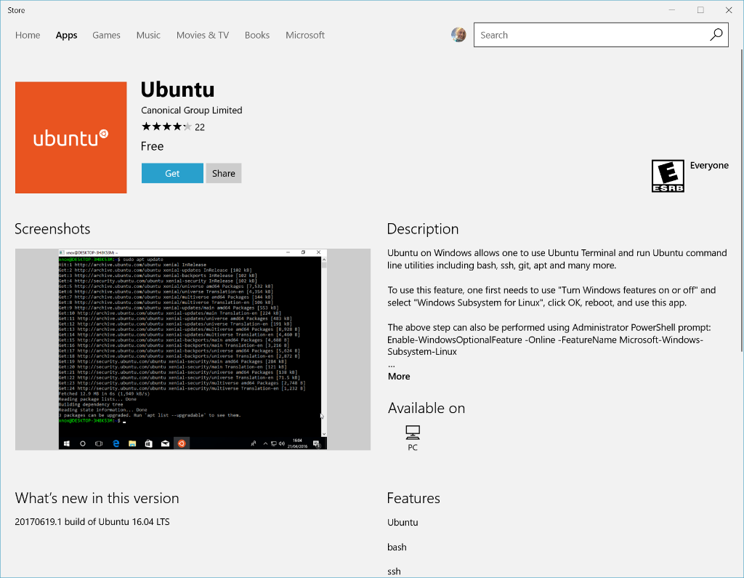
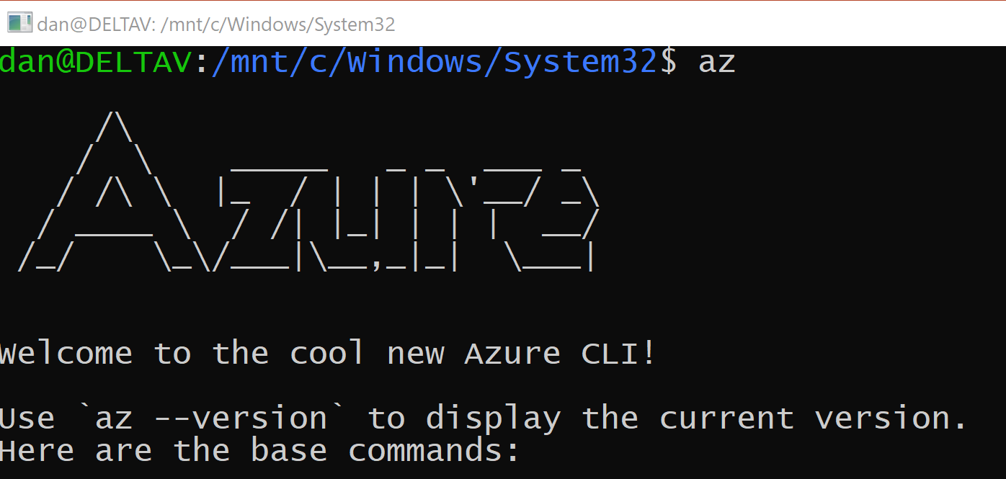
Running Bash version on Windows
Install Windows for Linux Sub System
Install bash version of CLI using bash install script just as any Linux box
Full support for bash

Slide 8
az commands
az is the command used to run the CLI
Commands organized as commands of groups
Each group represents an Azure service, and commands operate on that service
Resource type | az command group
Resource group | az group
Virtual machines | az vm
Storage accounts | az storage account
Key Vault | az keyvault
Web applications | az webapp
SQL databases | az sql server
CosmosDB | az cosmosdb

Slide 9
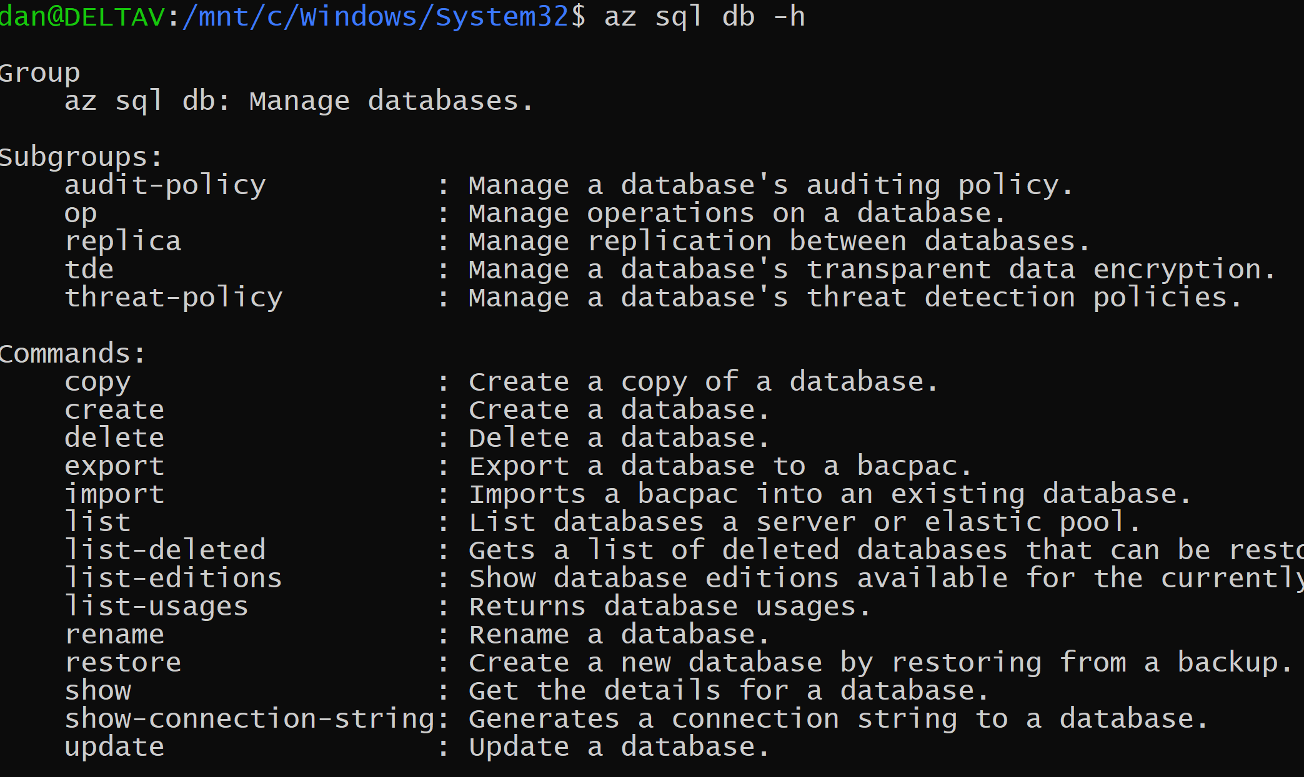
az command groups
All top-level command groups can be seen by running az
When running “az command-group-name –h” you will see all of the sub groups and commands supported

Slide 10
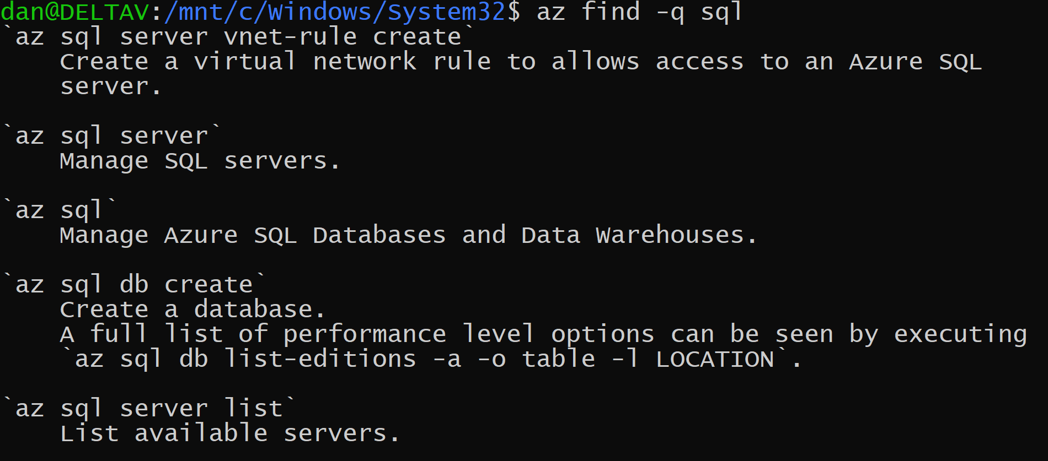
Find az command
Run az find –q <text-here> to locate commands by searching all commands

Slide 11
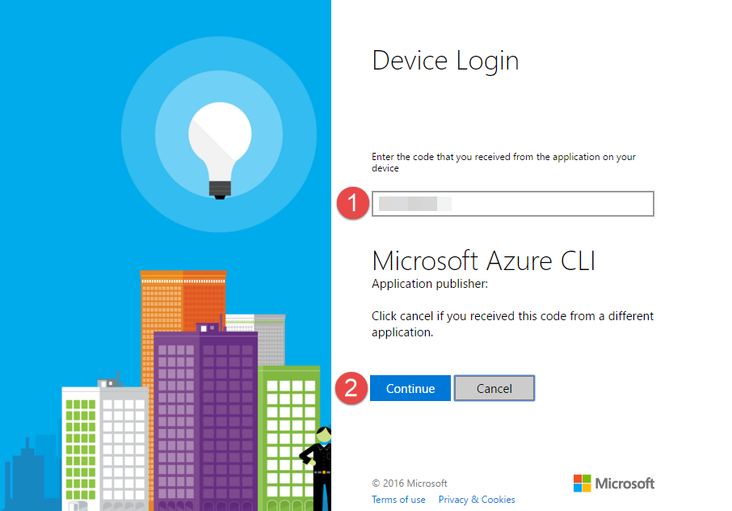
Authentication/Authorization
az login
Interactive mode with code prompt after browser login
Supports -Credentials parameter
Supports for also authenticating from the command line
Notes:
https://azure.microsoft.com/en-us/documentation/articles/resource-group-authenticate-service-principal/

Slide 12
Basics of Subscription Management
az account list
Enumerates subscriptions you have access to
az account set
Selects subscription to use when executing commands
az account show
Shows the current “Set” Account

Slide 13
Demo – Running the CLI for the first time

Slide 14
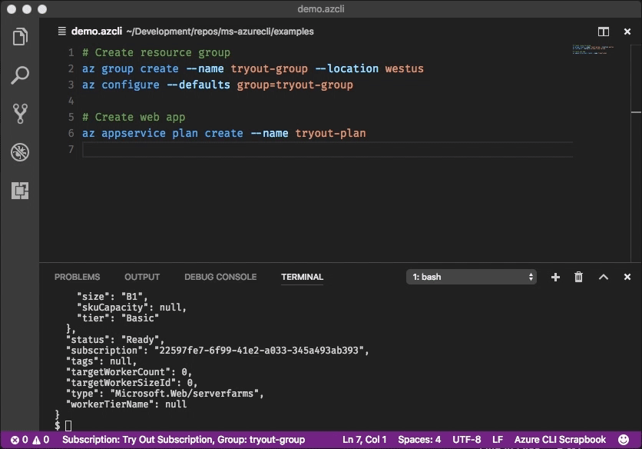
VS Code Azure CLI add-in
Create .azcli files and use these features:
IntelliSense for commands and their arguments
Snippets for commands, inserting required arguments automatically
Run the current command in the integrated terminal
Run the current command and show its output in a side-by-side editor
Show documentation on mouse hover
Display current subscription and defaults in status bar

Slide 15
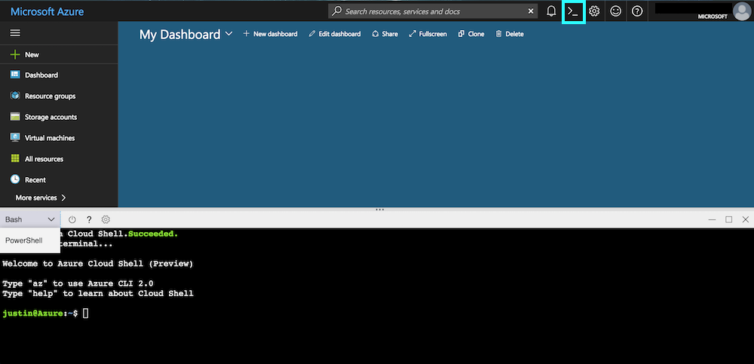
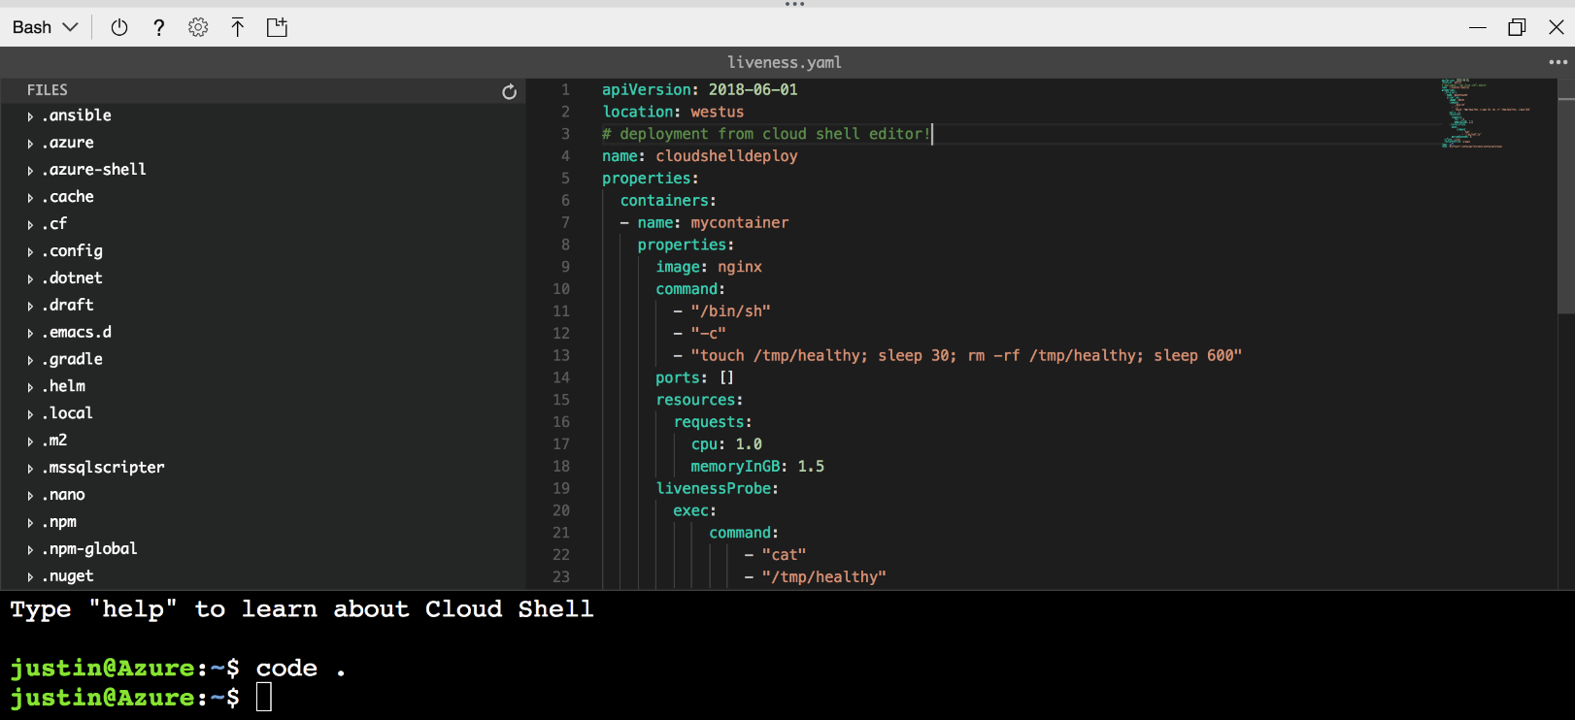
Cloud Shell
Connect to CLI from the Azure Portal
Auto-Authentication
Integrated editor

Slide 16
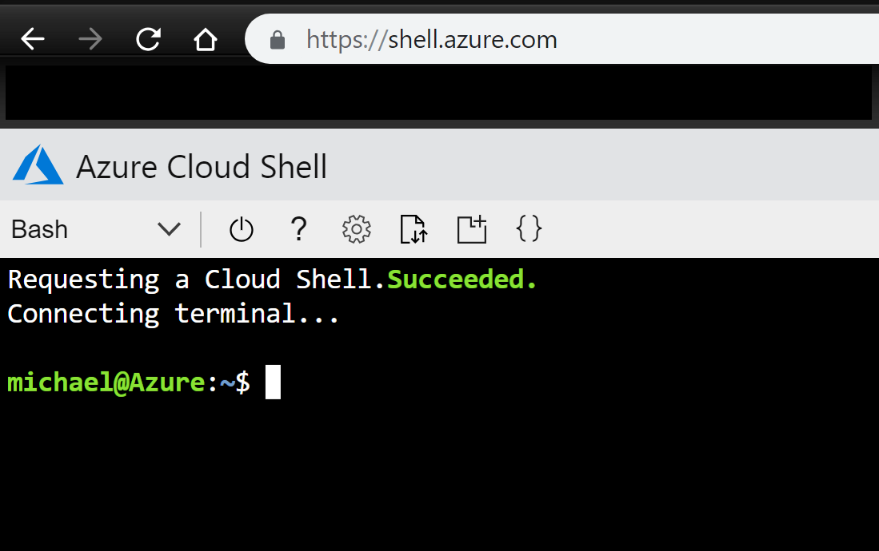
http://shell.azure.com

Slide 17
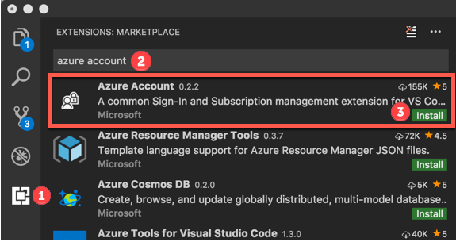
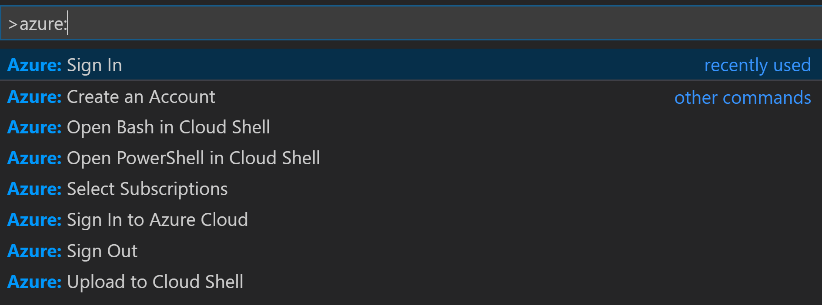
Open Cloud Shell using VS Code
Install the Azure Account add-in
From the Command Palette run
Azure:
Authenticate to Azure
Then to Start
Azure: Open Bash in Cloud Shell
Runs in Container Instances, not fast or robust

Slide 18
Demo – Cloud Shell

Slide 19
http://stormtrooper.io
Open source project, just started and to remember those commands that are easy to forget
Example based, and match the command groups
bash, written using the VS Code .azcli file extensions
HELP! ☺

Slide 20
Demo – Stormtropper

Slide 21
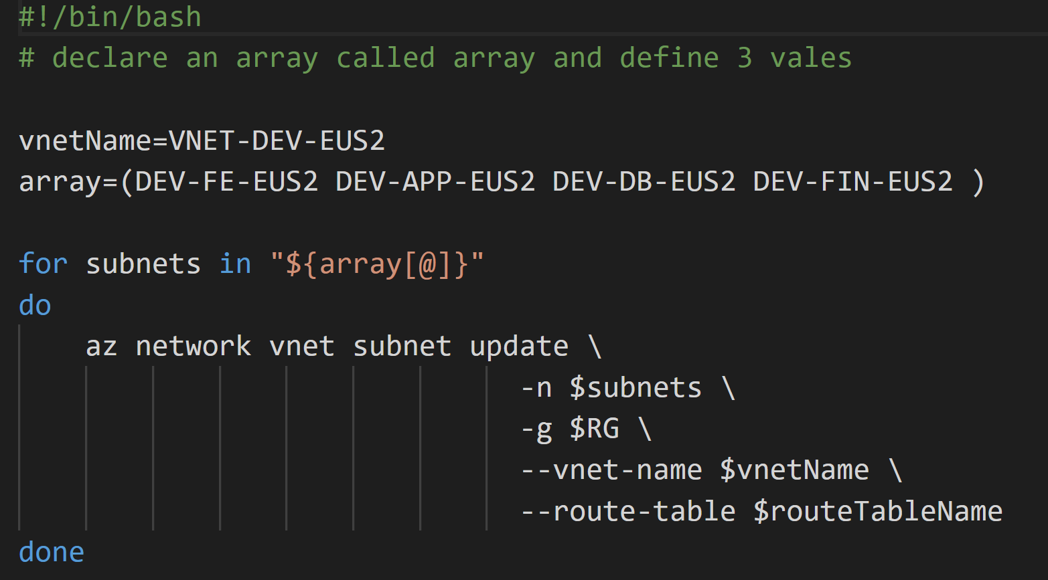
Full bash support
Anything you can do with bash is supported by the cli
Think grep, awk, sed etc.

Slide 22
Query Support
Using JMESPath, information can be found and used to perform operations
http://jmespath.org/
Notes:
The Azure CLI uses the --query argument to execute a JMESPath query on the results of commands. JMESPath is a query language for JSON, giving you the ability to select and modify data from CLI output. Queries are executed on the JSON output before any display formatting.
The --query argument is supported by all commands in the Azure CLI. This article covers how to use the features of JMESPath with a series of small, simple examples.

Slide 23
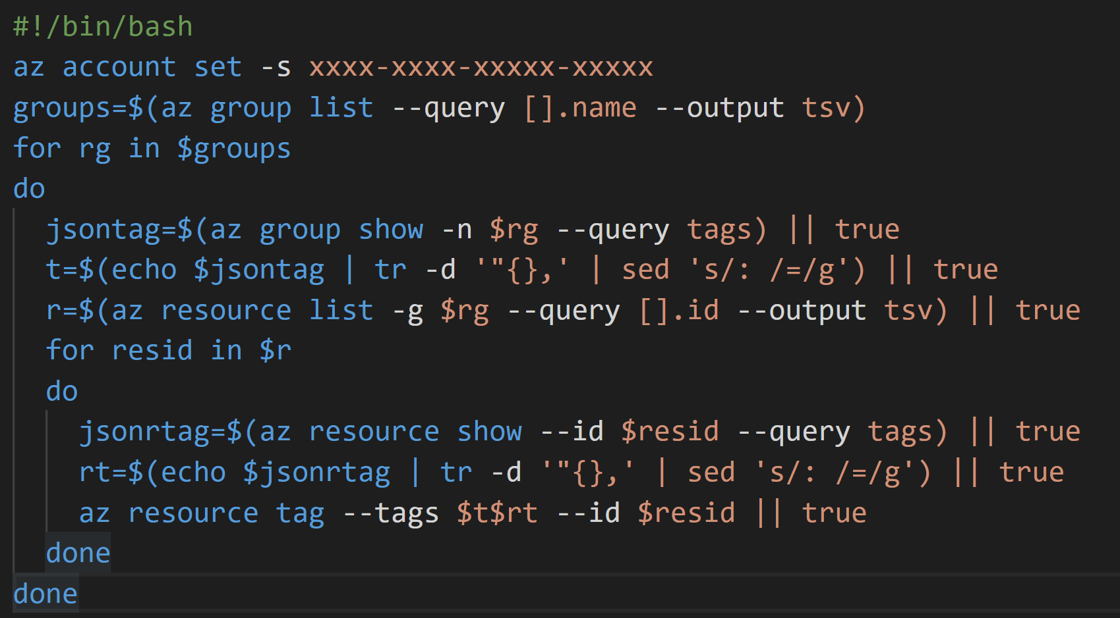
How the CLI saved by bacon…this week!
I needed to tag every resource in a subscription
Use the queries to load arrays with values
Execute actions based on the arrays
Notes:
The Azure CLI uses the --query argument to execute a JMESPath query on the results of commands. JMESPath is a query language for JSON, giving you the ability to select and modify data from CLI output. Queries are executed on the JSON output before any display formatting.
The --query argument is supported by all commands in the Azure CLI. This article covers how to use the features of JMESPath with a series of small, simple examples.

Slide 24
Questions?
Please use EventsXD to fill out a session evaluation.
Thank you!

