Slide 1

SHIELDS UP:
SECURING YOUR AZURE DEPLOYMENTS
Dan Patrick
dan@solliance.net
@deltadan
Notes:
n this session, you will learn the many different ways Azure helps you to protect your deployments. Using a sample architecture you will learn how to use Azure’s tools and implement defense in depth. This implementation will include security features including Networking, Firewalls, Key Vault, Managed Identity, RBAC, Roles, and Policies amongst others. Next, we will examine how to evaluate and monitor the environment which has been deployed. Tools such as Azure Security Center, Azure Monitor, Log Analytics and Network Watcher will be introduced.

Slide 2


Slide 3
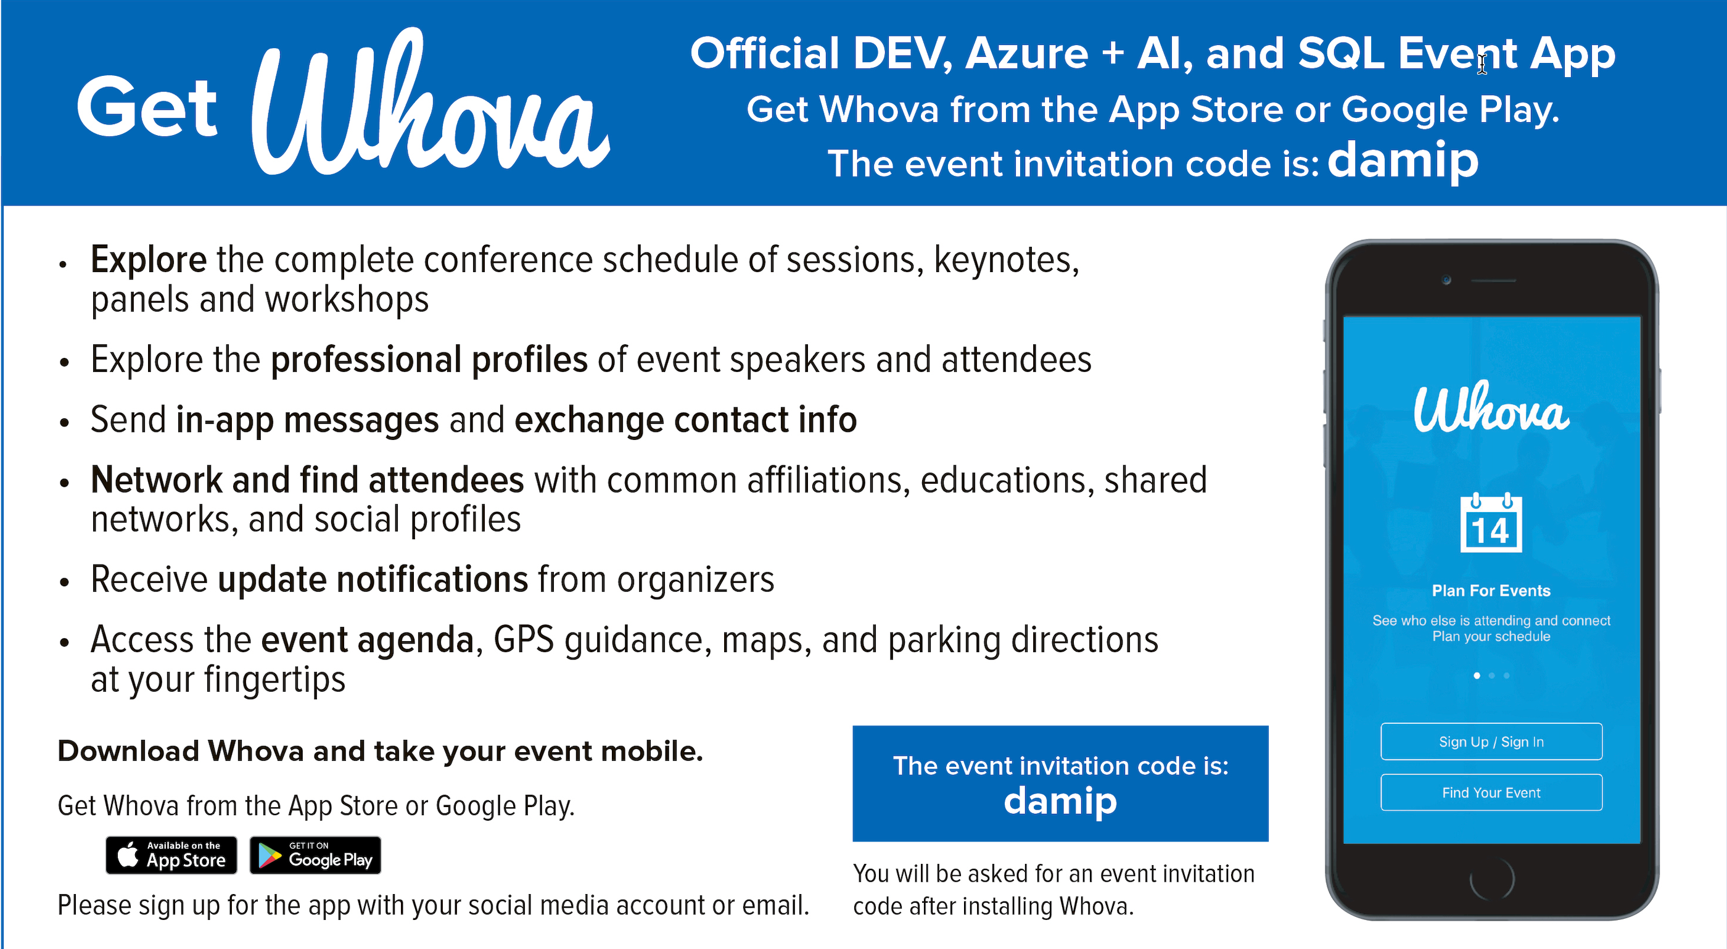

Slide 4


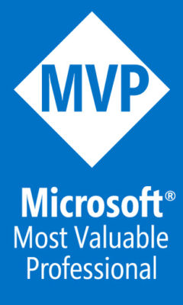
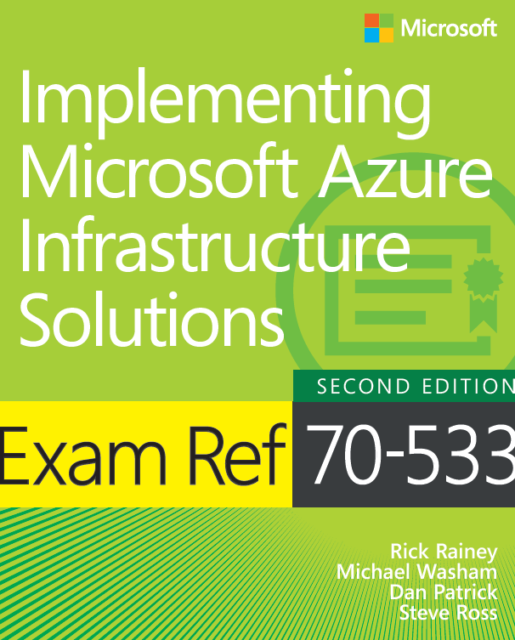
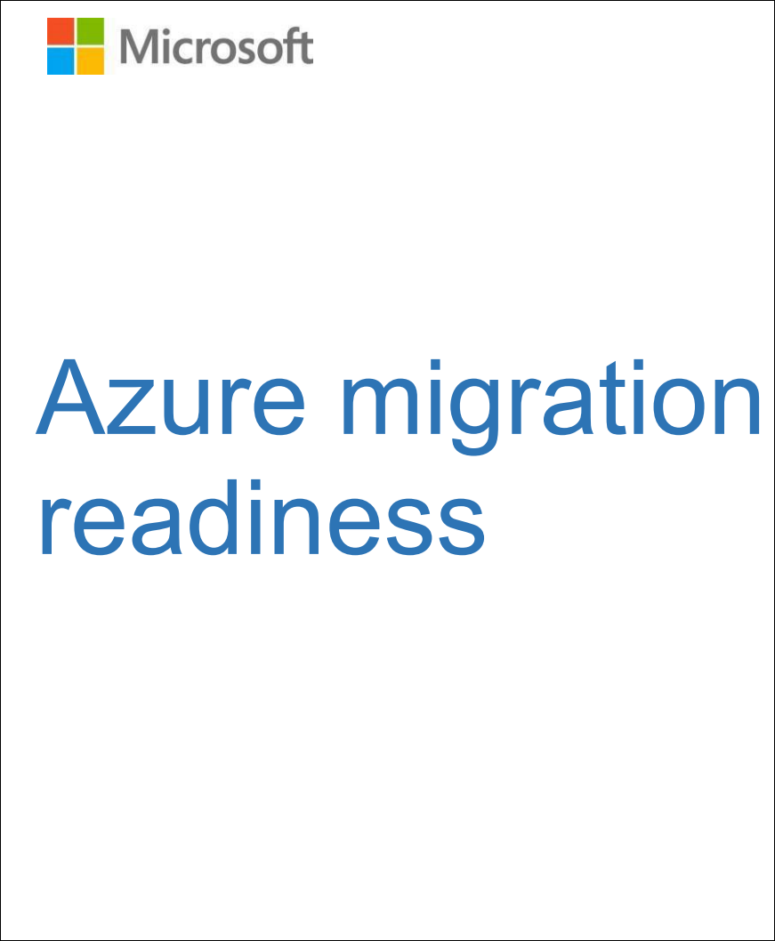
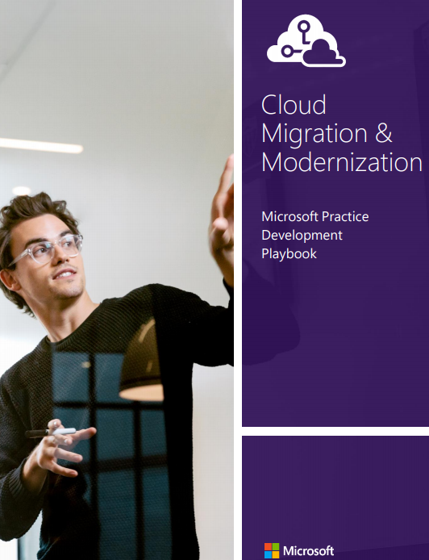
General Manager DevOps, Chief Infrastructure Architect
Azure MVP
Author/co-author of several books on Azure
New Migration Whitepaper
15 Year Microsoft Veteran
Dan Patrick
dan@solliance.net
@deltadan
http://aka.ms/smartpaper

Slide 5
Security Responsibilities Transfer to Cloud
Responsibility | PaaS | IaaS
Information and Data
Devices (Mobile and PCs)
Accounts and Identities
Identity and directory infrastructure
Application
Network controls
Operating system
Physical hosts
Physical network
Physical datacenter
  Transferred for PaaS
  Security Patches
  Feature Upgrades
  VMs/Containers security –
  OS and Middleware Installation, Maintenance, troubleshooting, etc.
Azure Marketplace fits PaaS or IaaS model
  Transferred for IaaS and PaaS
  Denial of Service*
  Racking/Stacking Servers,
  Delays in Adding Capacity
  Fabric/Virtualization Patching,
  Maintenance & Troubleshooting
  Fabric Availability / Uptime
  → SLA from Microsoft
  Attacks on
  Physical Attacks
  Virtualization Fabric
  Hardware/Firmware
  Network Infrastructure
 | Microsoft |  | Customer
*You still need to manage feature configuration

Slide 6
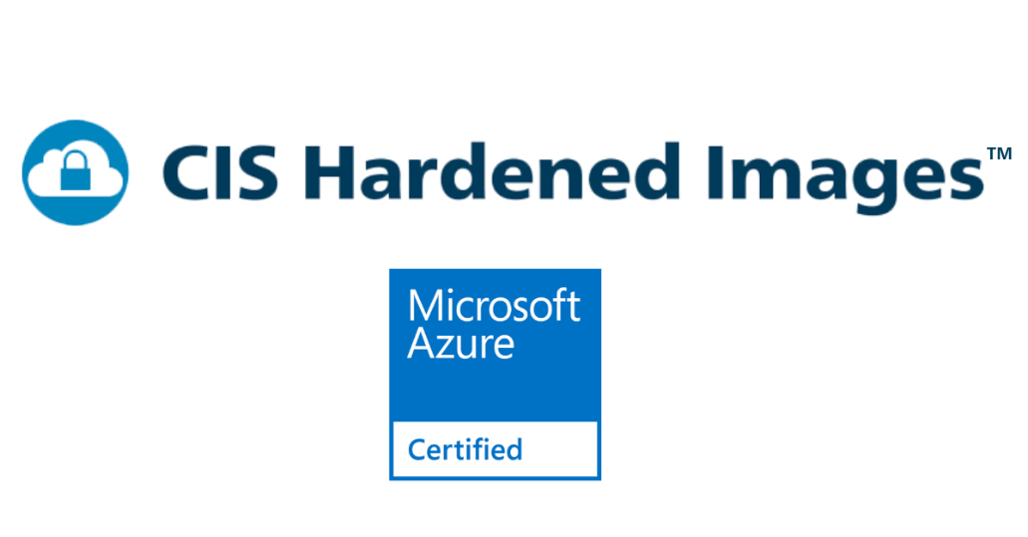
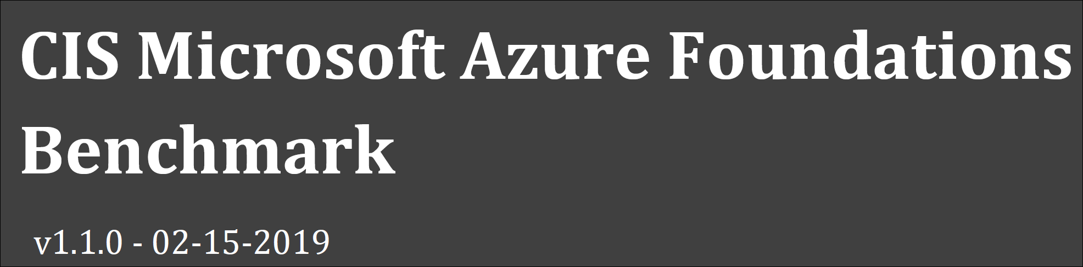
CIS Benchmark
Step by Step Guide to reviewing security in Azure
Images for use as VMs
Container Security
Integration with Azure Policy and Security Center
https://www.cisecurity.org/benchmark/azure/

Slide 7

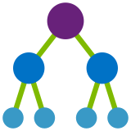

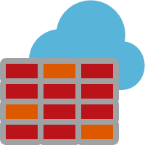
Security Control Planes in Azure
Resource
Configuration
Networking
Identity
Governance
Tools
Azure AD
Conditional Access
Service Principal
Managed Identity
Roles
Subscriptions
Management Groups
Policies
Blueprints
Security Center
Microsoft Defender for Cloud
Sentinel
Key Vault
Azure Threat Protection
RBAC
Storage
SQL
ACR
AKS
Firewall
FrontDoor
WAF
NSGs
Service Endpoints
Private Link

Slide 8
Identity

Slide 9

Identity is the Control Plane of most concern
Authentication
Authorization
Something you know
Apps & resources
Something you have
Data
Something you are
Access level

Slide 10






One identity and access management
Single sign on to any app anywhere
Secure user credentials
Multi-factor Authentication
Conditional Access
Microsoft Azure
Active Directory
Azure AD
Connect
On-premises /
Private cloud
Notes:
The first thing you need to do is to connect your on-premises Active Directory to the cloud with Azure AD Connect. Azure AD Connect is the Microsoft tool designed to meet and accomplish your hybrid identity goals. This allows you to provide a common identity for your users for Office 365, Azure, and SaaS applications integrated with Azure AD. At its core, it enables synchronization between on-premises and cloud identity infrastructures. Specifically, it creates users, groups, and other objects and ensures data is consistent between directories. Once user data is extended with the sync engine, the next consideration is a secure method to authenticate users.
App Proxy lets you use Azure AD as your authentication and authorization service for your on-premises apps as well as your cloud apps. This lets users who are remote from your business to get back to on-premises apps that are claims aware. We’ll use lightweight connectors in your firewall to do this, which lets you expose just the apps you want a user to get into out wherever they are out in the world while applying all of your common policies and security posture to them, without having to open up a VPN.
And let’s be real, VPNs are scary. Most corporate hacks start by compromising a user account, and then immediately heading to a VPN. And once I’m on your VPN, I’m in the network and I can take over pretty much whatever I want.
Accelerate adoption of your apps. As organizations move their identity systems to the cloud, you need applications that you use and develop to integrate with your enterprise identity system. With Azure AD your platform, it provides a tremendous opportunity for developers to integrate into this ecosystem.

Slide 11








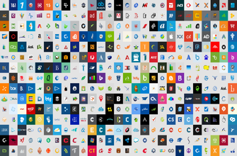


Azure AD Conditional Access
Azure AD
ADFS
Conditions
Controls
MSA
40TB
Google ID
Employee & Partner
Users and Roles
Allow/block
access
Microsoft Cloud
Android
Session
Risk
iOS
Trusted &
Compliant Devices
Machine
learning
3
MacOS
Limited
access
Microsoft
Cloud App Security
Windows
Windows
Defender ATP
Require
MFA
Real time
Evaluation
Engine
Cloud SaaS apps
Force
password
reset
Geo-location
Physical &
Virtual Location
******
Corporate
Network
Policies
Effective
policy
Client apps &
Auth Method
Block legacy
authentication
Browser apps
Client apps
On-premises & web apps

Slide 12
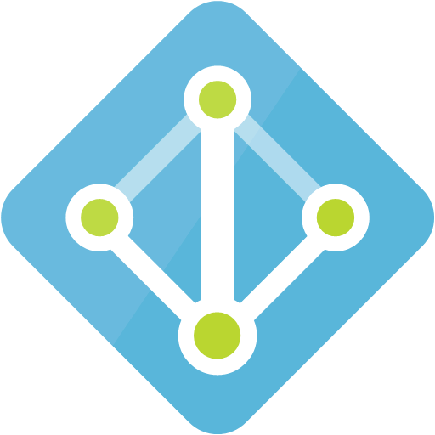


Contoso Identity Logical Configuration
Azure
Subscriptions
Active Directory
CONTOSO
Azure AD Tenet
contoso.com
Azure Resources
Users
Synchronized
Authentication
& Authorization
Groups
Service Principals
Subscription
Resource
Groups
Resources
Notes:
Here we see the relationship between Identity in Azure AD and RBAC. Users and Groups that live in Azure AD can be used to provide privileges in Azure for administration purposes.

Slide 13


Azure AD Objects
Users
  On-Premises, Cloud, External
Groups
  Assigned to Azure AD security groups
  Best practice: manage access through groups, adding roles, and assigning users
Service Principals
  Service identities represented as service principals in the directory
Managed Identity
  Azure Resources can authenticate to gain access to other resources

Slide 14
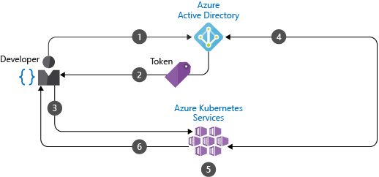
RBAC in AKS
AKS clusters deployed with Azure AD integration
Using Azure AD centralizes the identity management component
Any change in user account or group status is automatically updated in access to the AKS cluster

Slide 15
Governance

Slide 16
Azure Subscriptions
A subscription is a logical unit of Azure services used for access management and billing administration
Companies can have an unlimited number of subscriptions
Subscriptions help you organize access to cloud service resources
Notes:
✔️ Do you know how many subscriptions your organization has? Do you know how resources are organized into resource groups?

Slide 17
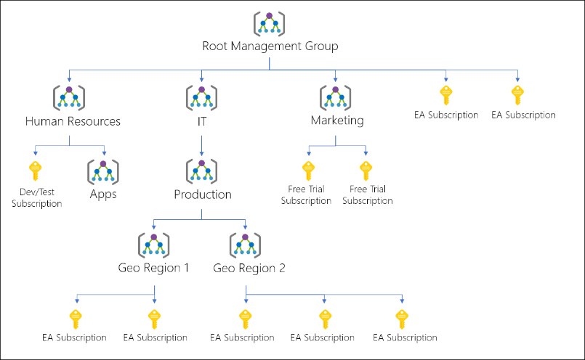
Management Groups
Provides a level of scope above subscriptions
Organizational alignment for your Azure subscriptions through
custom hierarchies and grouping
Targeting of policies and spend budgets across subscriptions and inheritance down the hierarchies
Compliance and cost reporting by organization (business/teams)

Slide 18

Azure Policy
Define what actions are allowed
Policies are described via Policy Definitions
Policies are applied via Policy Assignments
Scoped at:
  Subscription
  Resource Group
  Resource

Slide 19


Azure Blueprints
ARM Templates
Blueprint
Policy Definitions
2
Secure foundational resources
Role-based access controls
Subscription A
Subscription B
1
Custom Scripts*
Create a Blueprint definition and add artifacts
Subscription C
Cloud
Engineer
3
…
Stamp out environments
Coming in June
4
Version and Update Blueprints

Slide 20
Tools

Slide 21

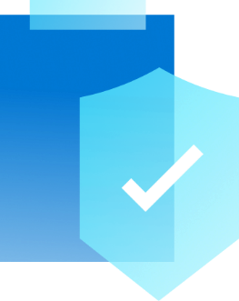
Cloud Native Security
Protect
Respond
Microsoft Defender for Cloud
Sentinel
Continuously Assess
Secure
Defend
AI driven Security Information and Event Management (SIEM)
Detect threats early with unique intelligence
Notes:
Improved security and compliance (SGX, Azure Sentinel for SEIM, Blueprint etc)

Slide 22
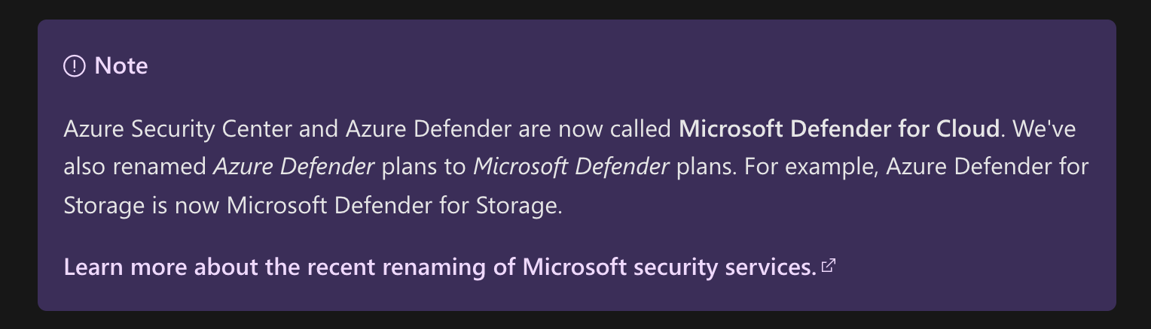
Azure Security Center + Azure Defender
= Microsoft Defender for Cloud

Slide 23
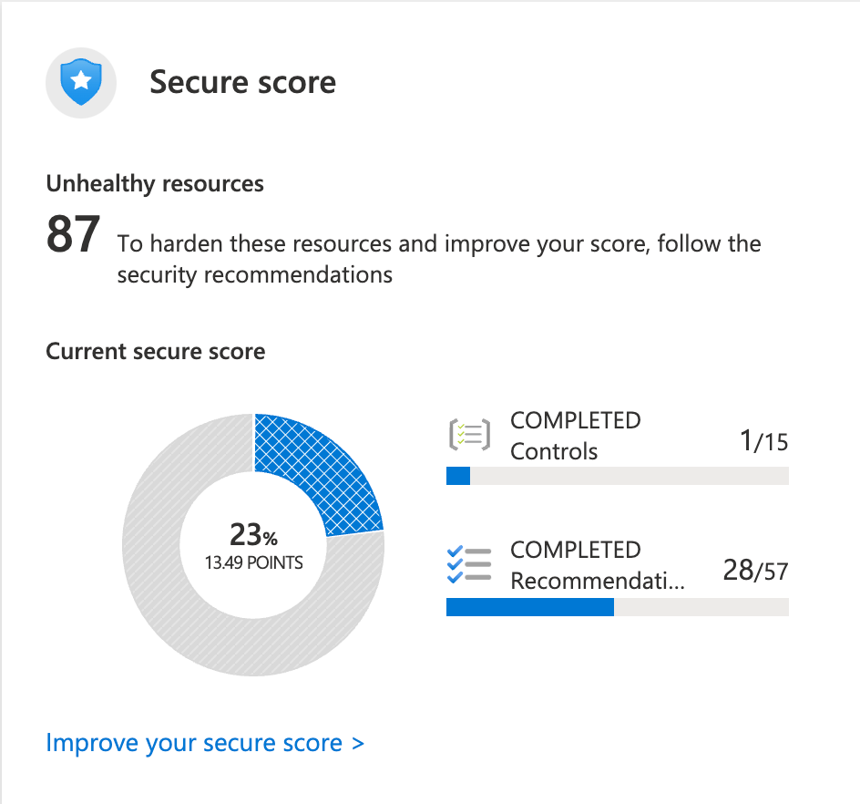
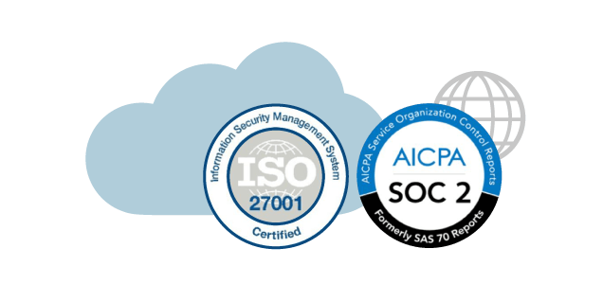
Microsoft Defender for Cloud: Continuously Assess
Secure score continually updated by the AI/ML
Vulnerability assessments: VMs, SQL, ACR – backed by Qualys (license included with service)
Regulatory compliance
File integrity monitoring: watch hashes of files in VMs and Storage accounts
Notes:
Just because you’re moving fast, doesn’t mean you have to lose control – even if you have some Shadow-Ops happening
Azure security gives you visibility and control of your entire cloud security state
Using analytics to provide pro-active recommendations across both Windows and Linux
Leverage services like Azure Event Viewer also to track access, see who change what and when.
------ (additional product context) ------
Secure your cloud resources with Azure Security Center
With Azure Security Center you can gain full visibility and control of your cloud security state with a single, unified view:
Collect security data from multiple sources: Collect, search, and analyze security data from a variety of sources, including connected partner solutions like network firewalls and other Microsoft services.
Integration with existing security workflows: Access, integrate, and analyze security information using REST APIs to connect existing tools and processes.
Easily onboard cloud resources: Keep pace with rapidly changing cloud workloads. Automatically discover and onboard new resources created in your Azure subscriptions.
Continuous security assessment: monitor the security of virtual machines, networks, and Azure services using hundreds of built-in security assessments or create your own.
Built-in dashboards provide instant insights into security issues that require attention.
Centralized policy management: Ensure compliance with company or regulatory security requirements by centrally managing security policies across all your cloud workloads.
Compliance reporting: Use security data and insights to demonstrate compliance and easily generate evidence for auditors.
(If asked whether Azure Security Center supports hybrid workloads, the answer is yes: manage security across all your hybrid cloud workloads – on-premises, Azure, and other cloud platforms – in one console.)
You can also identify and mitigate risks proactively to reduce your exposure to security threats:
Proactive security assessment: Identify software and configurations that are vulnerable to attack.
Actionable recommendations: Remediate security vulnerabilities before they can be exploited by attackers with prioritized, actionable security recommendations and built-in automation playbooks.
Adaptive application controls: Block malware and other unwanted applications by applying whitelisting recommendations adapted to your specific workloads and powered by machine learning.
Controlled network access: Reduce the network attack surface with just-in-time, controlled access to management ports on Azure VMs, drastically reducing exposure to brute force and other network attacks.
Azure Security Center has robust capabilities to prevent attacks. When threats do happen, Security Center can quickly detect and respond to threats with advanced analytics and Microsoft Intelligent Security Graph.
Industry’s most extensive threat intelligence: Tap into the Microsoft Intelligent Security Graph, which uses trillions of signals from Microsoft services and systems around the globe to identify new and evolving threats.
Advanced threat detection: Use built-in behavioral analytics and machine learning to identify attacks and zero-day exploits. Monitor networks, machines, and cloud services for known attack patterns and post-breach activity.
Prioritized alerts and incidents: Focus on the most critical threats first with prioritized security alerts and incidents that map alerts of different types into a single attack campaign. Create your own custom security alerts as well.
Streamlined investigation: Quickly assess the scope and impact of an attack with a visual, interactive experience. Use predefined or ad hoc queries for deeper exploration of security data.
Contextual threat intelligence: Visualize the source of attacks on an interactive world map. Use built-in threat intelligence reports to gain valuable insight into the techniques and objectives of known malicious actors.
At Microsoft, we analyze 300 billion user authentications and check 200 billion emails for spam and malware monthly. We also have unprecedented visibility into cloud infrastructure choices, platforms and the activity therein. Such visibility has no precedent in the on-premises world.

Slide 24

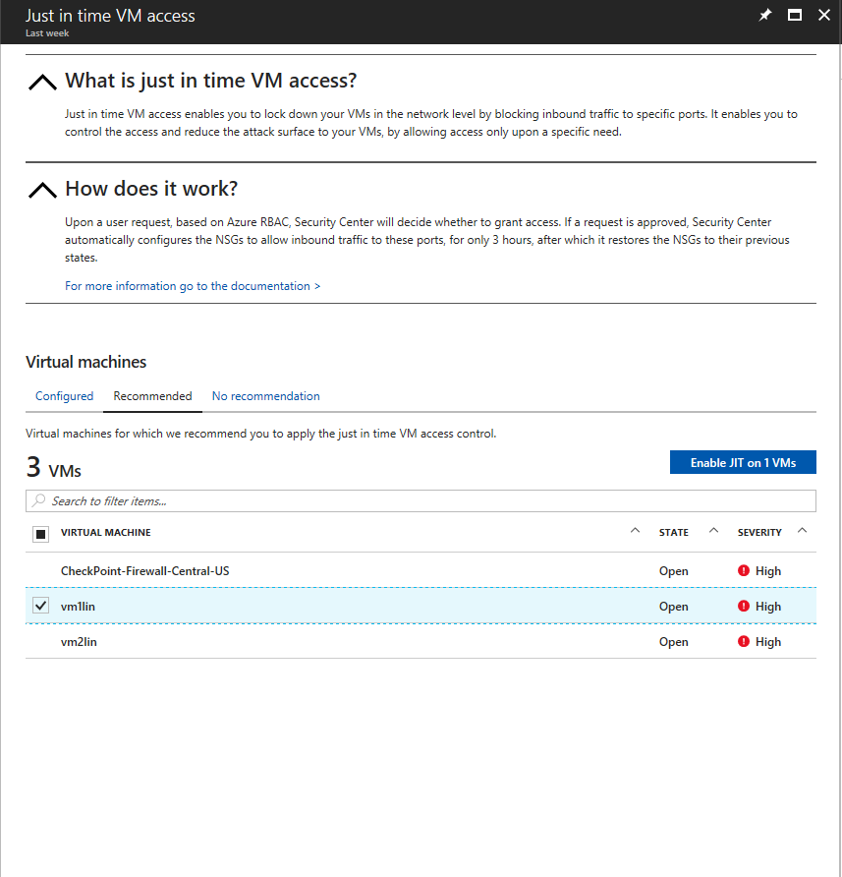
Microsoft Defender for Cloud: Secure
Azure PaaS services - Detect threats Azure App Service, Azure SQL, Azure Storage Account & Azure activity logs
Azure data services - Automatically classify and vulnerabilities in Azure SQL, & Storage services with recommendations for how to mitigate.
Networks - Limit exposure to brute force attacks using the just-in-time VM access
VMs – Microsoft Defender for Windows/Linux/Mac

Slide 25

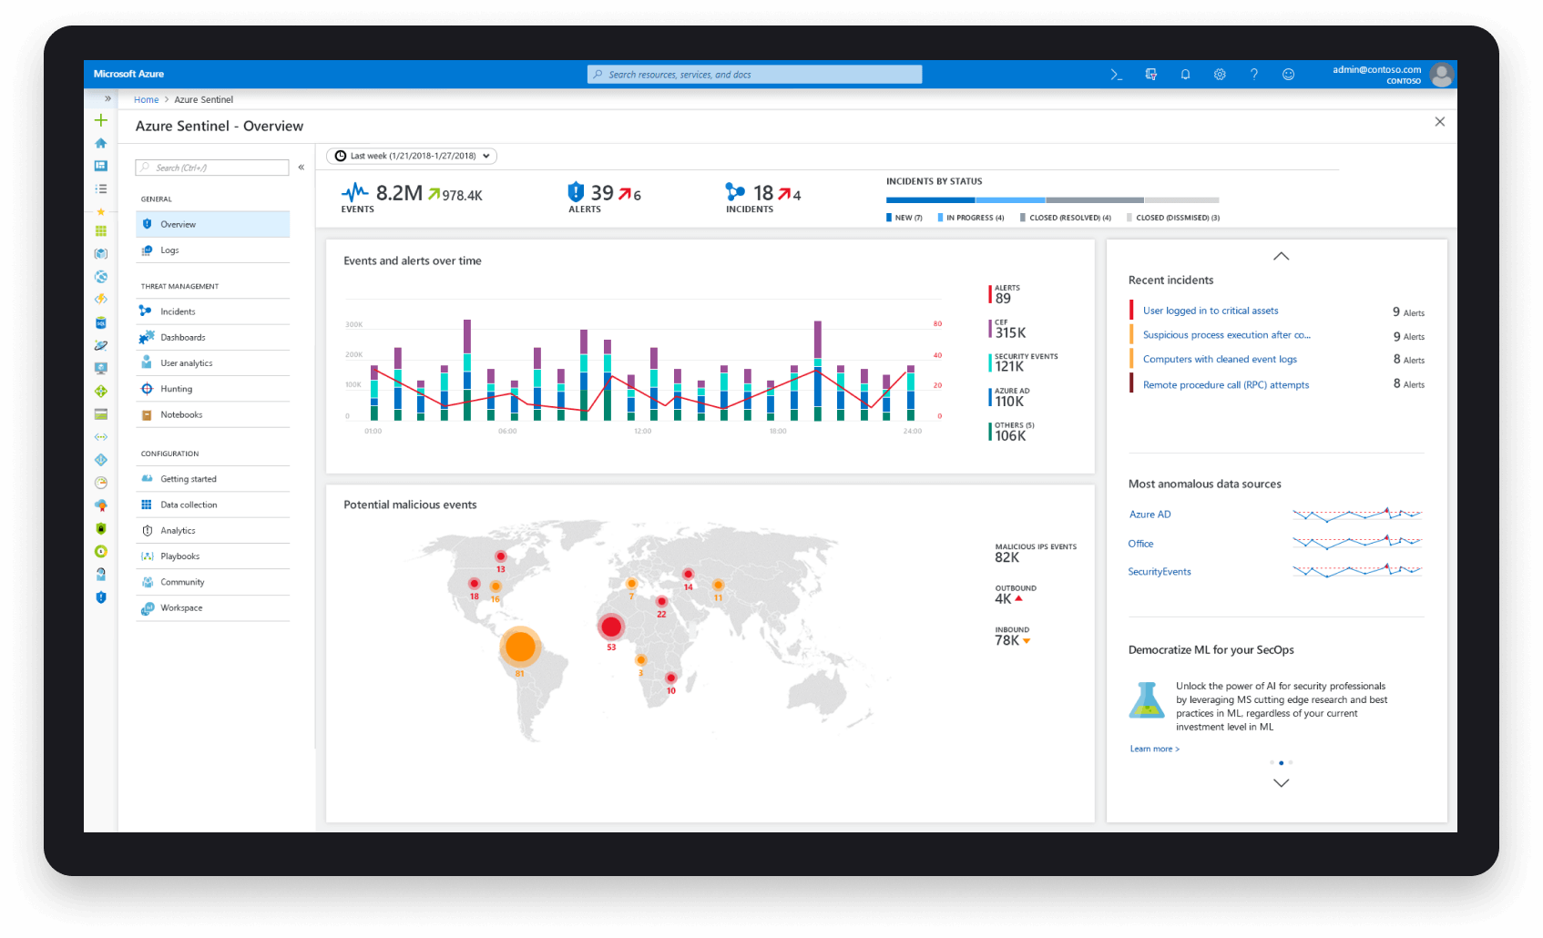
Azure Sentinel
Cloud Scale Security Event Information Management (SEIM) for On-Premises & All Clouds
Collect Data at Cloud Scale
Detect previously uncovered threats an minimize false positivizes
Investigate threats with AI tapping into decades of cybersecurity work at Microsoft
Respond to incidents rapidly with automation
Notes:
https://docs.microsoft.com/en-us/azure/sentinel/connect-windows-security-events

Slide 26

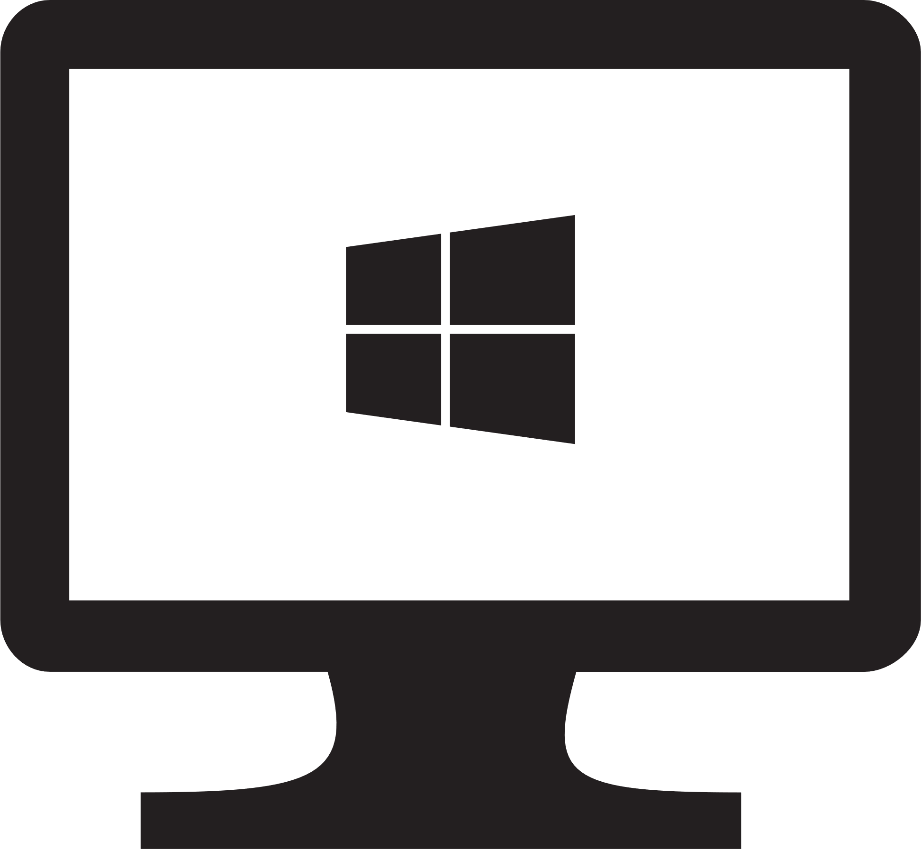
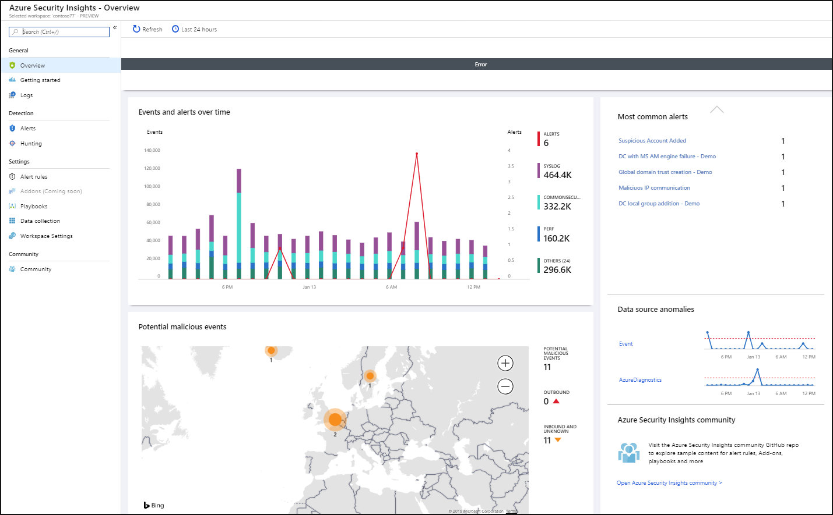
Azure Sentinel
Protecting Windows using Security Event Information Management (SEIM)
Security Events
System Logs
Windows Firewall
Traffic Analysis
Notes:
https://docs.microsoft.com/en-us/azure/sentinel/connect-windows-security-events

Slide 27


Key Vault Data Types
Keys: Managed cryptographic key service. Keys are irretrievable.
Secrets: Encrypted data values. Clients with vault access can read secret values.
Certificates*: Certificates stored as json-wrapped secrets instead of keys so they can be retrieved for deployments to virtual machines.

Slide 28
Resource Configuration

Slide 29



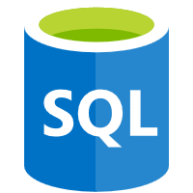
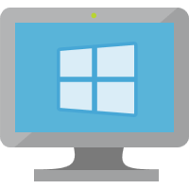


RBAC Scopes & Inheritance
Subscription
Owner
Contributor
Reader
Resource
Groups
Access is Inherited
Owner
Contributor
Reader
Resources
Web
SQL
VM
NIC
Disks
Owner
Contributor
Reader

Slide 30
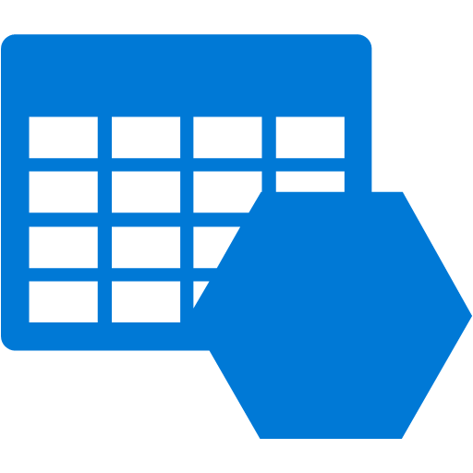


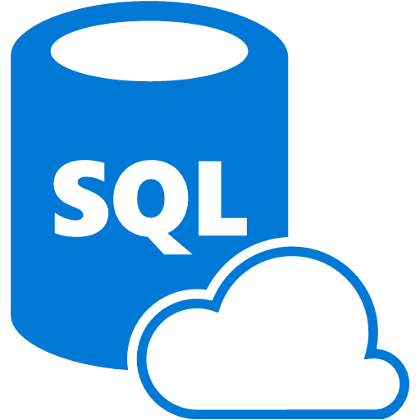


Protect Data at Rest with Encryption
Microsoft:
Storage Service Encryption
  Automatically encrypts customer data prior to persisting to storage and decrypts prior to retrieval
  Microsoft manages encryption keys
Customers:
Azure VMs
  Various services offer additional capabilities for securing data at rest
PaaS
  Azure SQL Database supports TDE
Applications
  Client Side encryption through .NET Crypto API
  RMS Service and SDK for file encryption by your applications
Storage Account
Storage Service Encryption
Virtual Machines
SQL TDE
Bitlocker
Partners
PaaS
SQL DB TDE
Applications
.NET Crypto
RMS SDK

Slide 31


Azure Storage Service Encryption
Service Encrypts Data Automatically
Support for Block Blobs, Append Blobs and Page Blobs (Standard and Premium storage)
Storage Account level one-click setting for enabling encryption both for new and existing storage accounts
AES 256 cipher

Slide 32
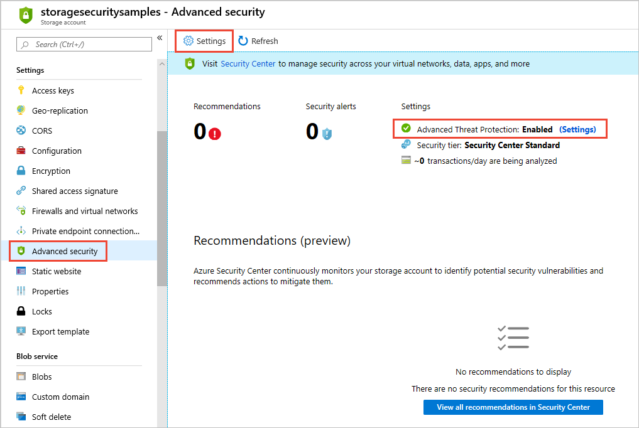
Storage
Threat Protection
Detects unusual and harmful attempts to exploit storage
Alerts sent to Azure Security Center
Email alerts send to subscription administrators
Notes:
Advanced threat protection for Azure Storage provides an additional layer of security intelligence that detects unusual and potentially harmful attempts to access or exploit storage accounts. This layer of protection allows you to address threats without being a security expert or managing security monitoring systems.
Security alerts are triggered when anomalies in activity occur. These security alerts are integrated with Azure Security Center, and are also sent via email to subscription administrators, with details of suspicious activity and recommendations on how to investigate and remediate threats.

Slide 33
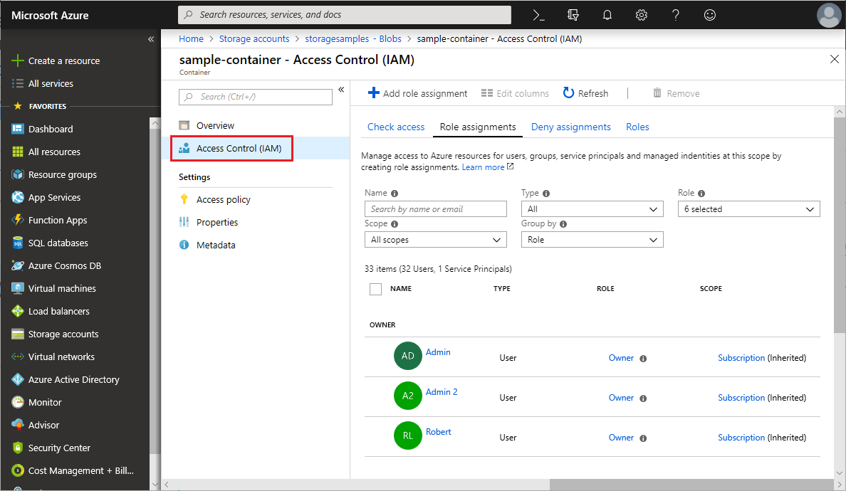
Storage & Azure AD
Azure Storage supports using Azure Active Directory (AD) to authorize requests to Blob and Queue storage
Notes:
Grant access to Azure blob and queue data with RBAC in the Azure portal
Grant access to Azure blob and queue data with RBAC using Azure CLI
Grant access to Azure blob and queue data with RBAC using PowerShell

Slide 34
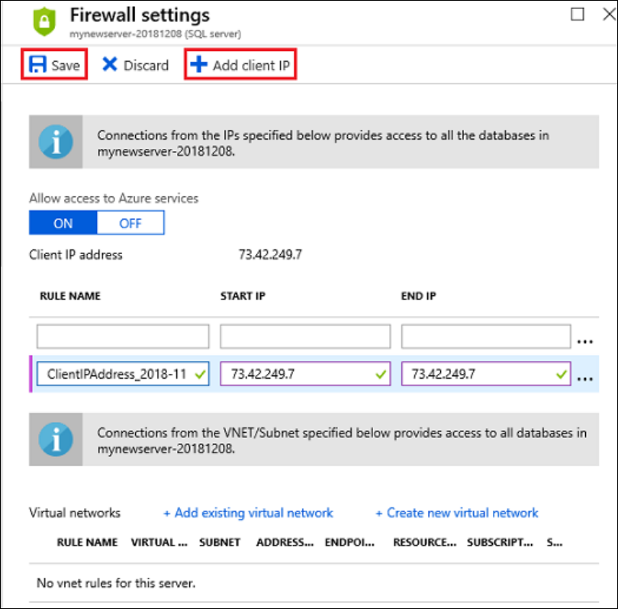
SQL PaaS Firewalls
Configure Service Endpoints to integrate with VNETs
Allowed IP Ranges
Allow access to Azure Services

Slide 35
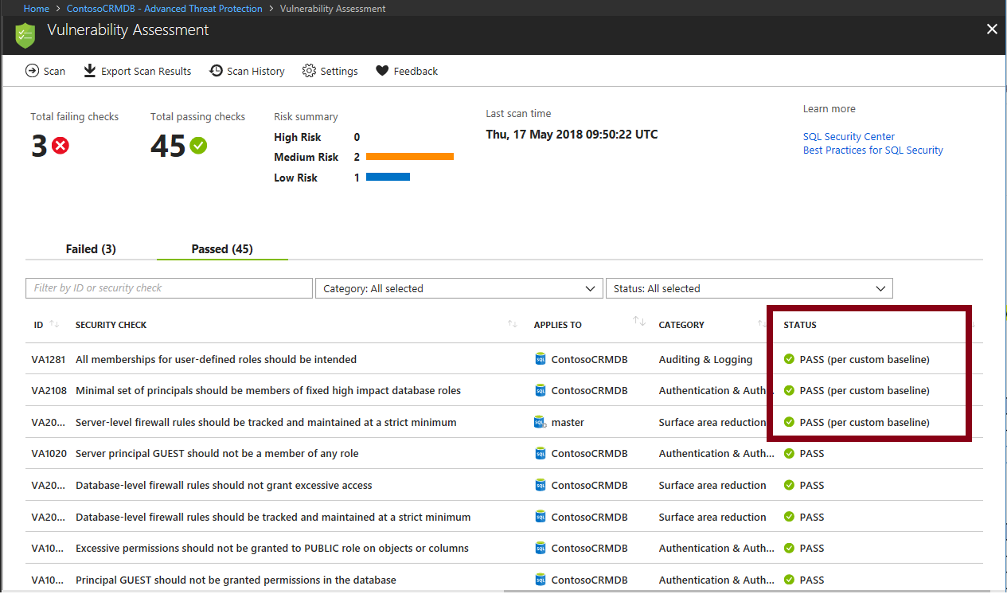
SQL Advanced Data Security
Threat Assessment
Data Discovery & Classification
Advanced Threat Protection

Slide 36
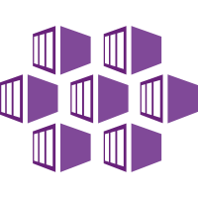
AKS Security
Master Security
Node Security
Cluster Updates
Network Security
Kubernetes Secrets
Private Cluster

Slide 37
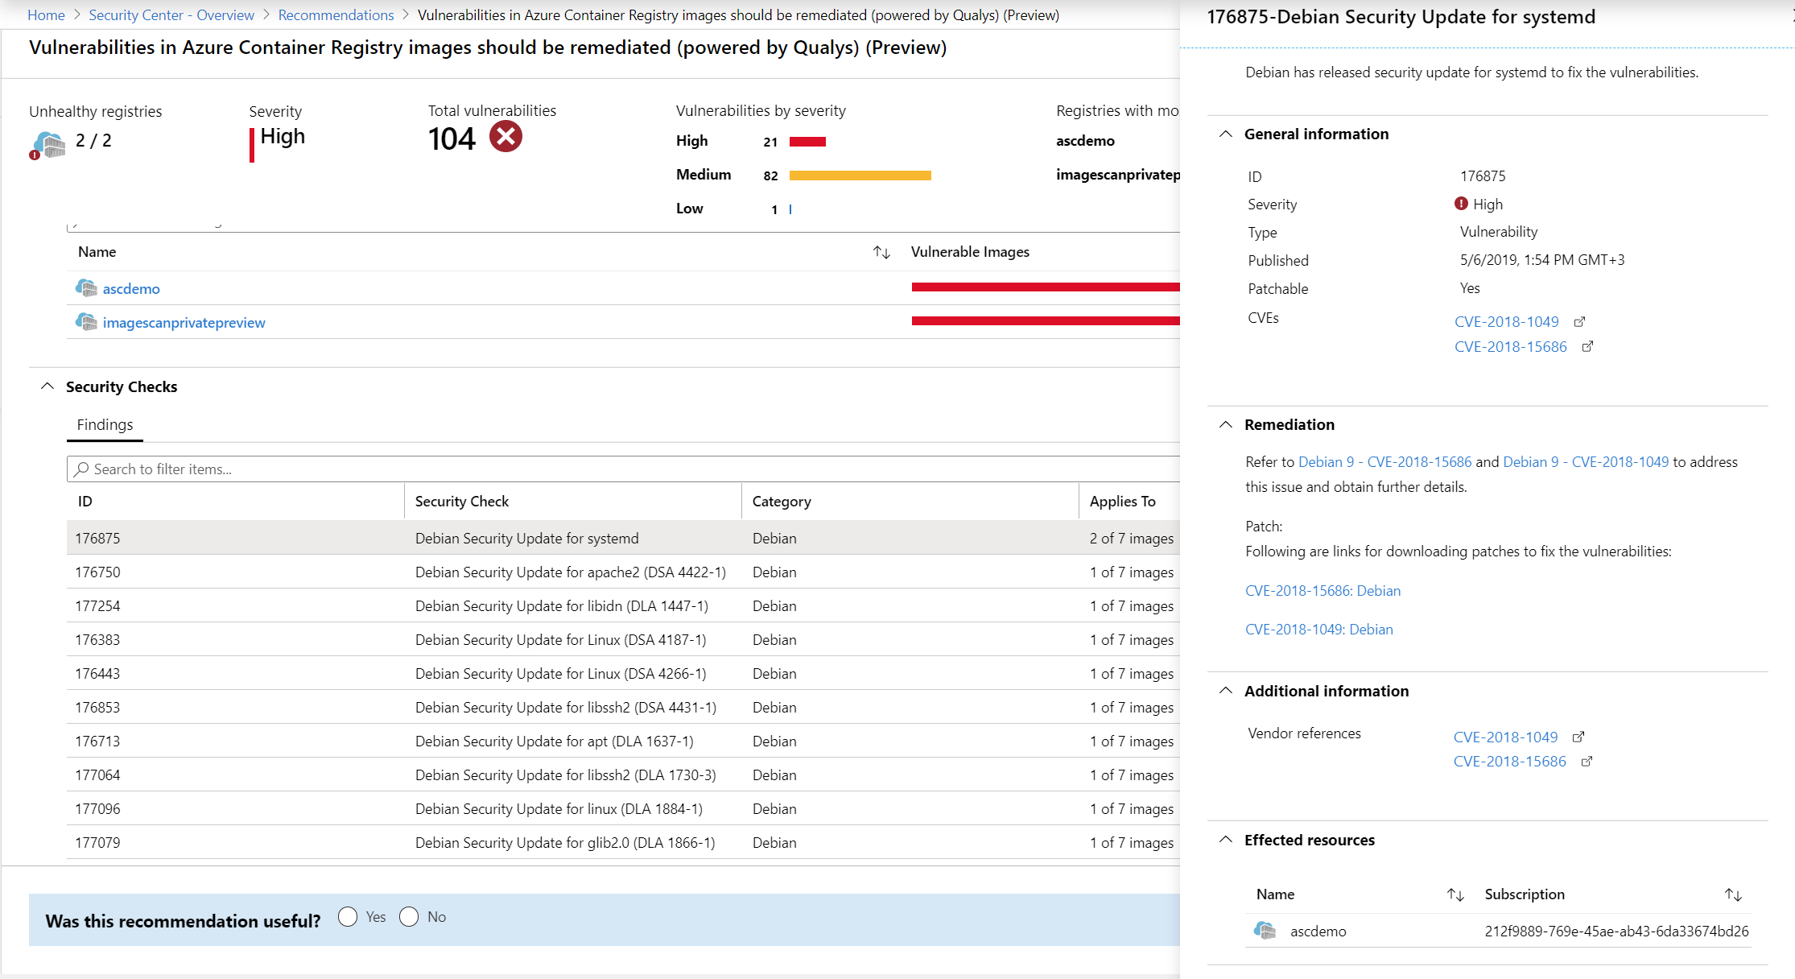
Azure Container Registry
Scanning Containers
Dealing with Vendor published Container Images with CVEs

Slide 38
Networking

Slide 39






Azure DDoS Protection Standard
Cloud scale DDoS protection for Azure
1
2
3
4
5
Azure global network
Adaptive
tuning
Attack analytics
and metrics
DDoS Rapid Response (DRR)
SLA guarantee and
cost protection
Internet
Azure
Public Internet
Public IP 1
Public IP 2
Spoke VNET
Central VNET
Spoke VNET
DDoS Protection Standard
Inbound /
Outbound
Inbound
Azure DDoS
Adaptive
Tuning
Engine
Web Application 1
Azure Firewall
Azure WAF
Web Application 2

Slide 40
Azure Front Door
Azure Front Door Service provides a scalable and secure entry point
for fast delivery of your global web applications
SSL offload and application acceleration
Global HTTP load balancing with instant failover
Application Firewall and DDoS protection
Centralized traffic orchestration view

Slide 41













Azure Web Application Firewall
OWASP rules
Bot management
WAF policy
Custom rules
Unified WAF policy
Protect your apps at network edge or in Azure regions
Uniform policy
PREVIEW
Azure Global WAF
(Front Door)
Azure Regional WAF
(Application Gateway)
Microsoft threat intelligence
Protect apps against automated attacks
Manage good/bad bots with Azure BotManager RuleSet
Site and URI path specific WAF policies
Customize WAF policies at regional WAF for finer grained protection at each host/listener or URI path level
Geo filtering on regional WAF
Enhanced custom rule matching criterion includes filtering by country
PaaS, IaaS, AKS, serverless and on-premises backends

Slide 42
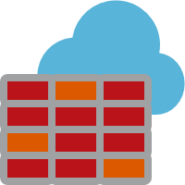
Azure Firewall
Cloud native stateful Firewall as a service
L3-L7 Connectivity Policies
Central governance of all traffic flows
Built-in high availability and auto scale
Network and application traffic filtering
Centralized policy across VNets and subscriptions
Complete VNET protection
Filter Outbound, Inbound, Spoke-Spoke & Hybrid Connections traffic (VPN and ExpressRoute)
Centralized logging
Archive logs to a storage account, stream events to your Event Hub, or send them to Log Analytics or Security Integration and Event Management (SIEM) system of choice
Spoke 1
NAT, Network and Application traffic filtering rules allows Inbound/Outbound access
HUB VNet
Spoke2
Azure Firewall
Spoke VNets
Azure to On-Prem traffic filtering
Traffic is denied by default
On-Premises

Slide 43
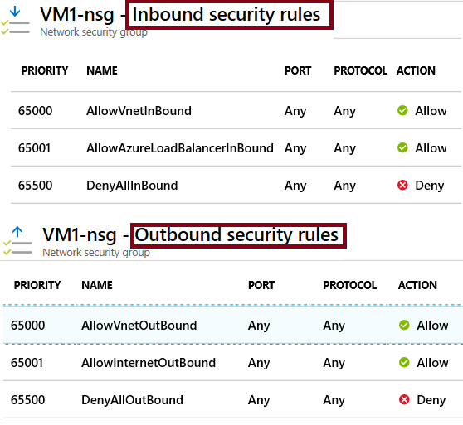
NSG Rules
Security rules in NSGs enable you to filter network traffic that can flow in and out of virtual network subnets and network interfaces.
There are default security rules. You cannot delete the default rules, but you can add other rules with a higher priority.

Slide 44




Stateful Firewall Rules using NSGs
N-Tier Example
Virtual Network
Address Space: 172.16.0.0/16
Subnet Web: 172.16.1.0/24
Allowed via NgnixSecurityGroup
NginixSecurityGroup
SRC ADDRESS PREFIX: INTERNET
SRC PORT RANGE: *
DEST PORT RANGE: 80
DEST ADDRESS PREFIX: 172.16.1.0/24
NGINX-VM1
Subnet Web
172.16.1.4
NGINIX-VM2
Subnet Web
172.16.1.5
NGINIX-VM3
Subnet Web
172.16.1.6
NGINIX-VM4
Subnet Web
172.16.1.7
Allowed via PostgreSQLSecurityGroup
PostGreSQLSecurityGroup
SRC ADDRESS PREFIX: 172.16.1.0/24
SRC PORT RANGE: *
DEST PORT RANGE: 5432
DEST ADDRESS PREFIX: 172.16.2.0/24
Subnet SQL: 172.16.2.0/24
Remember that OS Ports & Firewalls must be configured to allow traffic
PGRESQL-VM1
Subnet SQL
172.16.2.4
PGRESQL-VM2
Subnet SQL
172.16.2.5

Slide 45
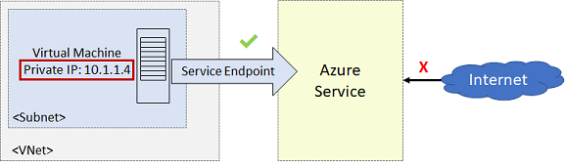
Service Endpoints
Endpoints limit network access to specific subnets and IP addresses
Improved security for your Azure service resources
Optimal routing for Azure service traffic from your virtual network
Endpoints use the Microsoft Azure backbone network
Simple to set up with less management overhead
Notes:
✔️ Can you see a use for service endpoints in your organization?
For more information, you can see:
Virtual network service endpoints - https://docs.microsoft.com/en-us/azure/virtual-network/virtual-network-service-endpoints-overview

Slide 46













Azure Private Link
Highly secure and private connectivity solution for Azure Platform
Deny Internet
Deny Internet
Customer
owned
services
Private
Link
Private Link Service
10.0.0.5
ER Private
Peering
ER Gateway
Azure
PaaS
services
On-premises
Private
endpoint
Storage
SQL
SQL DW
Marketplace
services
Virtual Network (10.0.0.0/16)
Private access from Virtual Network resources,
peered networks and
on-premise networks
In-built Data
Exfiltration Protection
Predictable private IP addresses for PaaS resources
Unified experience across PaaS, Customer Owned and marketplace Services

Slide 47

What is Azure ExpressRoute?
Use Azure ExpressRoute to create private connections between Azure data centers and infrastructure on your environment. ExpressRoute connections don’t go over
the public Internet, and they offer more reliability, faster speeds and lower latencies than typical Internet connections

Slide 48
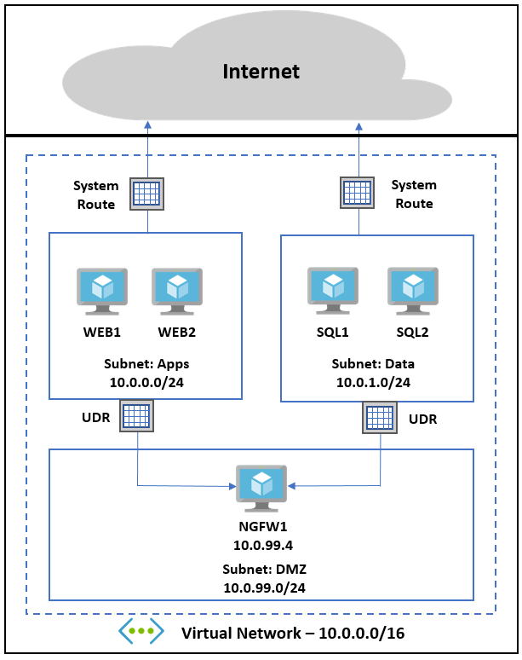
User defined routes
Administrators can change default routing behavior
Routing can be configured to direct traffic through devices such as Virtual Firewalls to create a DMZ

Slide 49




Azure Bastion
Customer’s Virtual Network
Secure and seamless RDP and SSH access to your virtual machines using zero trust
Private IP
Port: 3389/22
“AzureBastionSubnet”
RDP/SSH to your workload using HTML5 standards-based web-browser, directly in Azure Portal
Resources can be accessed without public IP addresses
Supported Azure resources include VMs, VM Scale Sets, Dev-Test Labs
No agent required
Azure VM
SSL
Remote Protocol
(RDP, SSH, et al)
Azure VM
Azure Portal
SSL
443,
Internet
Azure VM
Azure Bastion
AzureBastionSubnet
Target VM Subnet(s)

