Slide 1
Running Multi-region Applications on Azure
Dan Patrick – Azure MVP
dan@solliance.net
@deltadan
Notes:
Have you ever wondered what it would take to run a highly available multi-region application on Azure? In this session, we will examine the Azure services, features, and data center technologies that make this possible. Come learn from our pain building and running applications on Azure. Compute topics: IaaS, PaaS, Serverless, and Azure Kubernetes Services. Networking topics: Traffic Manager, Frontdoors, Application Gateway/WAF, and Azure load balancer.

Slide 2
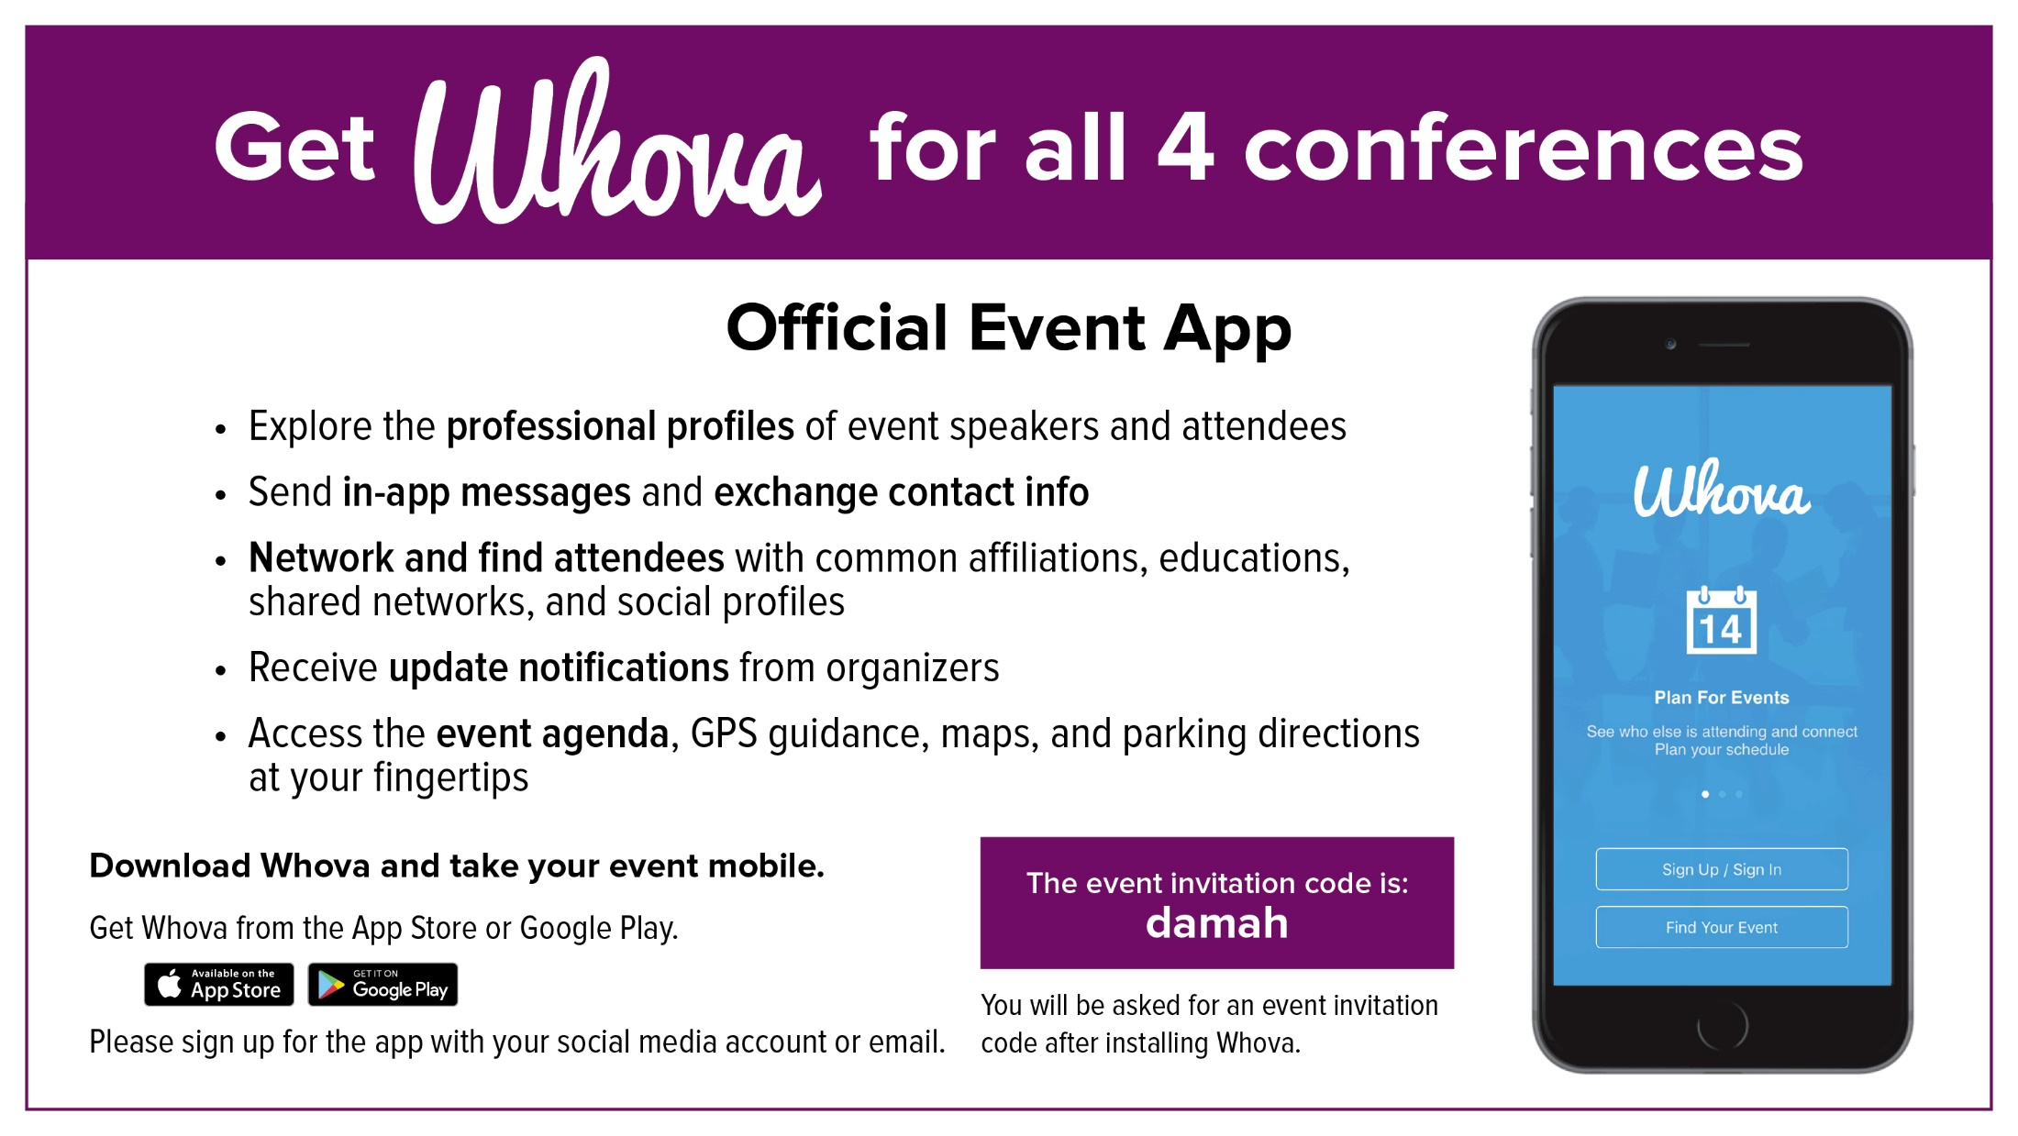



Slide 3



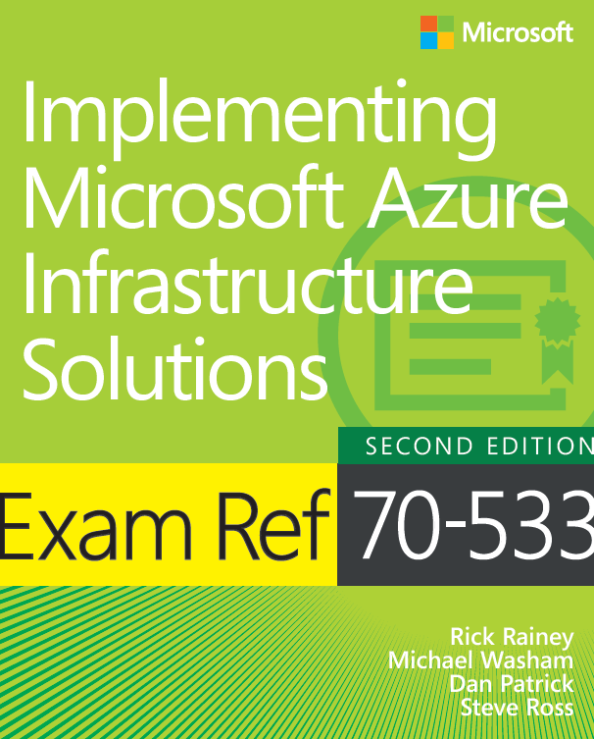
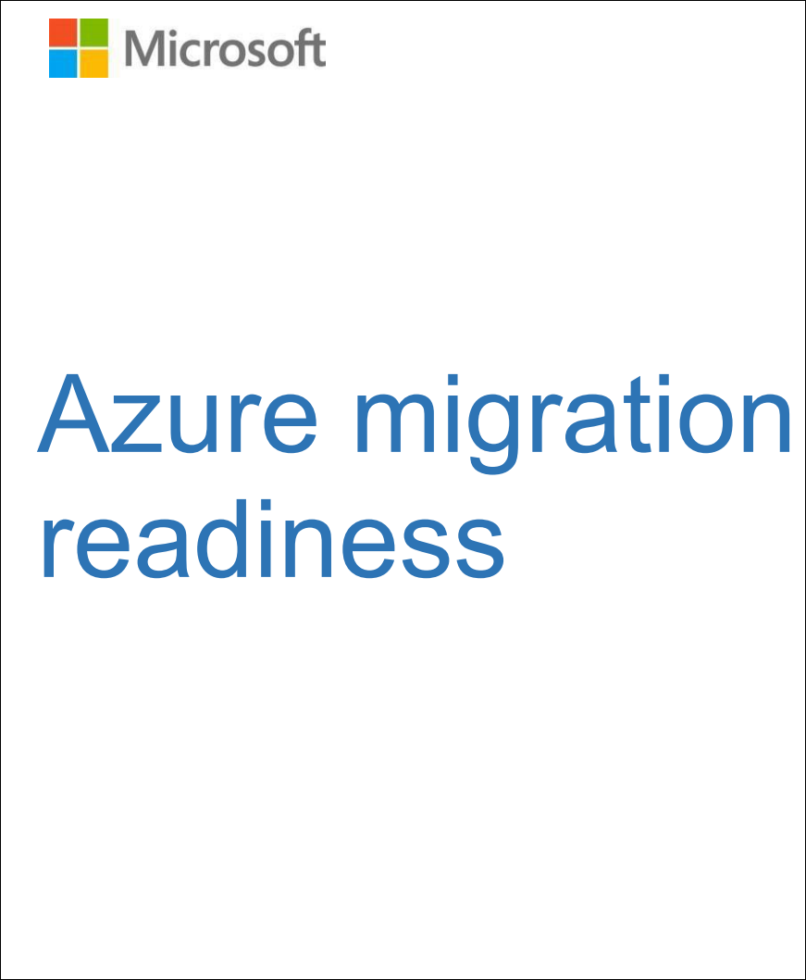
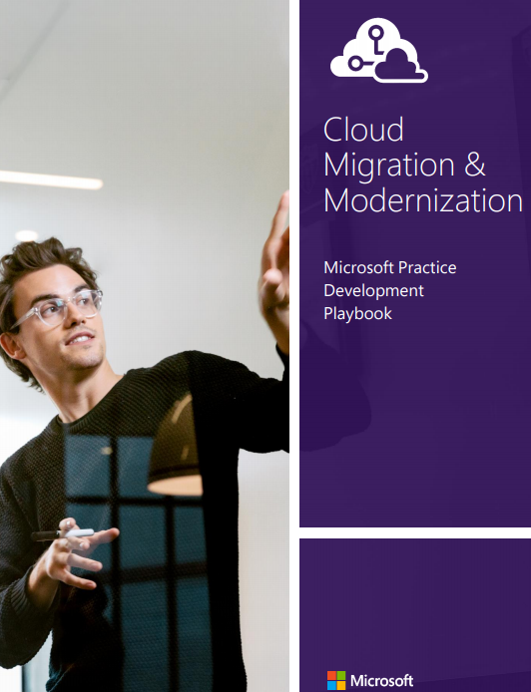
General Manager DevOps & Infrastructure
Azure MVP
Author/co-author of several books & Whitepapers on Azure
15 Year Microsoft Veteran
Dan Patrick
dan@solliance.net
@deltadan
http://aka.ms/smartpaper

Slide 4
Introduction
Architecture resources
Azure components
Multi-region architectures
Notes:
Well Architected Framework
Azure Components
IaaS Applications
PaaS Applications
AKS Applications

Slide 5
Architecture resources
Notes:
Assessments | Microsoft Docs
Microsoft Azure Well-Architected Framework - Azure Architecture Center | Microsoft Docs

Slide 6
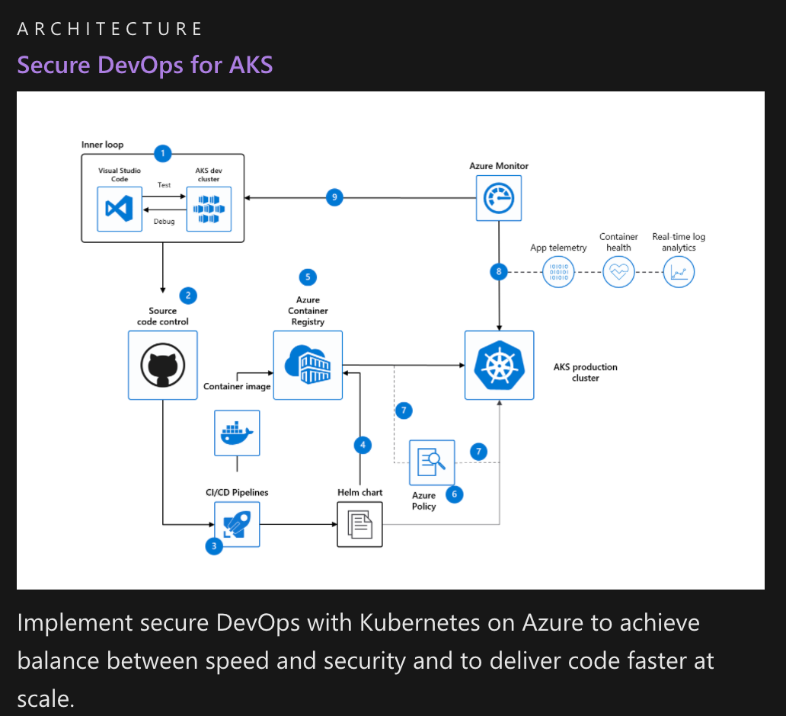
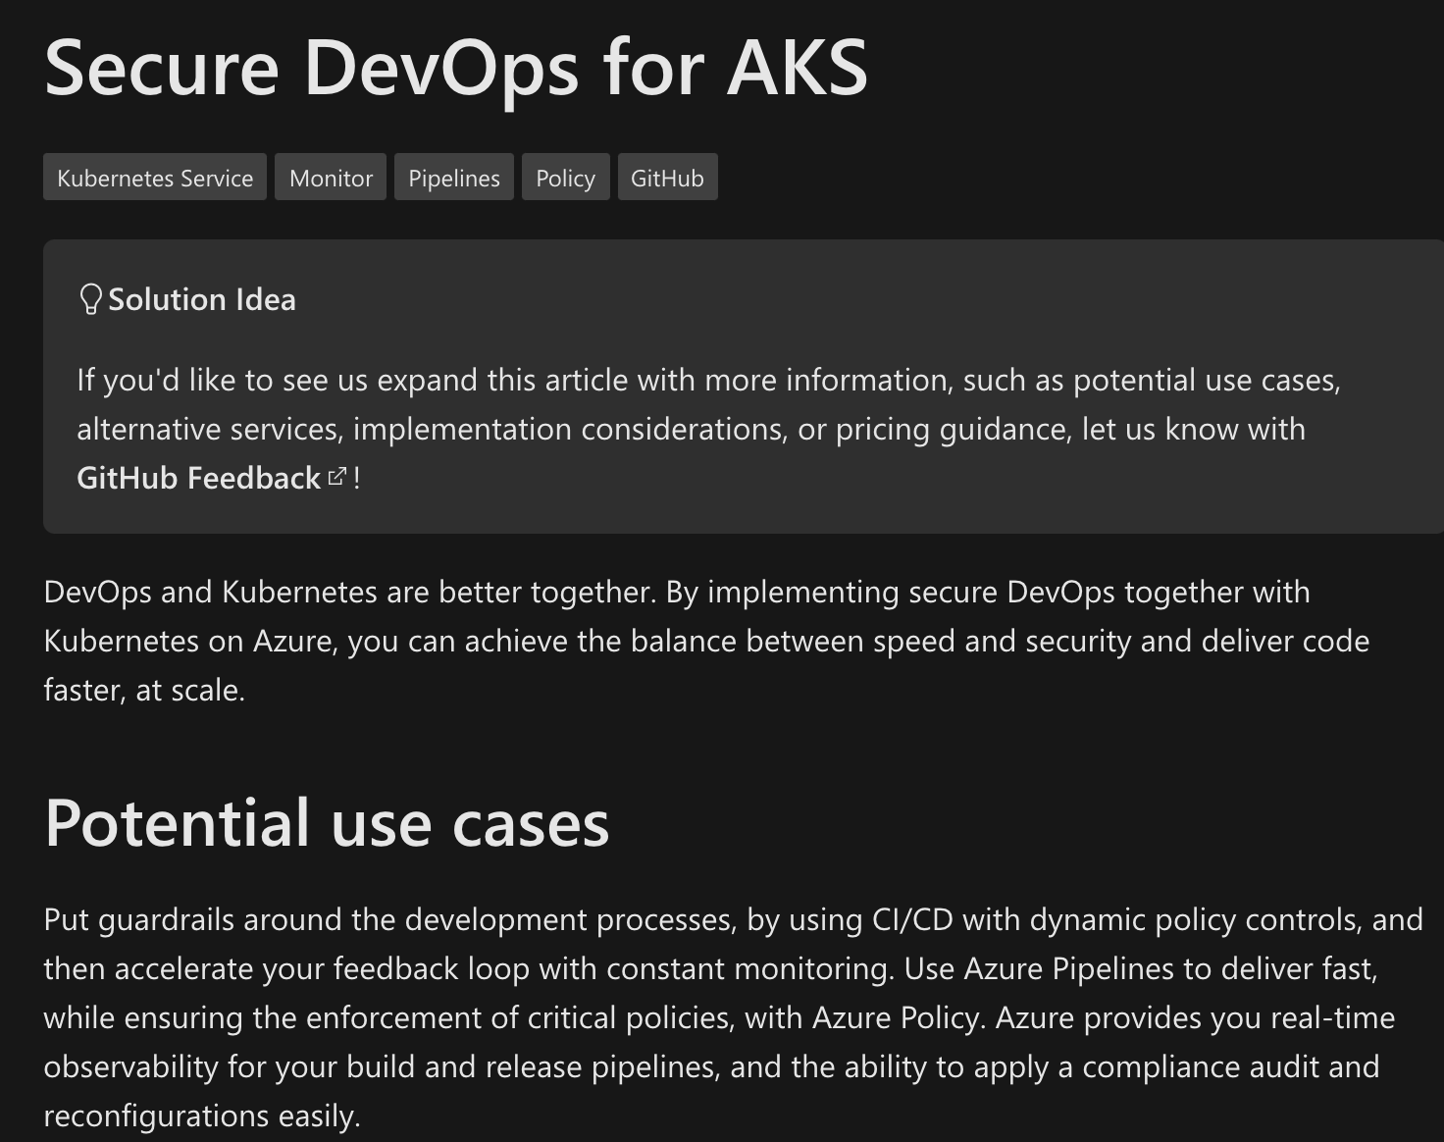
Azure Architecture Center
500+ Architectures with images & supporting documentation
Types: Functional, DevOps, Compute, Databases, Containers
https://docs.microsoft.com/azure/architecture/

Slide 7
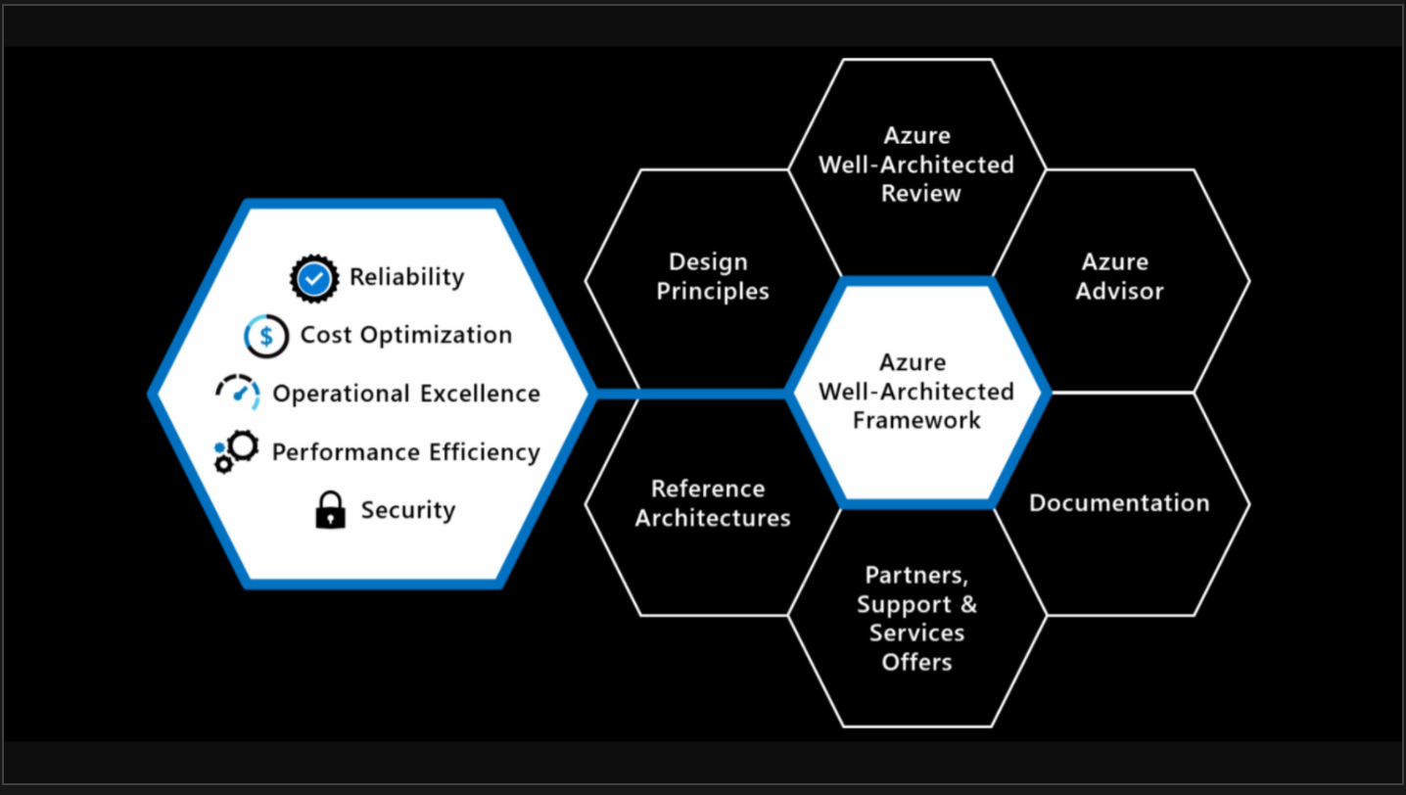
Azure Well-Architected Framework
“Set of guiding tenets that can be used to improve the quality of a workload.”
https://docs.microsoft.com/azure/architecture/framework

Slide 8
Well-Architected Framework Pillars
Reliability
Security
Cost Optimization
Operational Excellence
Performance Efficiency
The ability of a system to recover from failures and continue to function.
Protecting applications and data from threats.
Managing costs to maximize the value delivered.
Operations processes that keep a system running in production.
The ability of a system to adapt to changes in load.

Slide 9
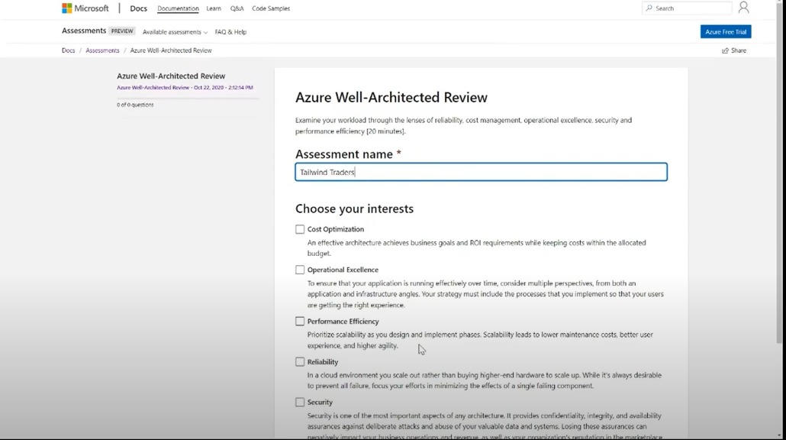
Assessments
Tool to help you evaluate your designs
Thought provoking and can help new teams working with Azure
https://docs.microsoft.com/assessments/
Notes:
Azure Well-Architected Review - Assessments | Microsoft Docs

Slide 10
Azure components

Slide 11
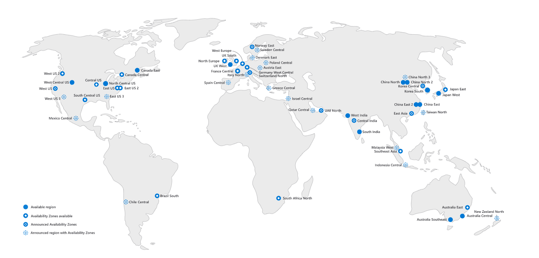
Azure Regions
68+
Azure regions
Notes:
An Azure region is a set of datacenters, deployed within a latency-defined perimeter and connected through a dedicated regional low-latency network.
With more global regions than any other cloud provider, Azure gives customers the flexibility to deploy applications where they need. An Azure region has discrete pricing and service availability.

Slide 12
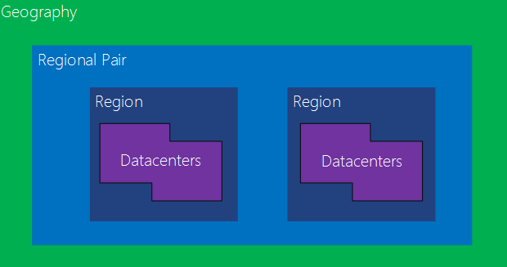
Azure Regions + Regional Pairs
An Azure region is a set of datacenters, deployed within a latency-defined perimeter and connected through a dedicated regional low-latency network.
DC’s have multiple layers of hardware and software redundancy for HA
Region to Region traffic over Microsoft backbone

Slide 13
Availability Zones
Central US
AZ
1
AZ2
Protect against datacenter-level failures
3 separate zones within each supported region
Independent power source, networking and cooling
AZ3
Azure backbone
AZ
1
AZ2
AZ3
East US 2
Notes:
And finally, Azure Availability Zones.
Azure Availability Zones are unique physical locations within an Azure region and offer high availability to protect your applications and data from datacenter failures. Each zone is made up of one or more datacenters equipped with independent power, cooling, and networking.
The physical separation of availability zones within a region protects apps and data from facility-level issues. Zone-redundant services replicate your apps and data across Azure Availability Zones to protect from single points of failure.

Slide 14
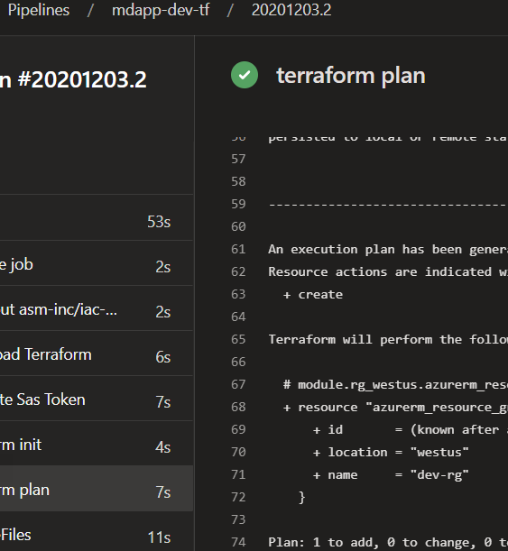
Provisioning with IaC
Terraform, Bicep, ARM Templates
Allows for known configurations across all regions, resource types
Add entire regions or spokes quickly

Slide 15
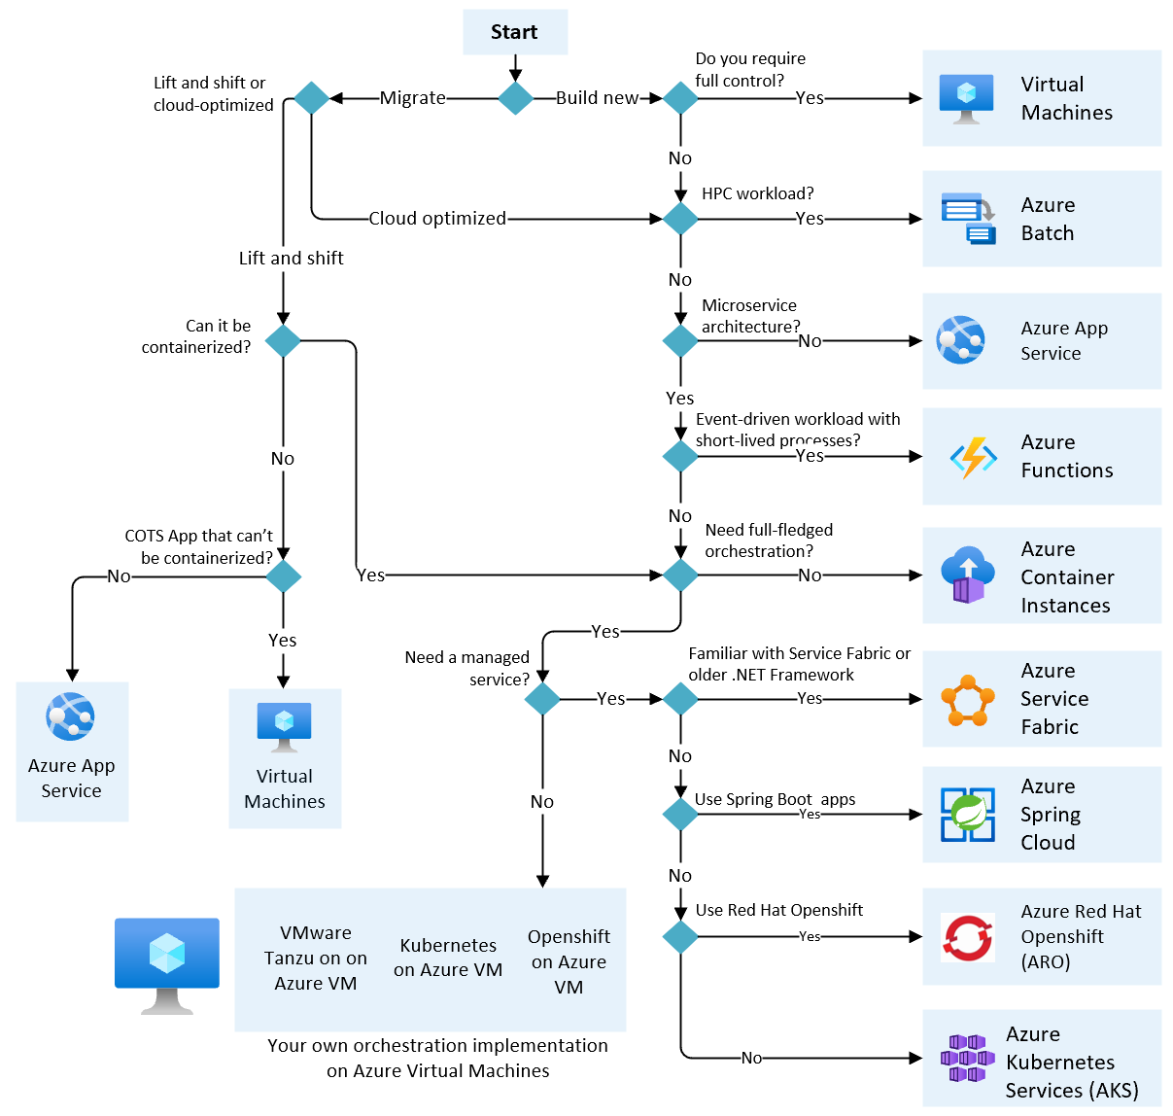
Compute
“The compute option is a critical design decision which impacts everything you need to deploy”
Notes:
https://docs.microsoft.com/en-us/azure/architecture/guide/technology-choices/compute-decision-tree

Slide 16





Database options
IaaS
PaaS
Cloud-native
DBMS deployed on VMs
User managed clusters Primary endpoint deployed into one region
Secondary endpoints in Secondary region
Azure Site Recovery could be used for failover
PaaS DBMS
Primary endpoint deployed into one region
Secondary endpoints in Secondary region
Failover Groups (SQL)
Breaking Failover or Auto failover based on SKU MySQL, PostGreSQL
60-minute auto-failover
Multi-write
Eventual Consistency
Support for many different DBMS types

Slide 17




Other resource types
Many Services in Azure have their own ”failover” technologies
Make sure you check the SKUs
Some are self-managed fail-over, many are MS managed

Slide 18



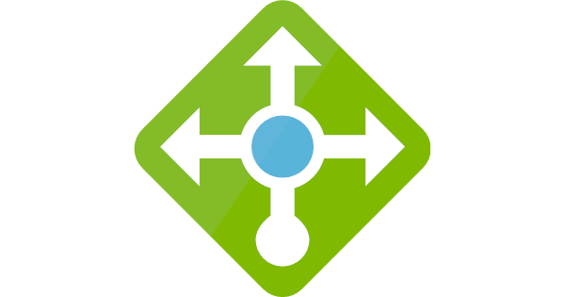
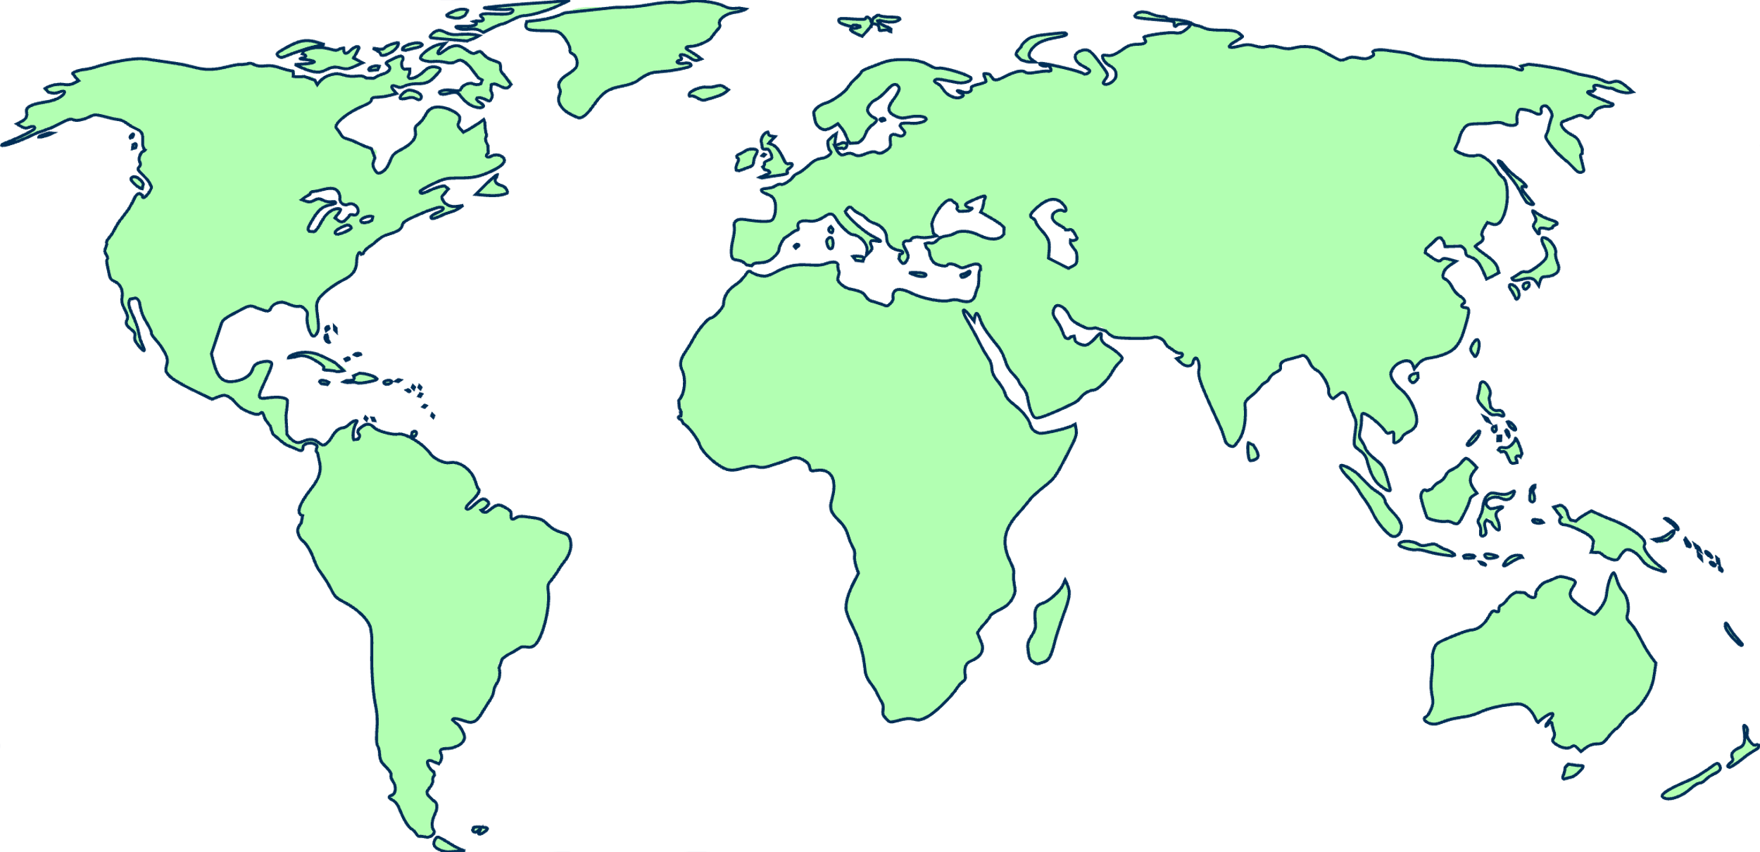





Load balancing in Azure
Front Door
Application Gateway
Application Gateway
Load Balancer
(Public)
Traffic Manager
Load Balancer (Internal)
Global
Region / Zone
Global
Internal
Regional
Route to your closest available service region or your on-prem DC. Offload SSL, improve performance / accelerate websites at the Edge.
Route across zones and into your VNET. Offload SSL and build your application-specific logic.
Route across and between your resources to build your regional application.

Slide 19
Azure Front Door
Azure Front Door Service provides a scalable and secure entry point
for fast delivery of your global web applications
SSL offload and application acceleration
Global HTTP load balancing with instant failover
Application Firewall and DDoS protection
Centralized traffic orchestration view

Slide 20
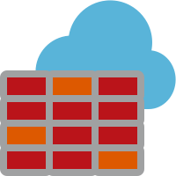
Azure Firewall
Cloud native stateful Firewall as a service
L3-L7 Connectivity Policies
Central governance of all traffic flows
Built-in high availability and auto scale
Network and application traffic filtering
Centralized policy across VNets and subscriptions
Complete VNET protection
Filter Outbound, Inbound, Spoke-Spoke & Hybrid Connections traffic (VPN and ExpressRoute)
Centralized logging
Archive logs to a storage account, stream events to your Event Hub, or send them to Log Analytics or Security Integration and Event Management (SIEM) system of choice
NAT, Network and Application traffic filtering rules allows Inbound/Outbound access
Spoke 1
HUB VNet
Spoke2
Azure Firewall
Spoke VNets
Azure to On-Prem traffic filtering
Traffic is denied by default
On-Premises

Slide 21
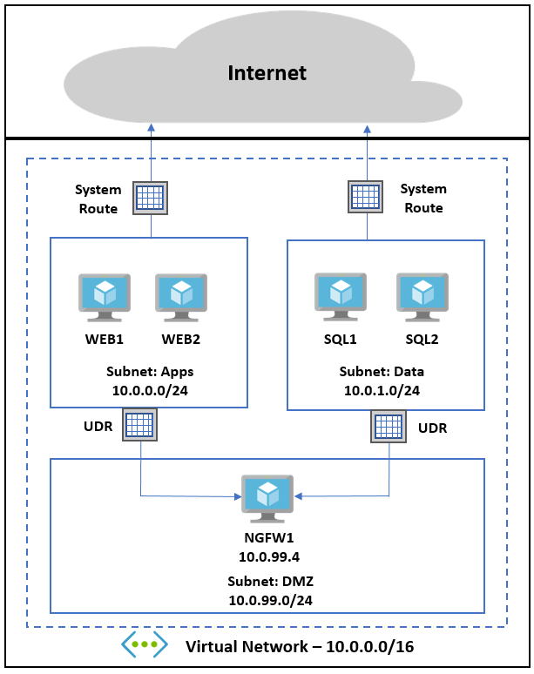
User defined routes
Administrators can change default routing behavior
Routing can be configured to direct traffic through devices such as Virtual Firewalls to create a DMZ

Slide 22
Multi-region architectures

Slide 23

Considerations for Multi-region
Is the application stateless or not?
How do I want to direct my users to the Point of Presence “POP”?
IaaS? PaaS? Hybrid connections to data or APIs on-premises or cross region?
What DBMS(s) will be used and is it IaaS or PaaS?

Slide 24
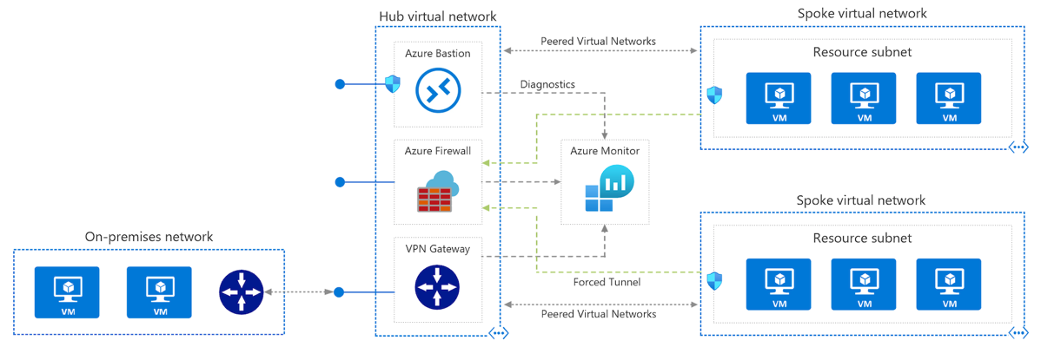
Traditional Cloud Hub & Spoke
Customer provisioned and supported Hub & Spoke module
UDRs to route traffic to/from FW
Provision at least two hubs in region pairs
Notes:
Hub-spoke network topology in Azure - Azure Reference Architectures | Microsoft Docs

Slide 25
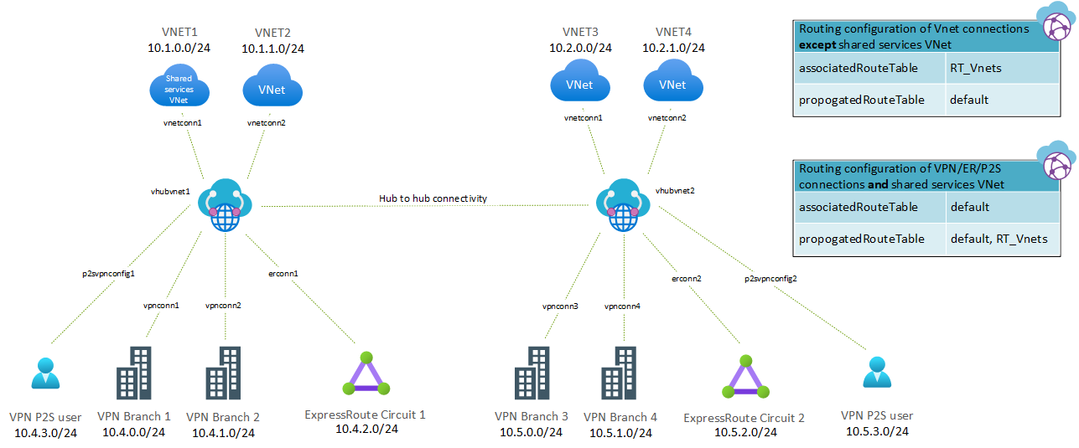
Virtual WAN Hub and Spoke
Better for enterprises that want to implement a cloud-based SD-WAN
Azure takes care of routing & Spokes will look traditional
Notes:
Hub-spoke network topology with Azure Virtual WAN - Azure Architecture Center | Microsoft Docs

Slide 26
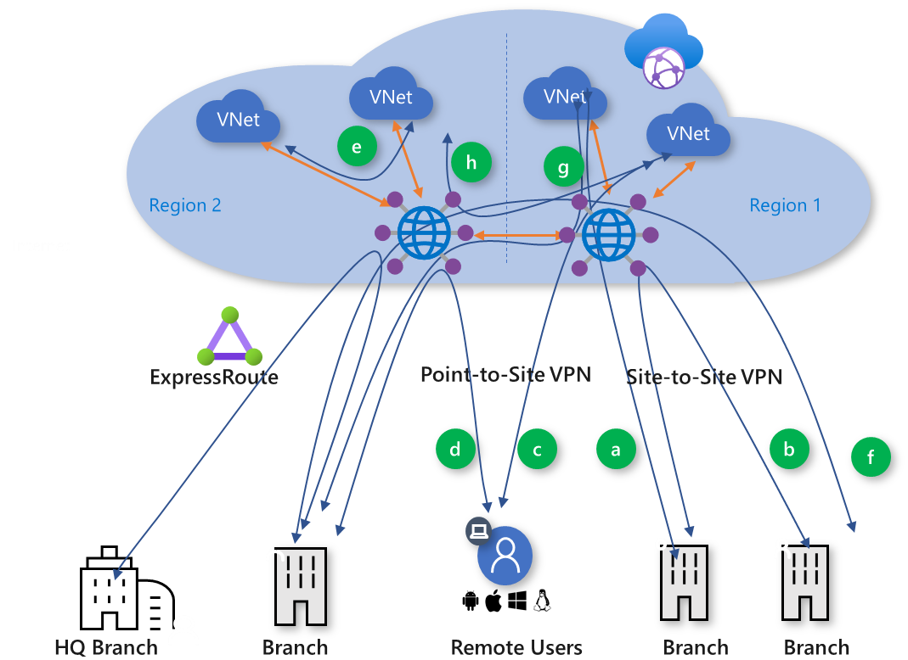
Global V-WAN Connectivity
Branch-to-VNet (a)
Branch-to-branch (b)
  ExpressRoute Global Reach and Virtual WAN
Remote User-to-VNet (c)
Remote User-to-branch (d)
VNet-to-VNet (e)
Branch-to-hub-hub-to-Branch (f)
Branch-to-hub-hub-to-VNet (g)
VNet-to-hub-hub-to-VNet (h)

Slide 27
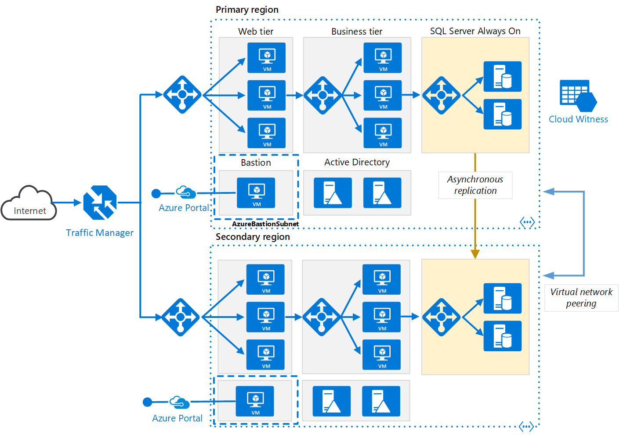
IaaS
Multi-region using Traffic Manager Primary config
Availability Sets
AGW, VMs in N-tier
Data is VMs SQL AOG cluster
SLA 99.95%
Notes:
Multi-region N-tier application - Azure Architecture Center | Microsoft Docs

Slide 28
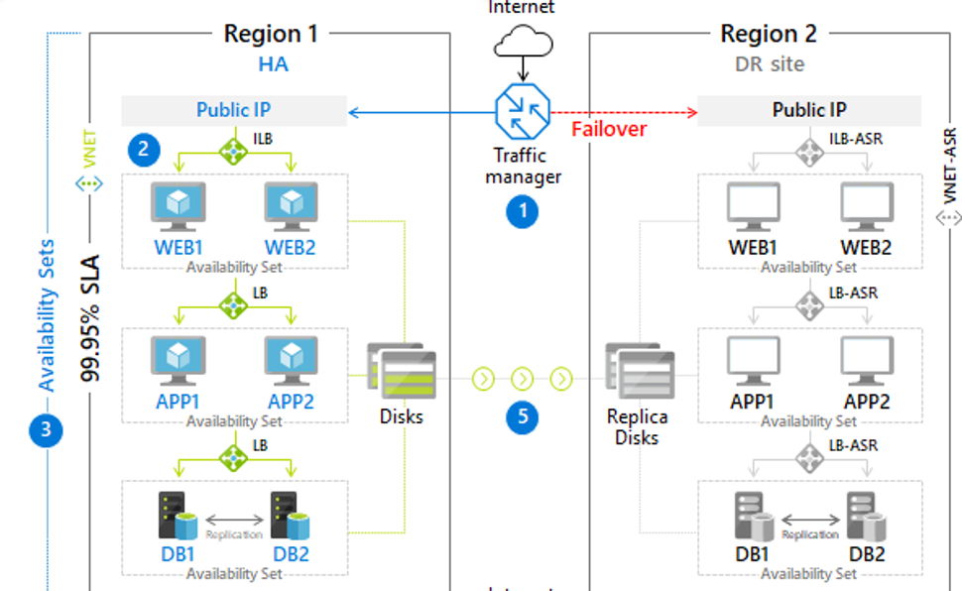
IaaS
Multi-region using Traffic Manager Primary Config
Availability Sets
AGW, VMs in N-tier
Data is VMs SQL AOG cluster
Azure Site Recovery
SLA 99.95%

Slide 29
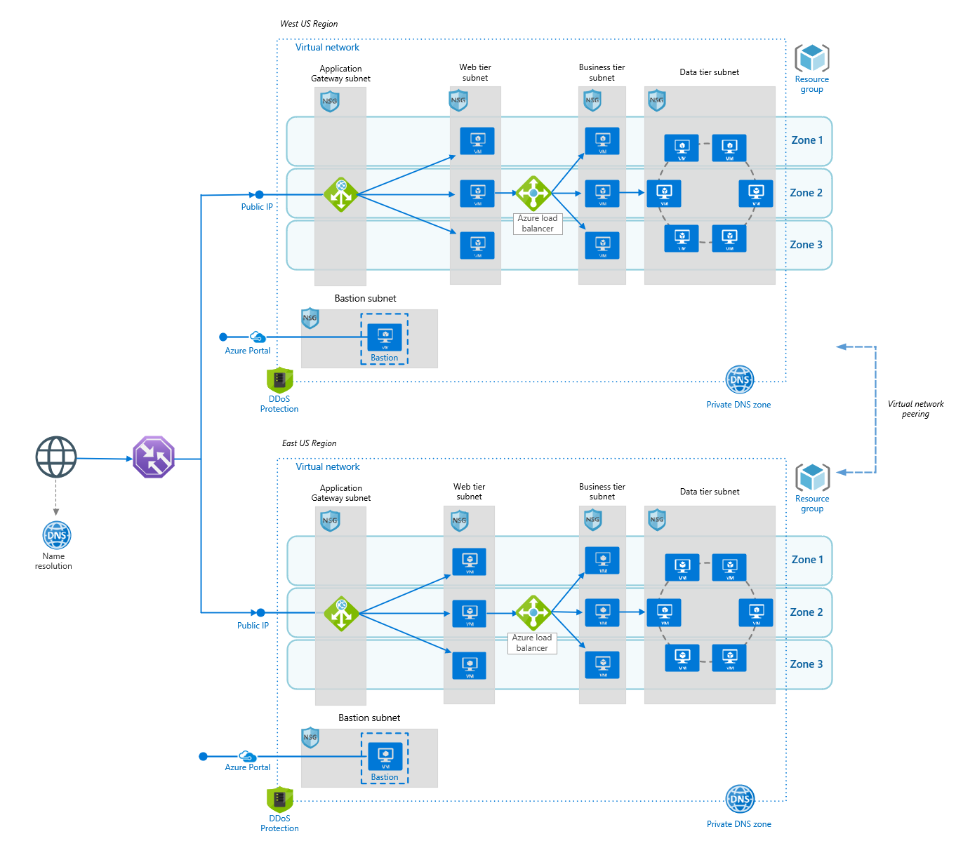
IaaS
Multi-region using Traffic Manager Performance Config
Availability Zones
AGW, VMs in N-tier
Data is VMs
Database replication eventual consistancy
SLA 99.99%
Notes:
Multi-region load balancing - Azure Reference Architectures | Microsoft Docs

Slide 30
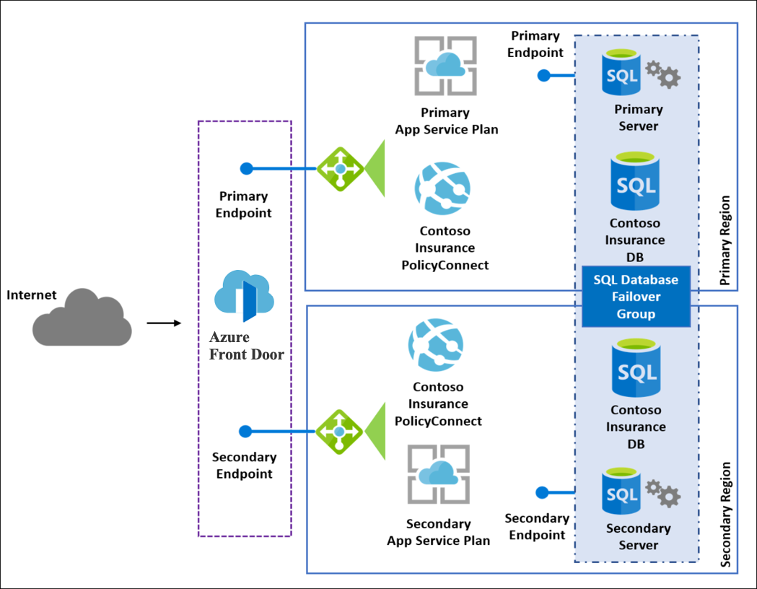
PaaS
Simple app that was refactored to PaaS
SQL PaaS Failover Groups
Front-door for accelerations and TM
SLA 99.95%
Notes:
MCW-Business-continuity-and-disaster-recovery/HOL step-by step - Business continuity and disaster recovery.md at master · microsoft/MCW-Business-continuity-and-disaster-recovery (github.com)

Slide 31
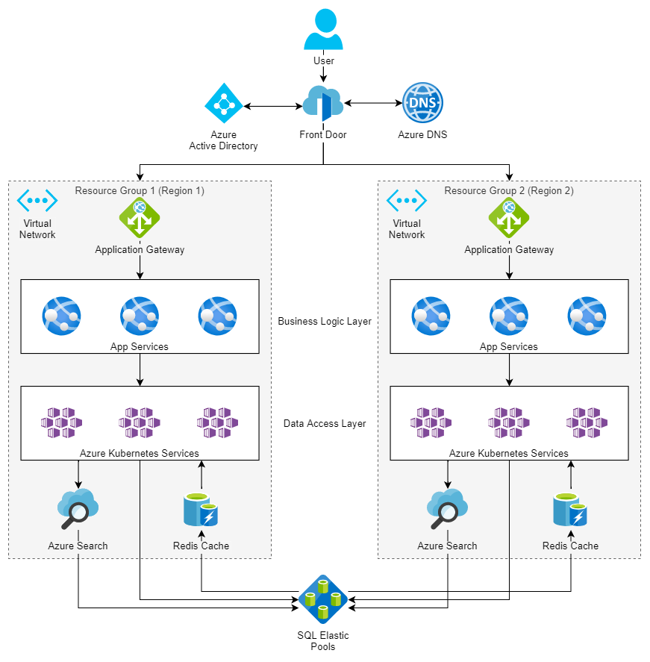
AKS
Front-doors for accelerations TM
App Services
AKS
Search / Redis PaaS
Azure SQL Elastic pools & Failover Groups
SQL 99.95%
Notes:
Multitenant SaaS on Azure - Azure Architecture Center | Microsoft Docs

Slide 32
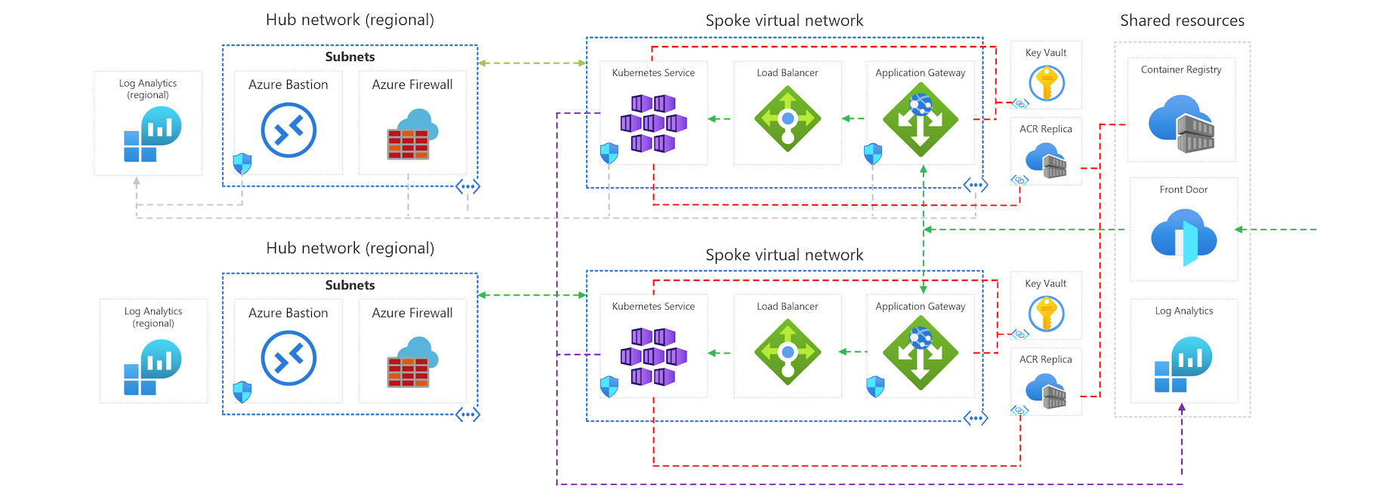
AKS Hub and Spoke WAF
Notes:
AKS baseline for multiregion clusters - Azure Architecture Center | Microsoft Docs

Slide 33
Introduction
Architecture resources
Azure Components
Multi-region Architectures
Notes:
Well Architected Framework
Azure Components
IaaS Applications
PaaS Applications
AKS Applications

Slide 34
Don’t forget to complete an online
Running Multi-region Applications in Azure
Your evaluation helps organizers build better conferences
and helps speakers improve their sessions.
Thank you!

