Slide 1
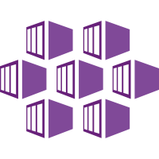


Running AKS in PROD
Dan Patrick
dan@solliance.net
@deltadan

Slide 2


Slide 3


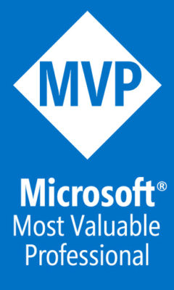
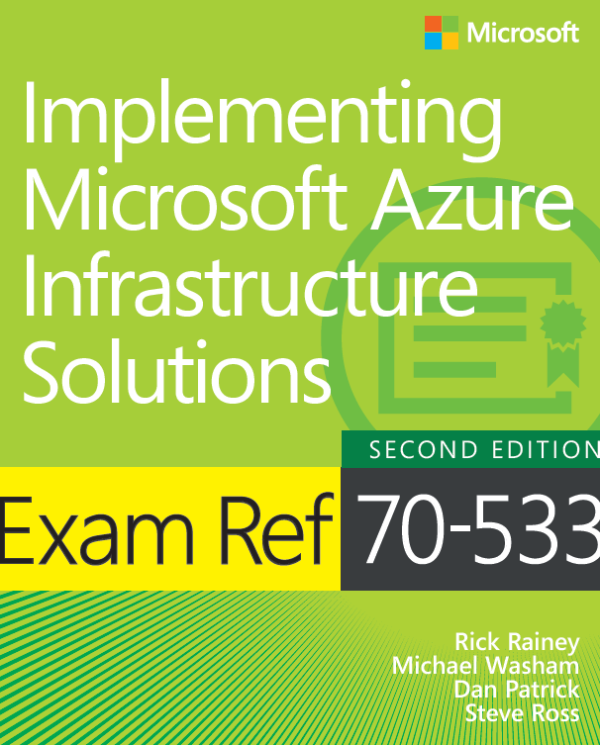
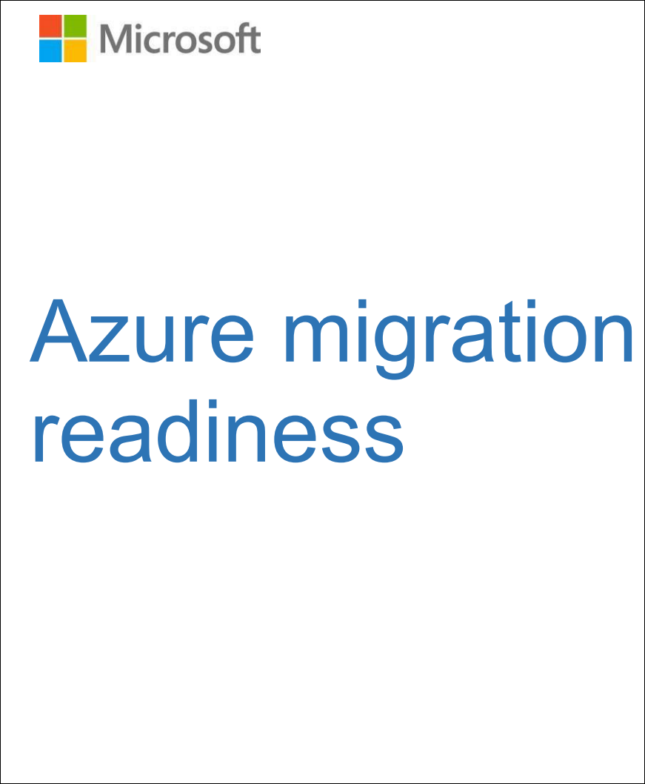
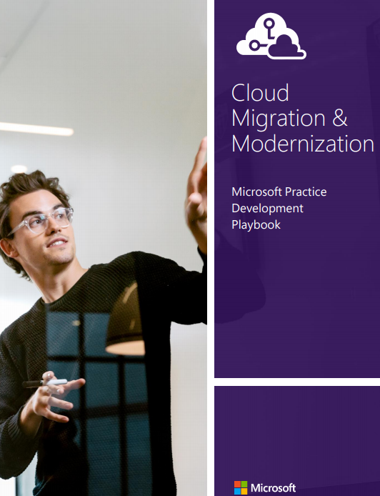
General Manager DevOps, Chief Infrastructure Architect
Azure MVP
Author/co-author of several books on Azure
New Migration Whitepaper
15 Year Microsoft Veteran
Dan Patrick
dan@solliance.net
@deltadan
http://aka.ms/smartpaper

Slide 4
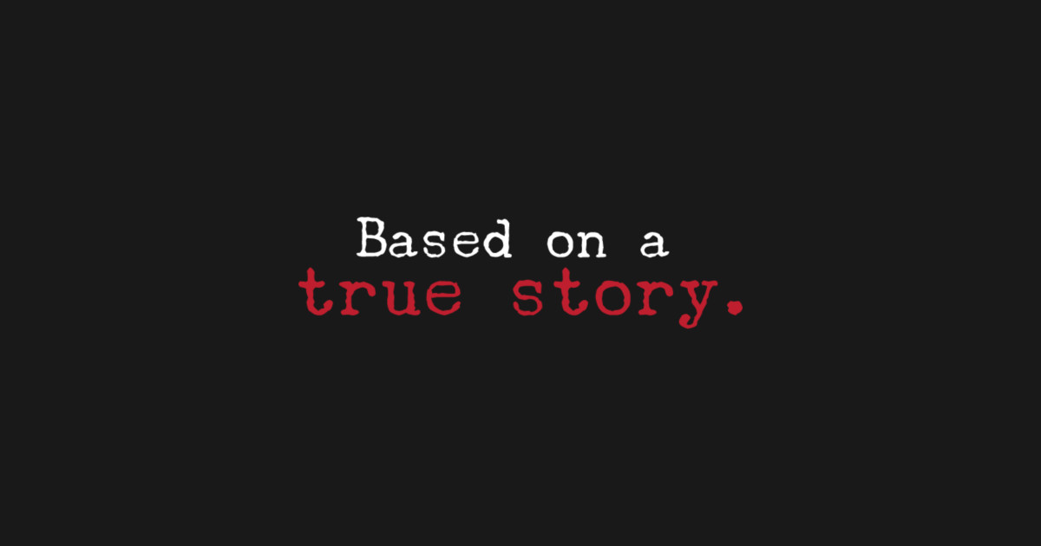

Slide 5
Breaking the Monolith
Legacy 3 tier asp.net application with millions of users
Large SQL 2016 DBs with very large tables (800 million rows) - AOG
On-prem
  Mix of physical and VMware
  Pure storage (very fast masking lots of technical debt)
Plan
  Migrate to microservices architecture on Azure AKS over 4 years
  Start with “Lighthouse” of one service
  Sync SQL Data to Azure then ETL into CosmosDB (near real-time data)

Slide 6
Breaking the Monolith
Non negotiable Requirements
  Security of PHI & PPI is the first priority
  Separation of duties is critical in support of HIPPA & Sarbanes-Oxley
  Must be Infrastructure as Code with 99.9% hands off from the portal
  Four environments minimum: DEV, TST, STG, PRD
Wishes:
  All Data replicated to Azure, allows for agile development
  Empower Developers
  Embrace Agile/Scrum while being flexible

Slide 7

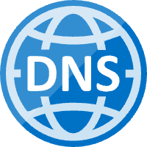


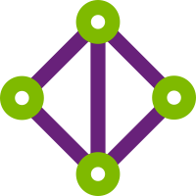
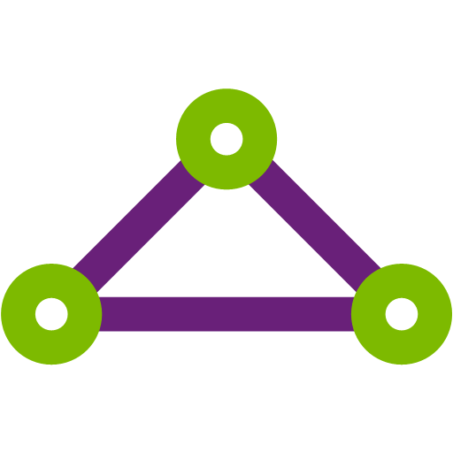
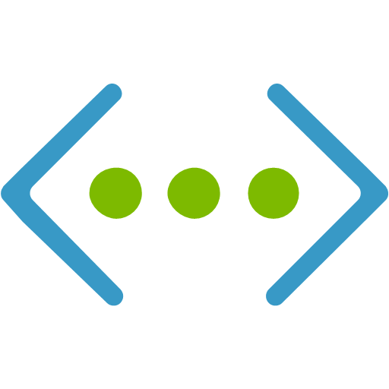



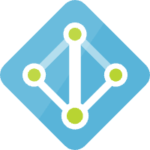






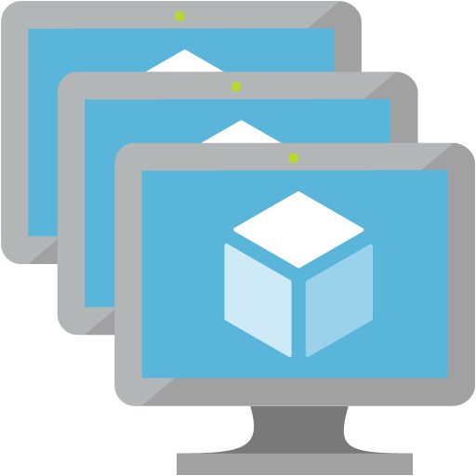




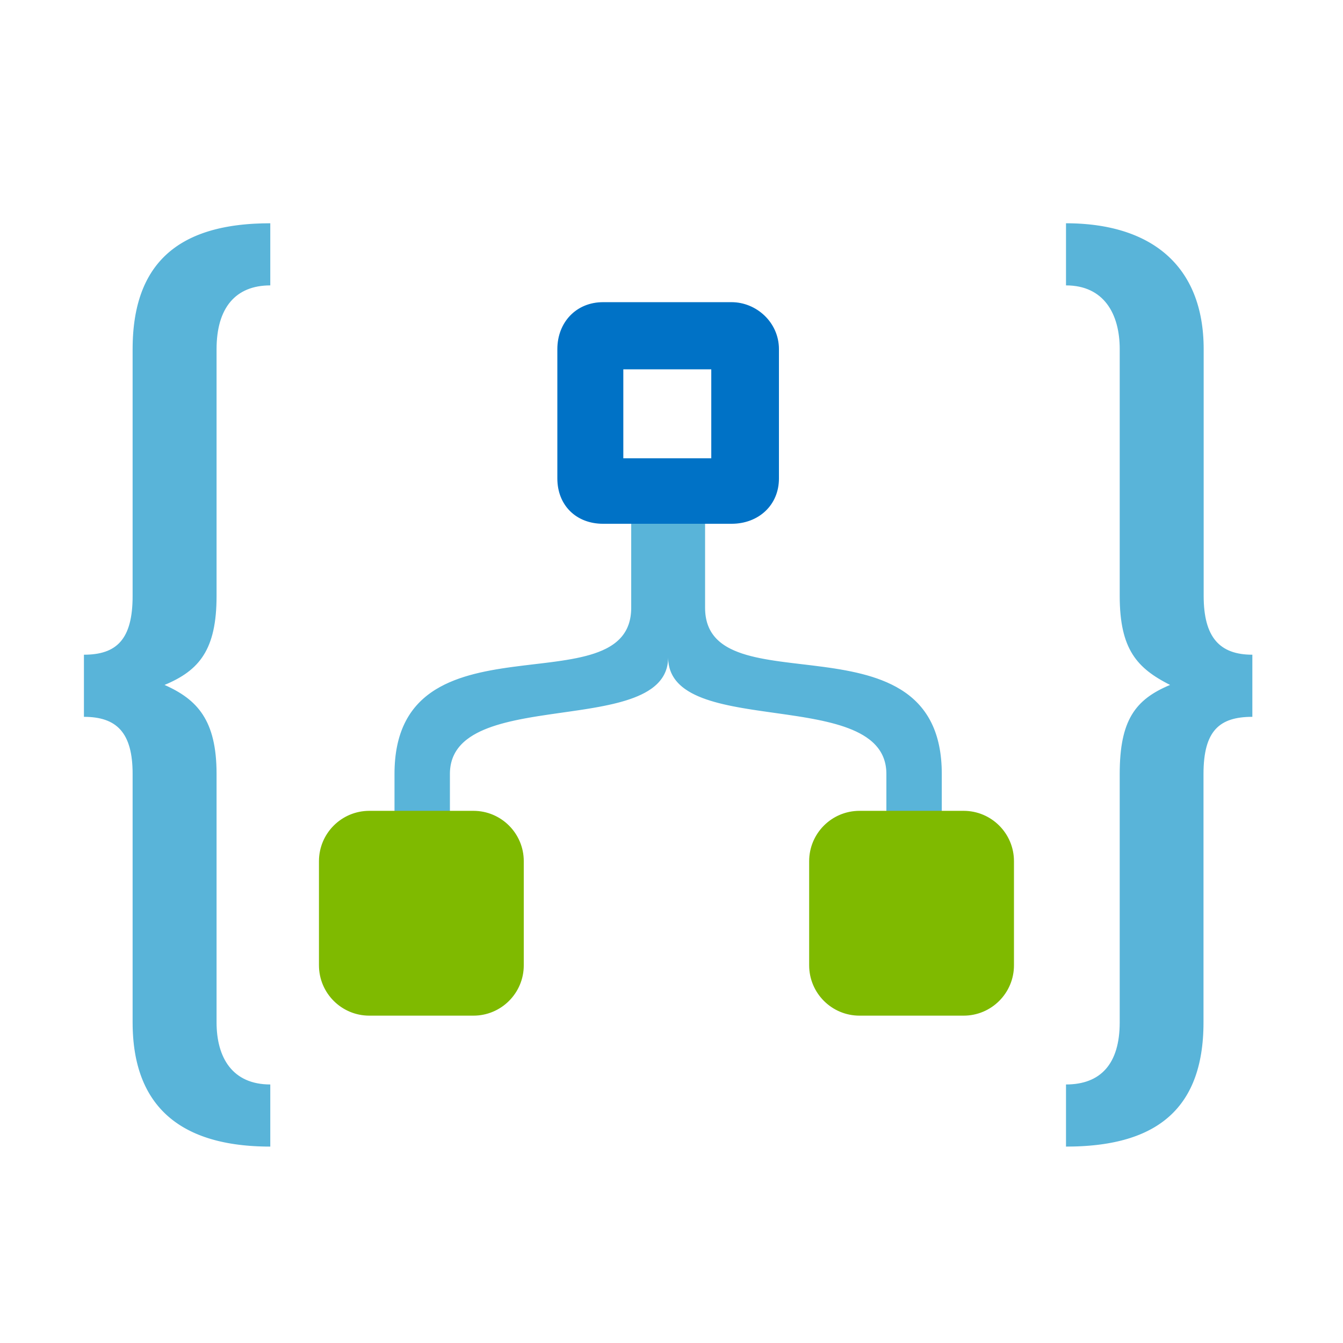



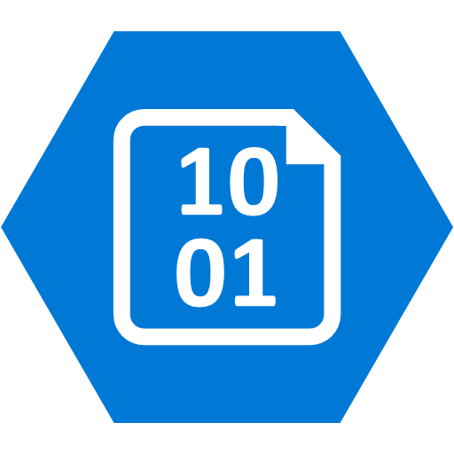

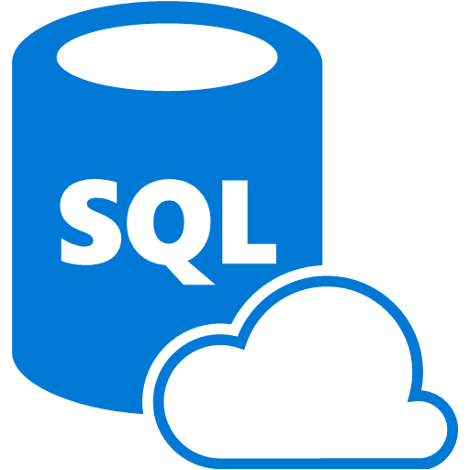




Azure Resources
DevOps
Jumpboxes
Networking
Security
DNS*
Traffic
Manager
App Gateway
WAF
VNET Peering
Express Route
Virtual Network
Gateway
CDN*
Azure Container
Registry
Azure AD
Compute
Events
APIs
Instrumentation
Data Sync
Azure
Kubernetes
Service
Azure DevOps
App Insights
Key
Vault
Management Nodes
Event
Grid*
API
Management*
SQL Server
Log Analytics
Agent Nodes
Security
Center*
Terraform
Event
Hubs*
Azure
Kubernetes
Service
Logic
Apps*
Storage
Monitoring
Azure Portal
Blob
Storage
Redis
Cache*
Alerts
Cosmos DB
SQL PaaS
Data Bricks
Active Directory
Azure CLI

Slide 8
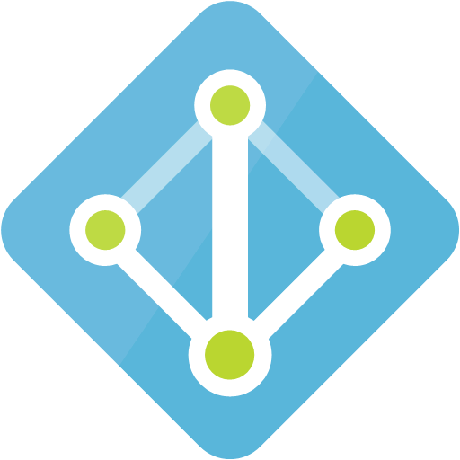

Azure Regions, Subscriptions & EntraID
Entra ID
SBX
DEV
TST
STG
PRD
HUB
Single Region Spin up/down resources for testing/scripts
Single Region App & DataSync Masked data
Dual Regions App & DataSync Masked Data
Dual Regions App & DataSync
Masked Data
Dual Regions App & DataSync
Real Data
ExpressRoute
DNS/DCs
Jumpboxes
Central US
Central US
Central US
Central US
Central US
Central US
East US 2
East US 2
East US 2
East US 2

Slide 9
DevOps Teams
Domains
Infrastructure
Application & Data architects
Developers
Infrastructure architects
Site Reliability Engineers (SRE)
Develop & Test Apps and microservices
Design Classic Integrations
Design & Build Databases, Collections
Build & Release Pipelines for Apps
Design & maintain Git Repos
Develop & Test IAC using Terraform
Build and Release Pipelines for Infra
Design & Deploy Networks
Implement Governance & Polices
Secure the environments
Maintain separation of duties
Design and maintain Git Repos

Slide 10



Fully managed Kubernetes cluster
Managed control pane
Automated upgrades, patches
Easy cluster scaling
Self-healing
Cost savings
Managed
Infrastructure
Operations
Applications
Domains
Kubernetes
Docker
Azure infrastructure services

Slide 11





Azure DevOps
Azure Boards
Azure Pipelines
Azure Repos
“ScrumBAN” – use boards with swim lanes to manage tasks. Ceremonies: Backlog Planning, Stand-up, Demo, Sprints and Points (not very strict)
Infrastructure: Build and Release pipelines for each environment.
Domains: Build and Release pipelines for each application deployed to AKS.
Different types ex: Apps, Data, Governance supporting the different environments
Azure Test Plans
Azure Artifacts
Infrastructure – planned
Domains: 95% code coverage with automated tests using
Domains private NuGet feeds for apps
Notes:
So does TFS

Slide 12
Azure Repos
Repos
  Infrastructure.Governance
  Infrastructure.Base
  Infrastructure.ApplicationEnv
  Infrastrcture.DataSync
  Infrastructure.Tooling
  Infrastructure.Ops
  /env – Terraform projects for each environment
Governance puts in Policies, Resource Groups, Service Principals, Custom RBAC roles
Base is used to laydown Azure resources required for other environments: Vnets, NSGs, ExpressRoute, DCs
Operations hosts Azure DevOps Build Agents in AKS cluster

Slide 13
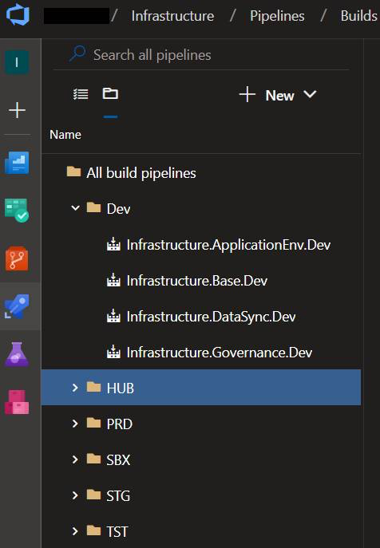
Azure Pipelines
Build & Release Pipelines matching the names of the repos & environment
Build Pipelines are YAML
  Does a “terraform plan”
  Leverage Variable Groups
  terraform State is in a Blob in Azure Storage (SAS URI used to access blob)
  Clone & adjust variables for each env
Releases
  Bash commands for “terraform apply”

Slide 14
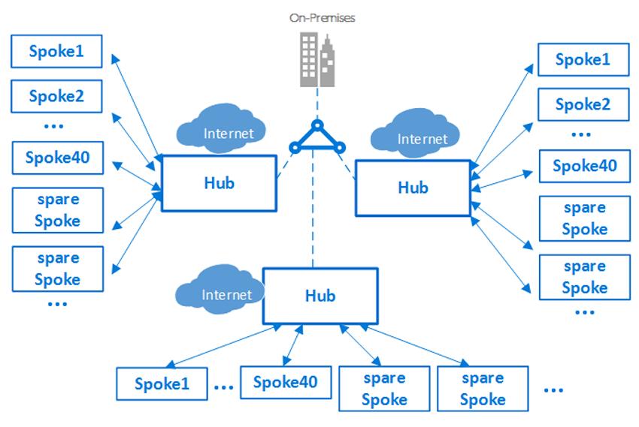
Hub & Spoke Model
Hub provides central services and networking
  DC/DNS for Windows IaaS
  ExpressRoute hybrid connectivity
  Jumpboxes
  Application Security Groups and Network Security Groups
  Recovery Services Vaults
  Central Logging

Slide 15
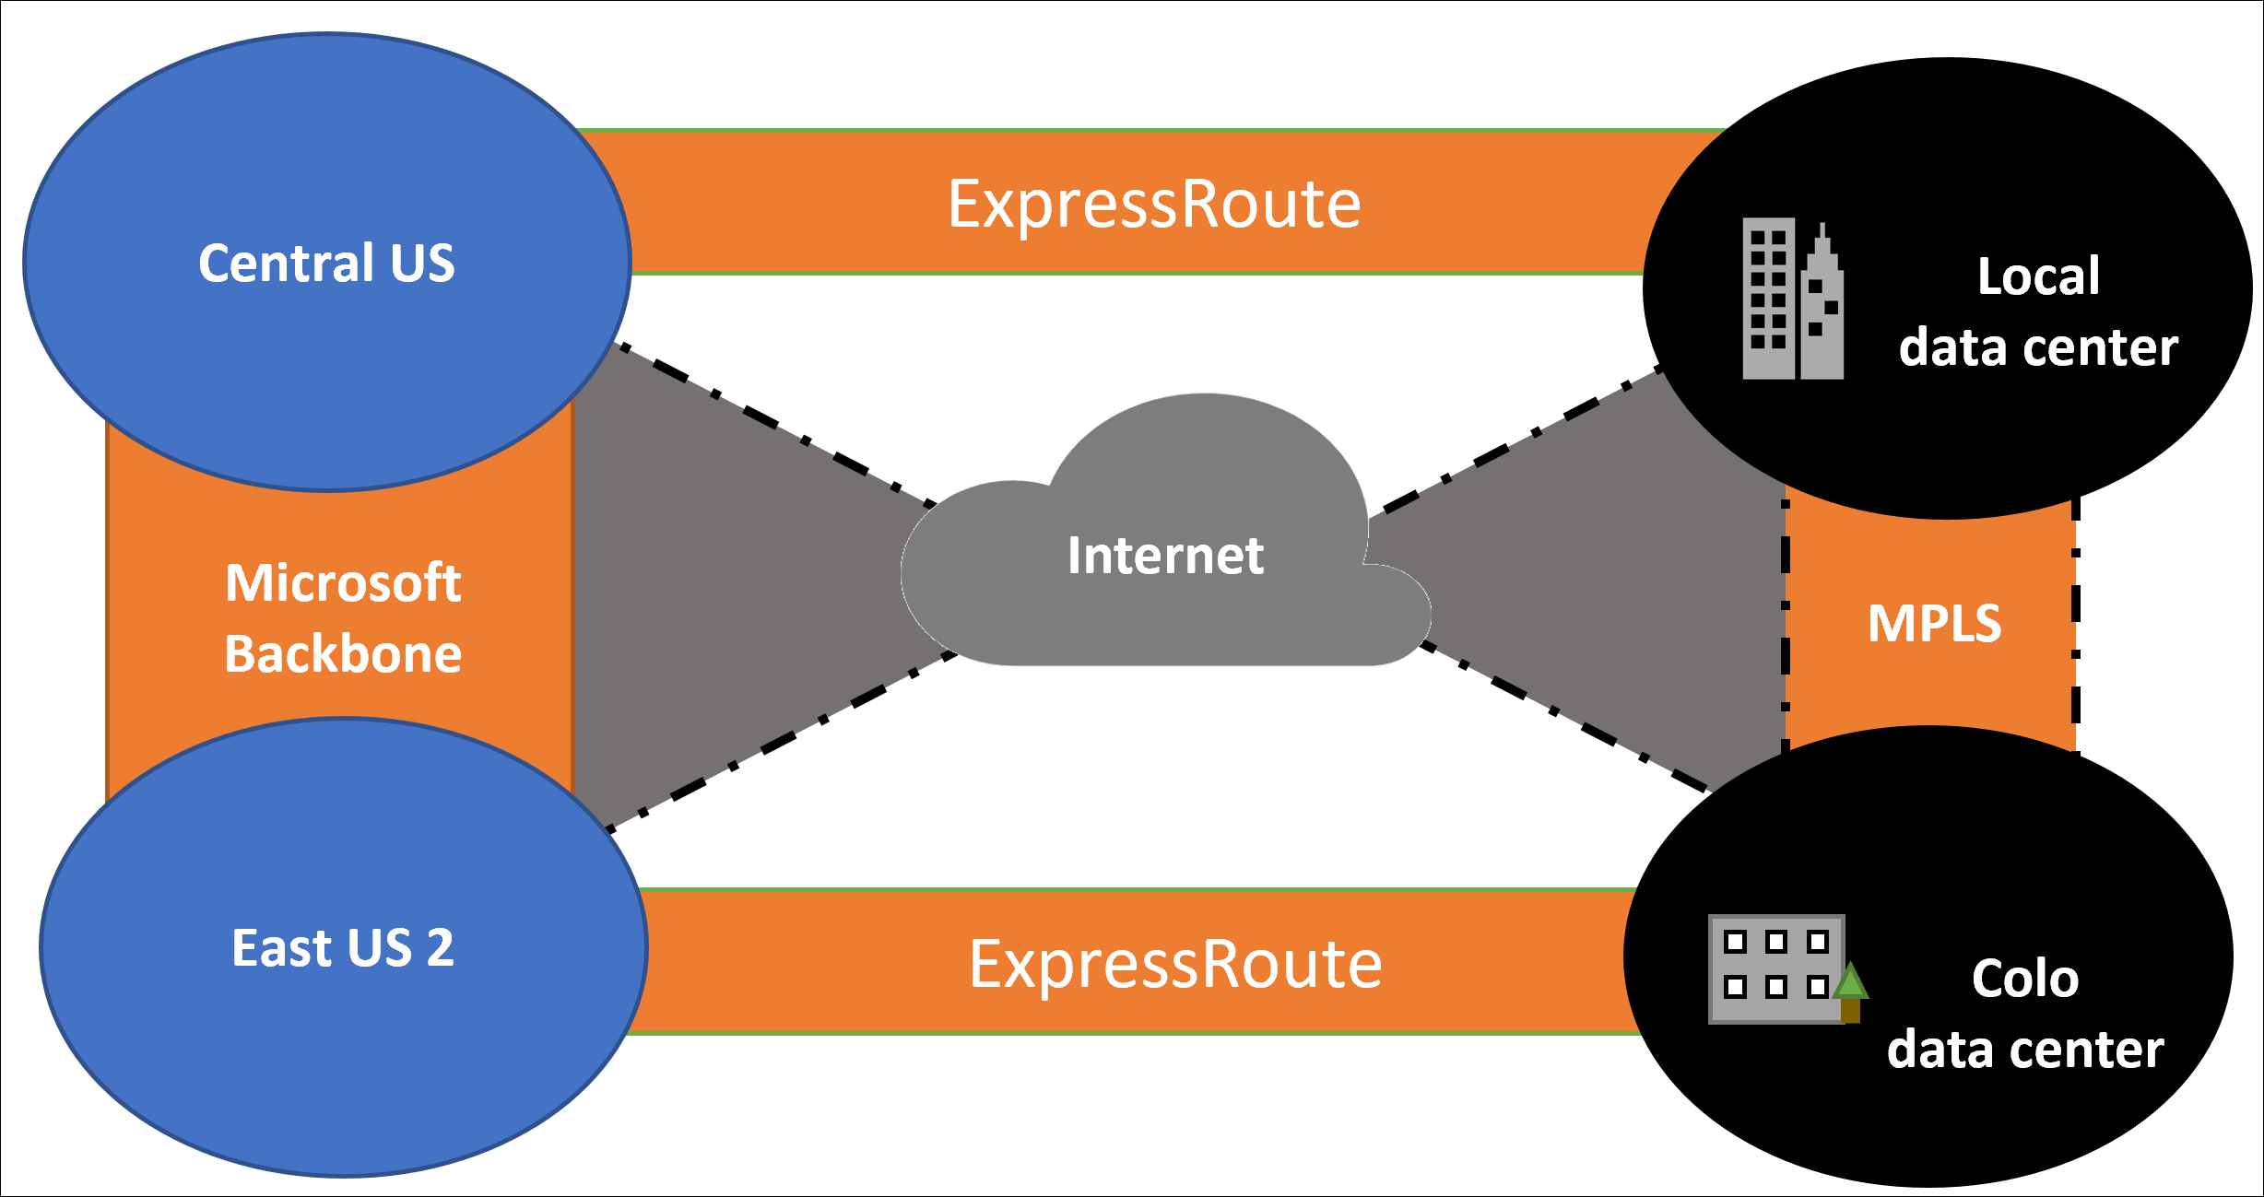
ExpressRoute
Multiple Circuits from two locations using multiple Providers
Private Peering to IaaS & AKS

Slide 16

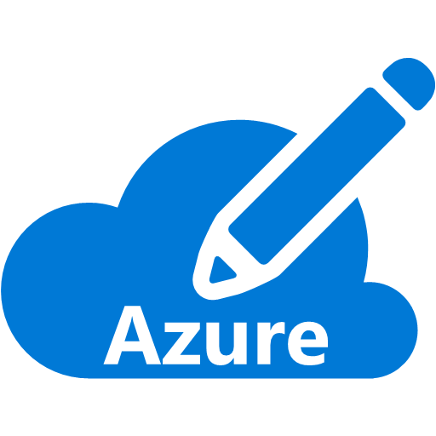

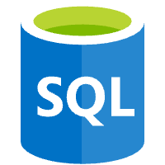






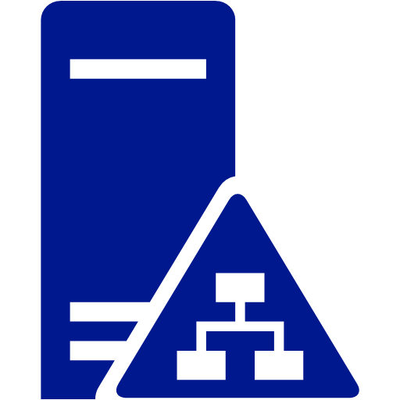


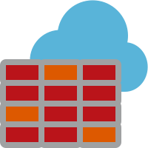


Separation of duties AKS VNet Design
AKS Advanced Networking, WAF V2, Service Endpoints to PaaS
DATA
AKS
DEV
CUS
AKS
DataSync
WAF
AKS
SEP
VNET Peering
DEV/TST:JMP
STG/PRD:JMP
DevOps Workstation
DATA
AKS
TST
CUS
EUS
AKS
DataSync
WAF
AKS
SEP
2GBPS
VNET Peering
ER - GATEWAY
AD-DC/DNS
Express Route
DATA
AKS
STG
CUS
EUS
AKS
DataSync
WAF
AKS
SEP
VNET Peering
Classic Data Source
FIREWALL
DATA
AKS
PRD
CUS
MGMT
HUB
EUS
AKS
DataSync
WAF
AKS
SEP
VNET Peering
Corporate DC
Internet
Notes:
https://docs.microsoft.com/en-us/azure/virtual-network/virtual-network-service-endpoints-overview

Slide 17
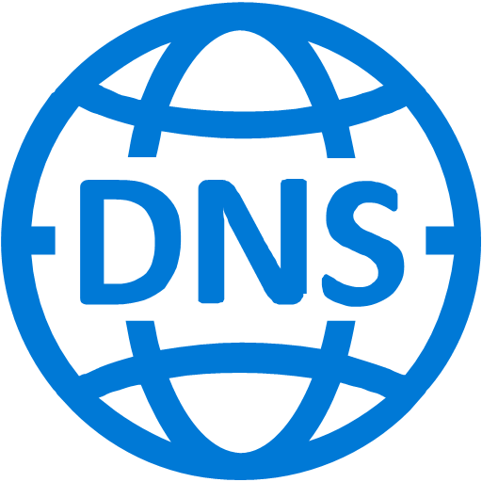




Multi-Region Setup
Internet
PRD
Traffic Manager
East US2
REGION
Central US
REGION
WAF v2
EventHubs
AKS
App Insights
VIP
Azure SQL DB
Azure Monitor
Secondary
Primary
CosmosDB
Geo Replication
Key Vault
Failover
Notes:
Limit access through waf, packets from no where except for NSG allowed IP address range

Slide 18
Azure Application Gateway - WAF
Version 2 (NGINX)
Zone Redundant
WAF enabled, protection mode – 128K Max Body Size, 10MB upload
Backend Pool
  Targets Azure Load Balancer in front of AKS by Private IP
HTTP Settings
  443/HTTPS Non-Cookie based affinity
  Connection Draining Enabled
  Timeout 120 seconds

Slide 19
Azure Application Gateway – WAF (con’t)
Frontend IP Config
  Public Address (Static)
Listeners * 2
  80, 443
Rules * 2 in support of Listeners
Probe * 1 to canary app running in AKS

Slide 20
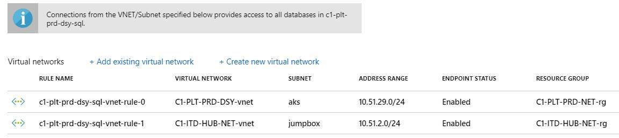
Service Endpoints and PaaS Firewalls
Enable Service Endpoints on PaaS Services to allow AKS to talk to PaaS Services without going to Azure Edge
Whitelist AKS and other networks to secure PaaS Services

Slide 21


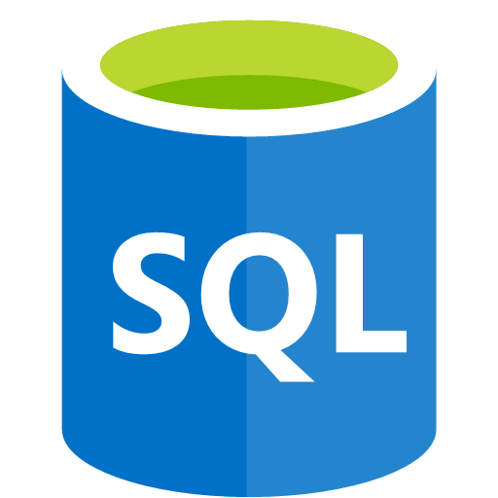
ExpressRoute & Peerings
C1-ITD-HUB-NET-vnet 10.51.0.0/20
10.12.x.x/16
Private Peering
ER Gateway
Jumpboxes
GatewaySubnet
jumpbox
Classic Data Source
CISCO ASA
Peering
Corp
C1-PLT-DSY-vnet 10.51.28.0/22
On-premises VMs to connect to Azure Services via private IP addresses without egressing to the Internet
DSY Reaches across ExpressRoute to Classic DBs
Service endpoints allow VNET resources to talk to PaaS Services
DSY AKS
AKS
Service Endpoints
Central US
Azure SQL
CosmosDB
Storage

Slide 22

Azure Policies
Policies are defined and assigned at the Subscription Level
IAC using the Governance Repo & Pipelines
Regions Allowed (if “notIn” […] then effect: “deny”)
  Central US
  East US 2
  Global
Resource Providers Allowed
  Only those which are being used for the solution in that Subscription
  No blockchain…

Slide 23

Contoso Identity Logical Configuration
Azure
Subscriptions
Active Directory
CONTOSO
Azure AD Tenet
contoso.com
Azure Resources
Users
Synchronized
Authentication
& Authorization
Groups
Service Principals
Subscription
Resource
Groups
Resources
Notes:
Here we see the relationship between Identity in Azure AD and RBAC. Users and Groups that live in Azure AD can be used to provide privileges in Azure for administration purposes.

Slide 24

RBAC
Custom Roles
IAC in Governance used Create the Roles
Customer RBAC Role Names match Groups Names created in ADDS on-premises
Users are added to groups in ADDS → AAD
Role is Assigned Subscription Level or Resource Group access desired
Groups and Users added are then granted those rights
To remove the rights from a user simply remove them from group in ADDS on-premises

Slide 25
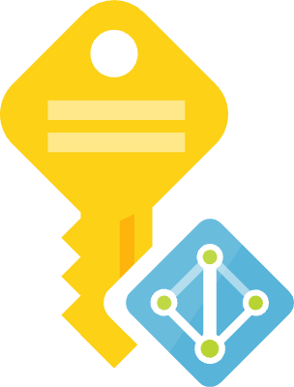
Service Principals & Managed Identity
SPNs created for each specific activity where they are required
IAC in Governance used SPNs
SPNs
  Azure DevOps
  Key Vault
Managed Identity
  AKS

Slide 26
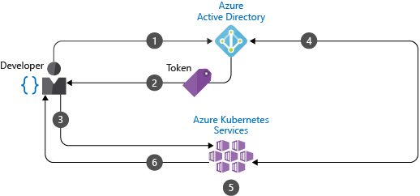
RBAC in AKS
AKS clusters deployed with Azure AD integration
Using Azure AD centralizes the identity management component
Any change in user account or group status is automatically updated in access to the AKS cluster

Slide 27
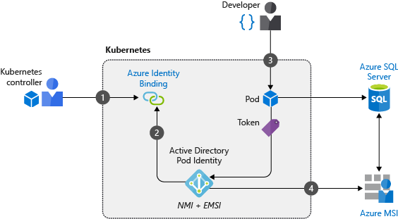
Leverage Pod Identities
When pods need access to other Azure services, such as Cosmos DB, Key Vault, or Blob Storage, the pod needs access credentials
Assign Managed Identity to pods

Slide 28
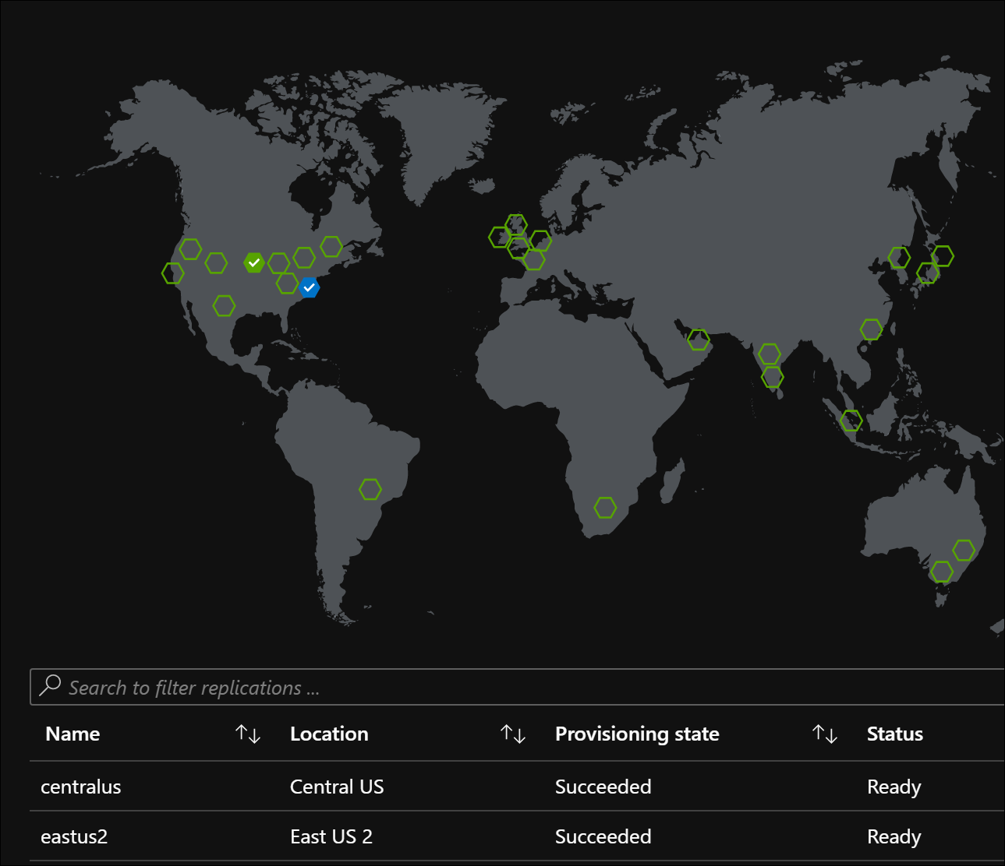
Azure Container Registry
Use Premium SKU
Replicate to secondary region
Managed Identity to allow for push and pull operations
Lock down with Service Endpoints just like other PaaS services
Firewall allowing AKS Build Agents

Slide 29
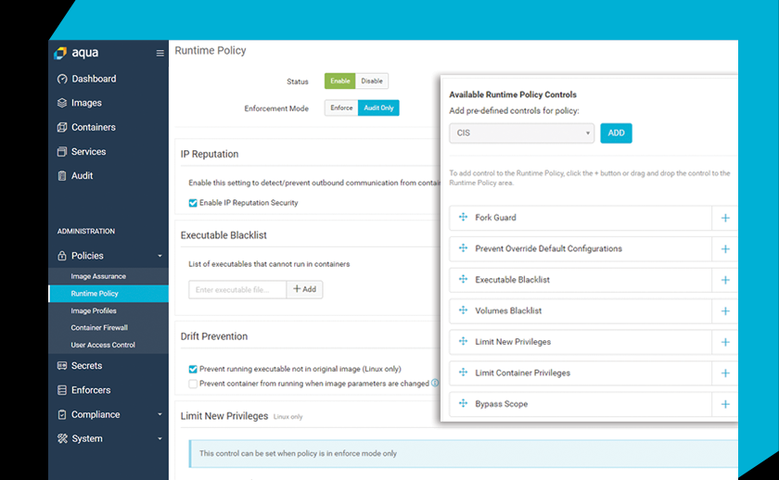
Container Scanning
AQUA
Running in Ops AKS cluster
Many vendors have containers with CVEs that are critical
Integrates with CIS benchmarks

Slide 30
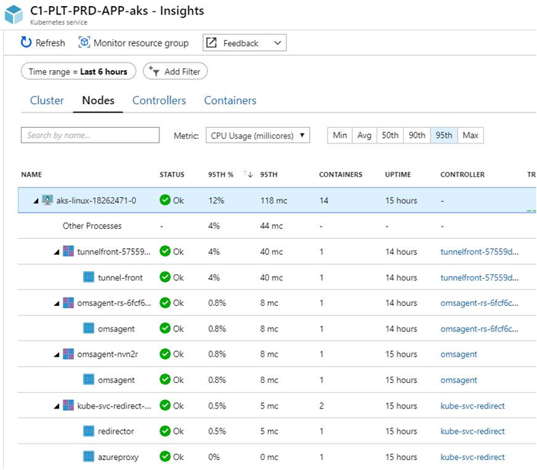
Monitoring AKS
Connect to Log Analytics which feeds Azure Monitor
Real-time data and archive
Setup alerts and webhooks

Slide 31
