Slide 1
Mastering Terraform Deployments for Azure

Slide 2
Agenda
Intro to the Toolchain used to build Azure
Designing the “Azure Cake” with Terraform projects
Configure Terraform Cloud for Azure Deployments
Deploy the layers of your “Azure Cake” using environment specific Workspaces on Terraform Cloud
Q & A

Slide 3
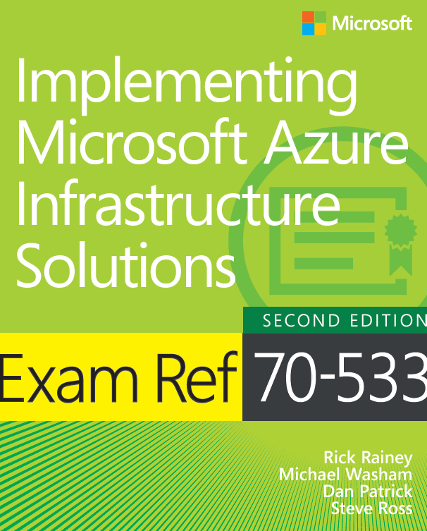
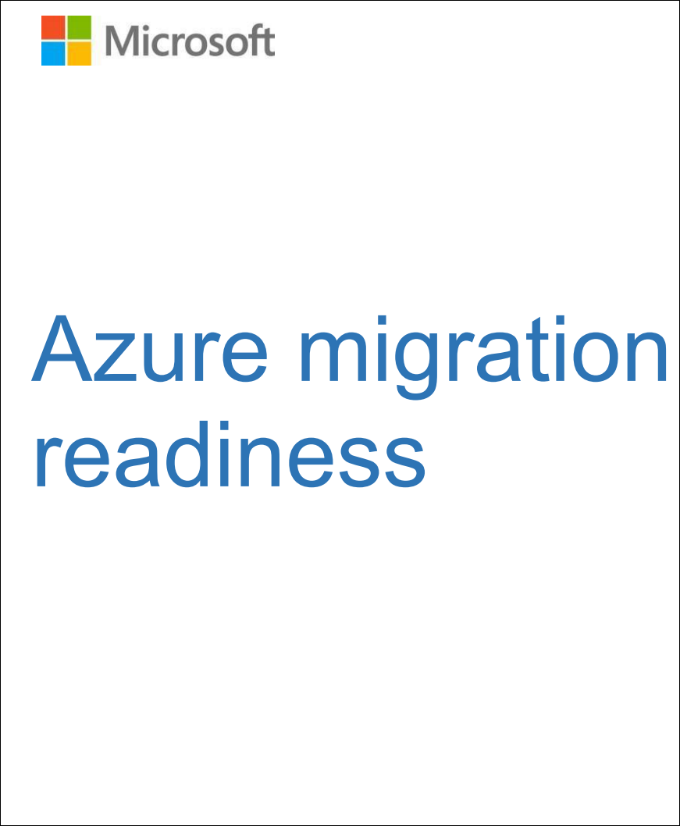
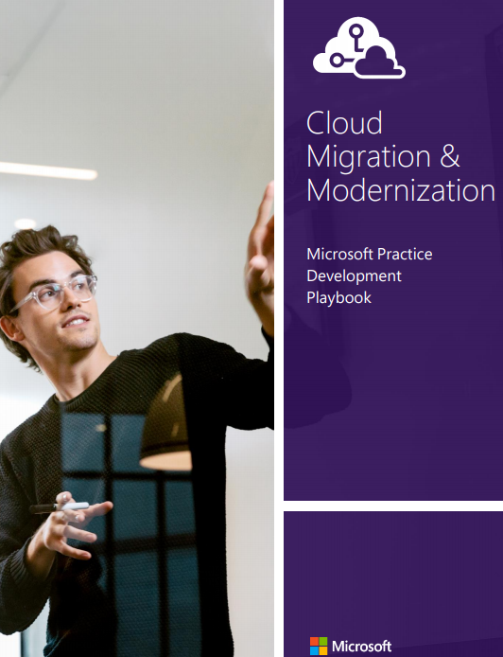
Dan Patrick
General Manager Infrastructure & DevOps, Solliance
Azure MVP
Author / co-author of several publications and whitepapers
Azure Migration Readiness
Cloud, Migration & Modernization
Implementing Microsoft Azure Infrastructure Solutions
15 Year Microsoft Veteran
dan@solliance.net
@deltadan

Slide 4
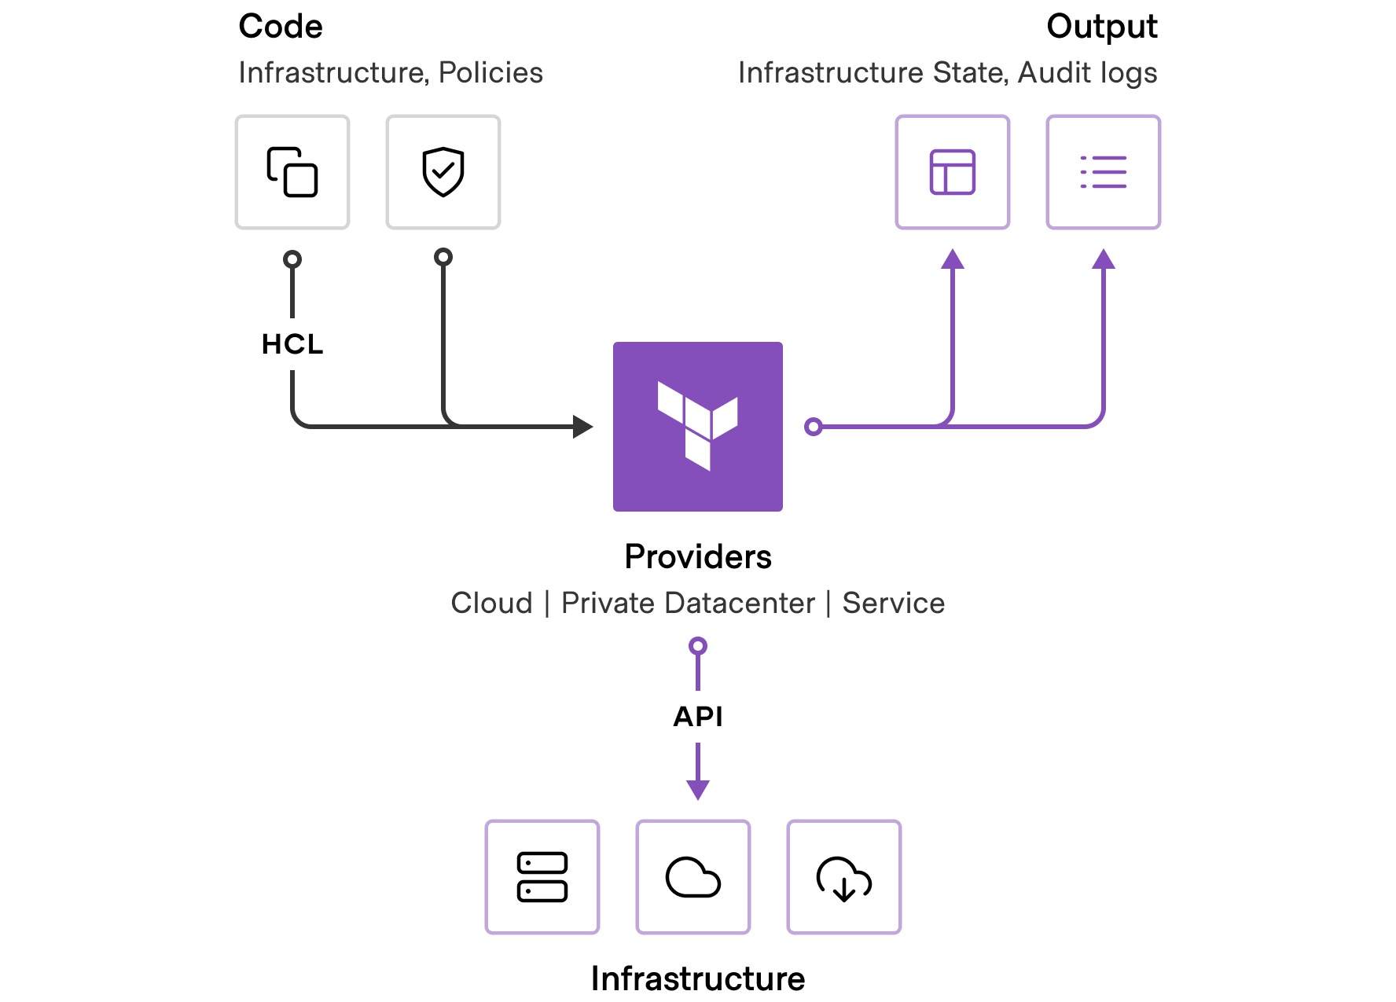
Toolchain to Build Azure

Slide 5
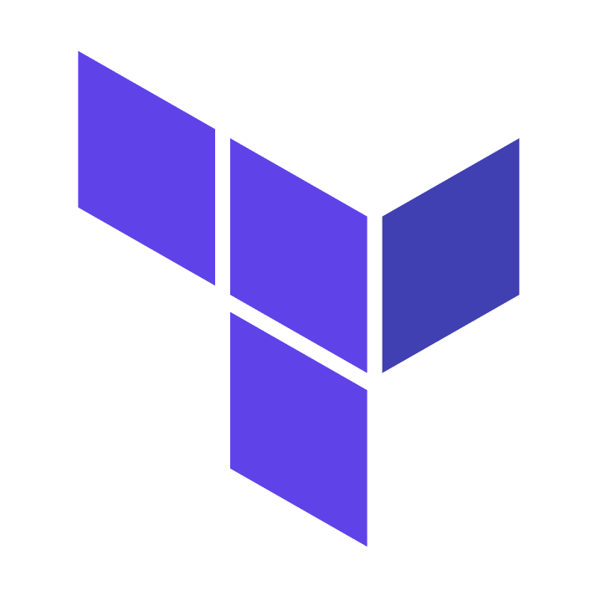
Toolchain
Github
Terraform Cloud
Azure & Active Directory
Create and manage source code repos for Terraform Projects
Template Repos for Terraform Private Registry
GitHub team management
Provision and manage all the infrastructures used for the solution
Variable Sets to manage variables (environment & terraform)
Workspaces manage deployments of our “Azure Cake” layers
Terraform Registry module reuse
Cloud platform for deployments and identity management
Subscriptions, Regions and Environments
Management Needs:
Governance
Networking
Application stack deployments
Notes:
TF
Provision and manage all the infrastructures used for the solution (even itself!)
Terraform Organization
OAUTH & SSH keys for connections to GitHub
Create and manage Service Principals & “client secrets” for Azure & Azure AD
Workspaces to manage deployments pieces of our “Azure Cake” to manage the layers of deployments
Variable Sets to manage variables (environment & terraform)
Az
Cloud platform for deployments and identity management
Management Needs:
Governance
Networking
Application stack deployments

Slide 6
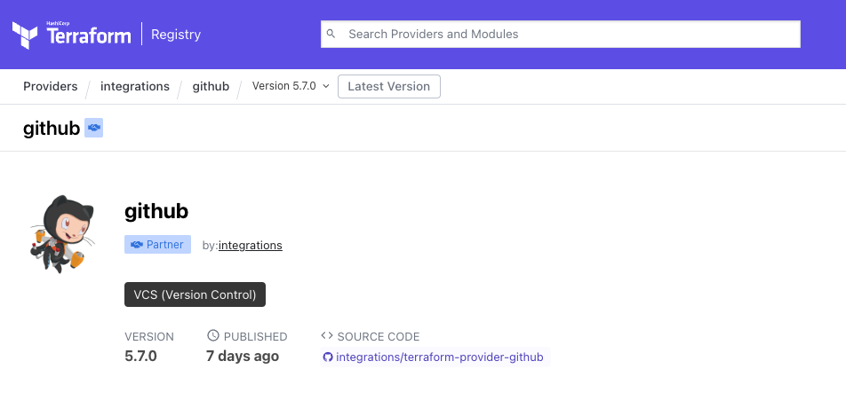
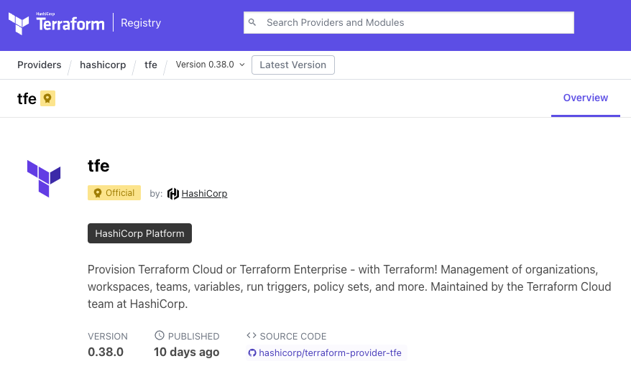
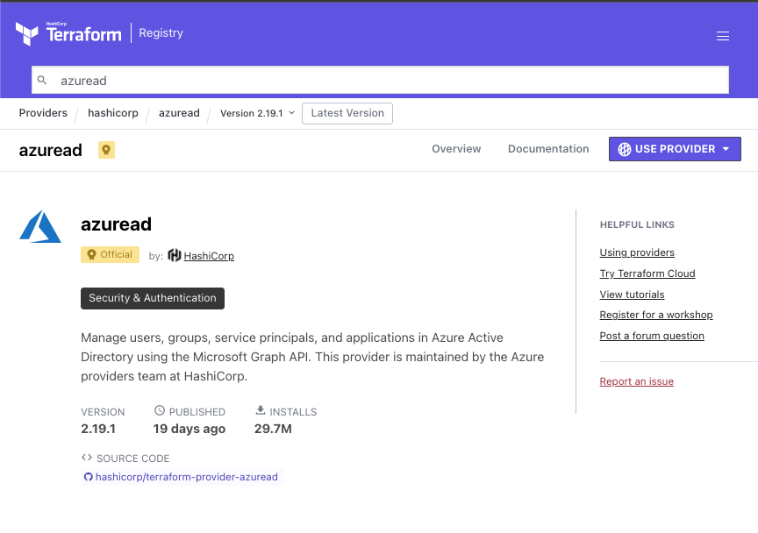
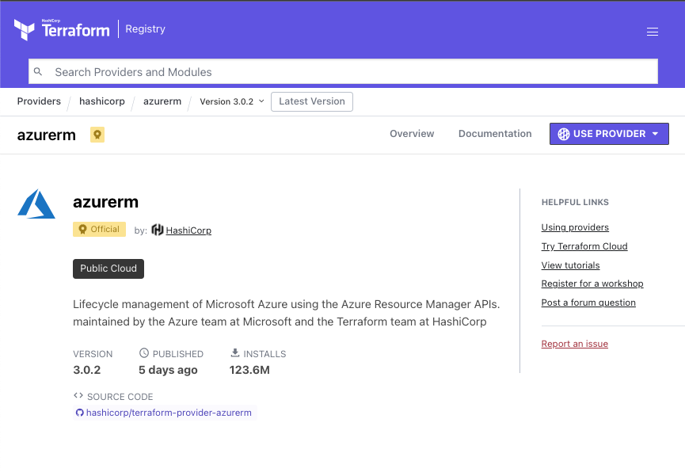
Terraform Providers
Platform specific tools
Providers, extensible to any cloud or service with an API, enable Terraform to provision diverse services without abstracting functionality.
Deep Integration with Azure services
Consistent workflow across your existing software and hardware estate

Slide 7
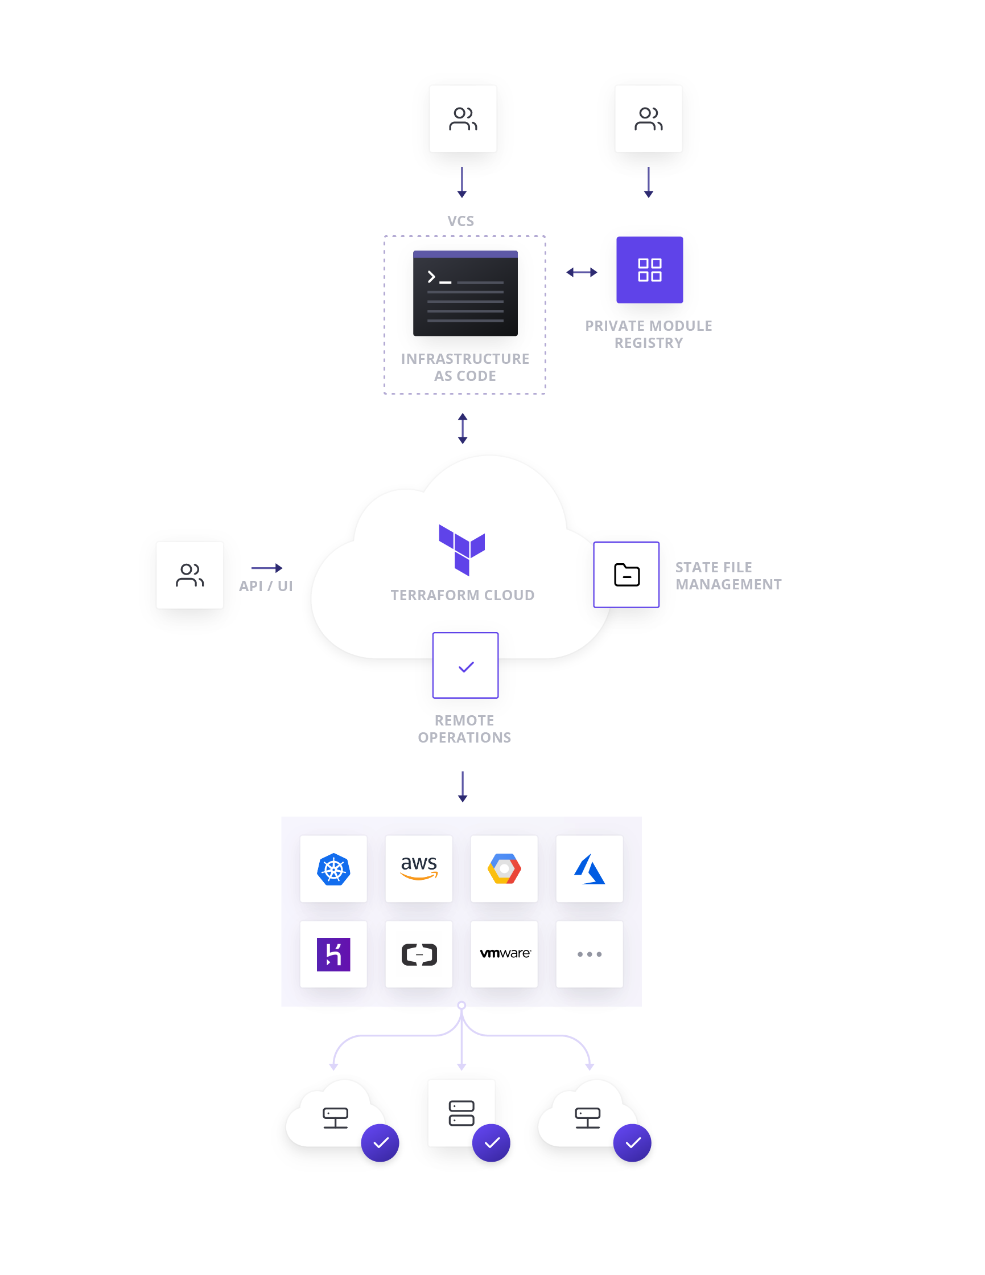
Terraform Cloud
Fully-managed Infrastructure as Code cloud service.
Cloud Compliance & Management to provision and manage any infrastructure with one workflow
Self-Service infrastructure for users to easily provision infrastructure on-demand with a library of approved infrastructure modules
Enterprise features to provide advanced security, compliance and governance organization wide

Slide 8
Terraform Workspaces
Layered deployments at scale
Decompose monolithic configurations to match organization and application structures.
All resources from a single Terraform run are intended to have a shared lifecycle
Drives separation of concerns
Reduces un-intended changes
SECURITY
TEAM
NETWORK
TEAM
APPLICATION DOMAIN TEAM
AZURE
GOVERANCE WORKSPACE
AZURE
NETWORK WORKSPACE
AZURE
APPS
WORKSPACE
*.tf config files
*.tf config files
*.tf config files
variables
variables
variables
state
state
state
logs
logs
logs

Slide 9
Secure Variable Management
Parameterize deployments & secure secrets
Input variables serve as parameters for a Terraform configurations, allowing aspects to be customized and shared between different configurations.
Variable types: Environment or Terraform
Variables can set on Workspaces directly or be grouped together using Variables Sets & assigned to multiple Workspaces
Variable Set
ARM_CLIENT_ID
ARM_CLIENT_SECRET
env
AZURE_REGION
tf
TFC_ORG

Slide 10
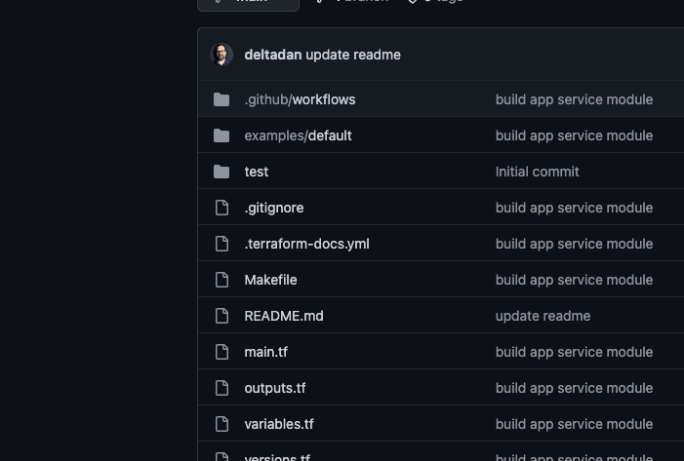
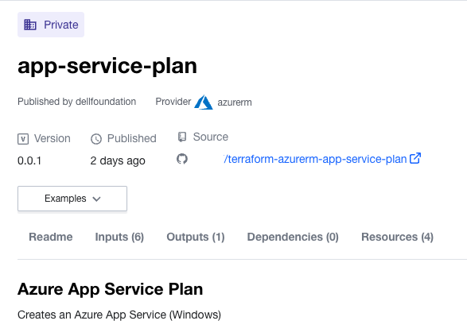
Store, version, and share modules internally
Creates an “eco-system of consumable cloud resources”
Enforce standards across all resource types (TLS 1.2)
Private Module Registry

Slide 11
Designing the “Azure Cake” with Terraform Projects

Slide 12
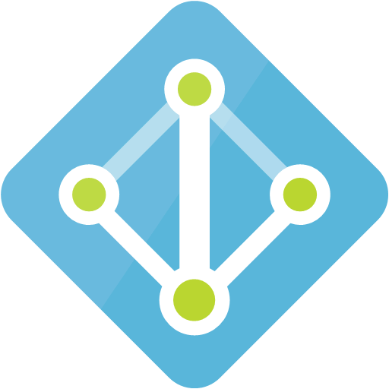
Subscriptions, Environments & Azure Regions
Landing zone design
Central US
AZ
1
AZ2
HUB
East US 2
AZ3
Central US
Azure backbone
DEV
STG
PRD
East US 2
East US 2
AZ
1
AZ2
East US 2
Central US
Central US
AZ3
Azure AD Tenant – contoso.com
East US 2

Slide 13
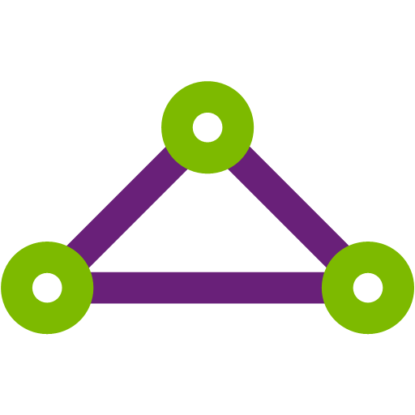
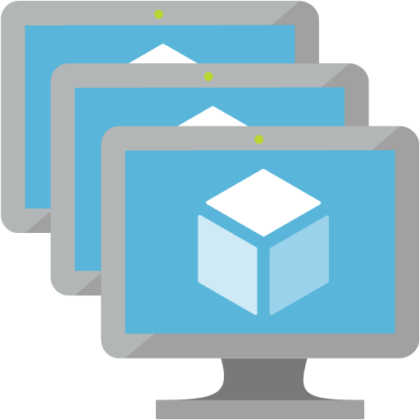
Multi-region, environment subscription deployment
HUB & PRD
HUB
E2-HUB-NET-hub-vnet
PRD
GatewaySubnet
VPN Gateway
E2-PRD-NET-PLE-vnet
Express
Route
NSG
NSG
Corporate
Network
SQL
MON
Policies Assigned
Hub & Spoke
Dedicated Apps Private Link Vnets peered to Hub
Dedicated Firewall and WAF for Application inspection
East US 2 & Central US mirror images
NSG
DC
Domain Controllers
STR
KEY
NSG
NSG
Bastion
NSG
Peerings
Jumpbox
E2-PRD-NET-APP-vnet
NSG
APP
AzureFirewall
Firewalls
Azure App Gateway
& WAF
NSG
DATA
WAF
NSG
Public IP
Traffic Manager
Allow Regions: Central US & East US 2
Tag: EVN, COST-CENTER, Created, Expires
Resource Providers: Only allow required
Policies

Slide 14
Azure Cake made up of Terraform “Projects”
Network
Governance
Apps
Bootstrap
Configure Terraform Cloud, GitHub Repos, & Azure Service Principals
Configure Policies, Resource Groups, Managed Identities, Role assignments
Virtual Networks, DNS (private & public), Hybrid connections, Logs, things that change infrequently
App Services, SQL Servers, Storage, Message Queues, APIs, ML workspaces

Slide 15
Layers of the Azure Cake distributed into Resource Groups
Apps
AKS
Key Vaults
Storage Accounts
App Insights
SQL Servers
SQL DBs
CosmosDB
App Service
App Service
Plan
Private Links
Private Links
PostGRE
MariaDB
Datafactory
APP VMs
APP-rg
DATA-rg
Network
Virtual Networks
ExpressRoute
Network Security
Groups (NSG)
Public IP Addresses
Dashboards
Log Analytics
Azure Monitor
FrontDoor
DNS Zones
Traffic Managers
Firewall
NET-rg
MON-rg
Governance
Policies
Roles, Groups & SPNs
Resource Groups
Managed Identities
Sentinel
Defender for Cloud

Slide 16
Configure Terraform Cloud for Azure Deployments

Slide 17
Layers
Networking
Governance
Environment
App
Modules that build upon each other.
Isolated to enforce security boundaries or reduce blast radius.
Layers above can read/reference layers below.
Requires you to deploy in the right order— tooling can’t infer dependencies across layers.
Can be useful for resolving race conditions during apply.

Slide 18
Infrastructure as Code Repositories
org/repo
global/
region/
Environment Configuration Repositories
Parameterized templates consisting of the major environment components
Example: Global and Regional modules for a network environment
These modules can be in subfolders of the same repository
The Workspaces provide the proper parameter values to deploy each module to the correct target environment:
HUB, DEV, STG, PRD

Slide 19
Azure Cake Repos
Layer
Repo
Terraform Providers
Purpose
Bootstrap
tfe, github
Configure Terraform Cloud, GitHub Repos, & Azure Service Principals
/iac-boot
azurerm, azuread
Configure Policies, Resource Groups, Managed Identities, Role assignments
Governance
/iac-gov
azurerm, azuread
Virtual Networks, DNS (private & public), Hybrid connections, Logs, things that change infrequently
Network
/iac-net
azurerm, azuread
App Services, SQL Servers, Key Vaults, Storage, Message Queues, APIs, ML workspaces
Apps
/iac-apps
Terraform Cloud Private Registry Modules
/terraform-azurerm-rg
Reusable terraform configs published as Modules in the private registry to be consumed by layer projects
/terraform-azurerm-vnet
azurerm, azuread
/terraform-azurerm-subnet

Slide 20
Terraform Cloud Variables, Variable Sets & Workspaces
Leveraging DRY principals to manage cloud deployments
Variables
Variable Sets
Workspace
ARM_TENANT_ID
Global
Global
ARM_CLIENT_ID
Subscription Specific
Subscription Specific
env
ARM_CLIENT_SECRET
ARM_SUBSCRIPTION_ID
AZURE_REGION
AZURE_REGION
tf
OTHER_TF_VARS
OTHER_TF_VARS

Slide 21
Deploy the layers of your “Azure Cake”

Slide 22
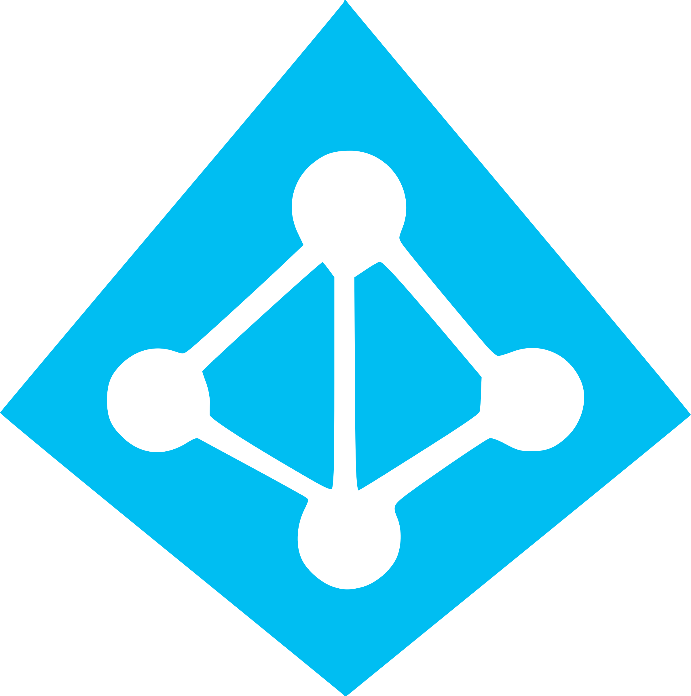
Building the Azure Networking using Terraform Cloud
HUB
Global
/iac-gov
Gov
Subscription
Gov
TF_VARS
resource groups
/terraform-azurerm-rg
gov-hub-centralus-shared-region
/iac-net
Global
Subscription
Net
/terraform-azurerm-vnet
Net
TF_VARS
vnets
subnets
/terraform-azurerm-subnet
net-hub-centralus-region
net-hub-eastus2-region

Slide 23
High Network topology implemented using TFC
centralus
Global
SUB
vnet-dev-app-eastus2
TF_VAR
HUB
/iac-net
vnet-dev-ple-eastus2
eastus2
Global
SUB
vnet-stg-app-eastus2
TF_VAR
vnet-ple-stg-eastus2
Global
centralus
SUB
vnet-app-prd-eastus2
TF_VAR
DEV
/iac-net
vnet-hub-eastus2
vnet-ple-prd-eastus2
eastus2
Global
ExpressRoute
SUB
TF_VAR
Corporate
vnet-dev-app-centralus
Global
centralus
SUB
vnet-hub-centralus
TF_VAR
STG
/iac-net
vnet-dev-ple-centralus
eastus2
Global
vnet-stg-app-centralus
SUB
TF_VAR
vnet-ple-stg-centralus
centralus
Global
vnet-app-prd-centralus
SUB
/terraform-azurerm-vnet
TF_VAR
PRD
/iac-net
vnet-ple-prd-centralus
/terraform-azurerm-subnet
eastus2
Global
SUB
TF_VAR
Notes:
<resource-type>-<workload>-<env>-<region>-<program>-<instance>

Slide 24
Q & A

