Slide 1
Getting Started with DevOps in Azure
Dan Patrick
dan@solliance.net
@deltadan

Slide 2
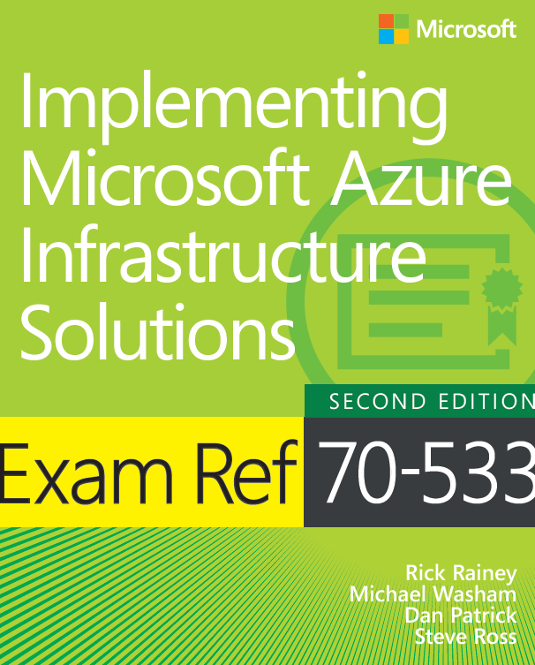
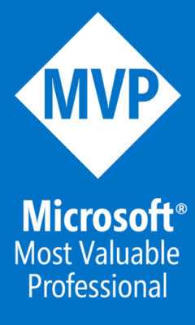
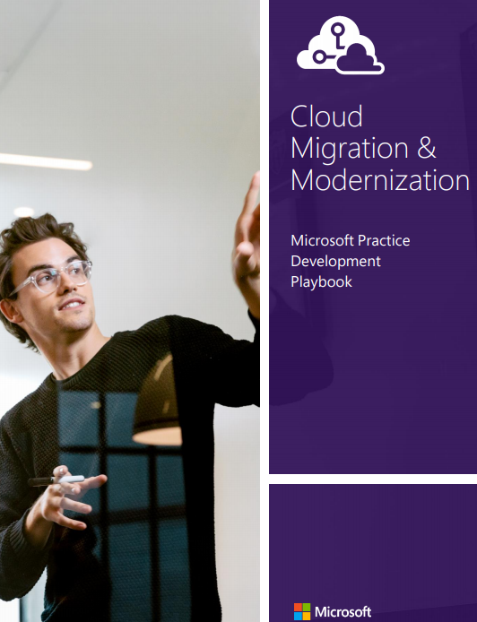
I need a new headshot!
General Manager DevOps, Chief Infrastructure Architect
Azure MVP
Author/co-author of several books on Azure
15 Year Blue-badge
Dan Patrick
dan@solliance.net
@deltadan

Slide 3
What is DevOps?
People. Process. Products.
Build& Test
Deploy
DevOps is the union of people, process, and products to enable continuous delivery of value to your end users.
“
Continuous Delivery
Develop
Operate
”
Plan & Track
Monitor & Learn
Notes:
DevOps is the union of people, process and products to enable the continuous delivery of value to your end customers

Slide 4
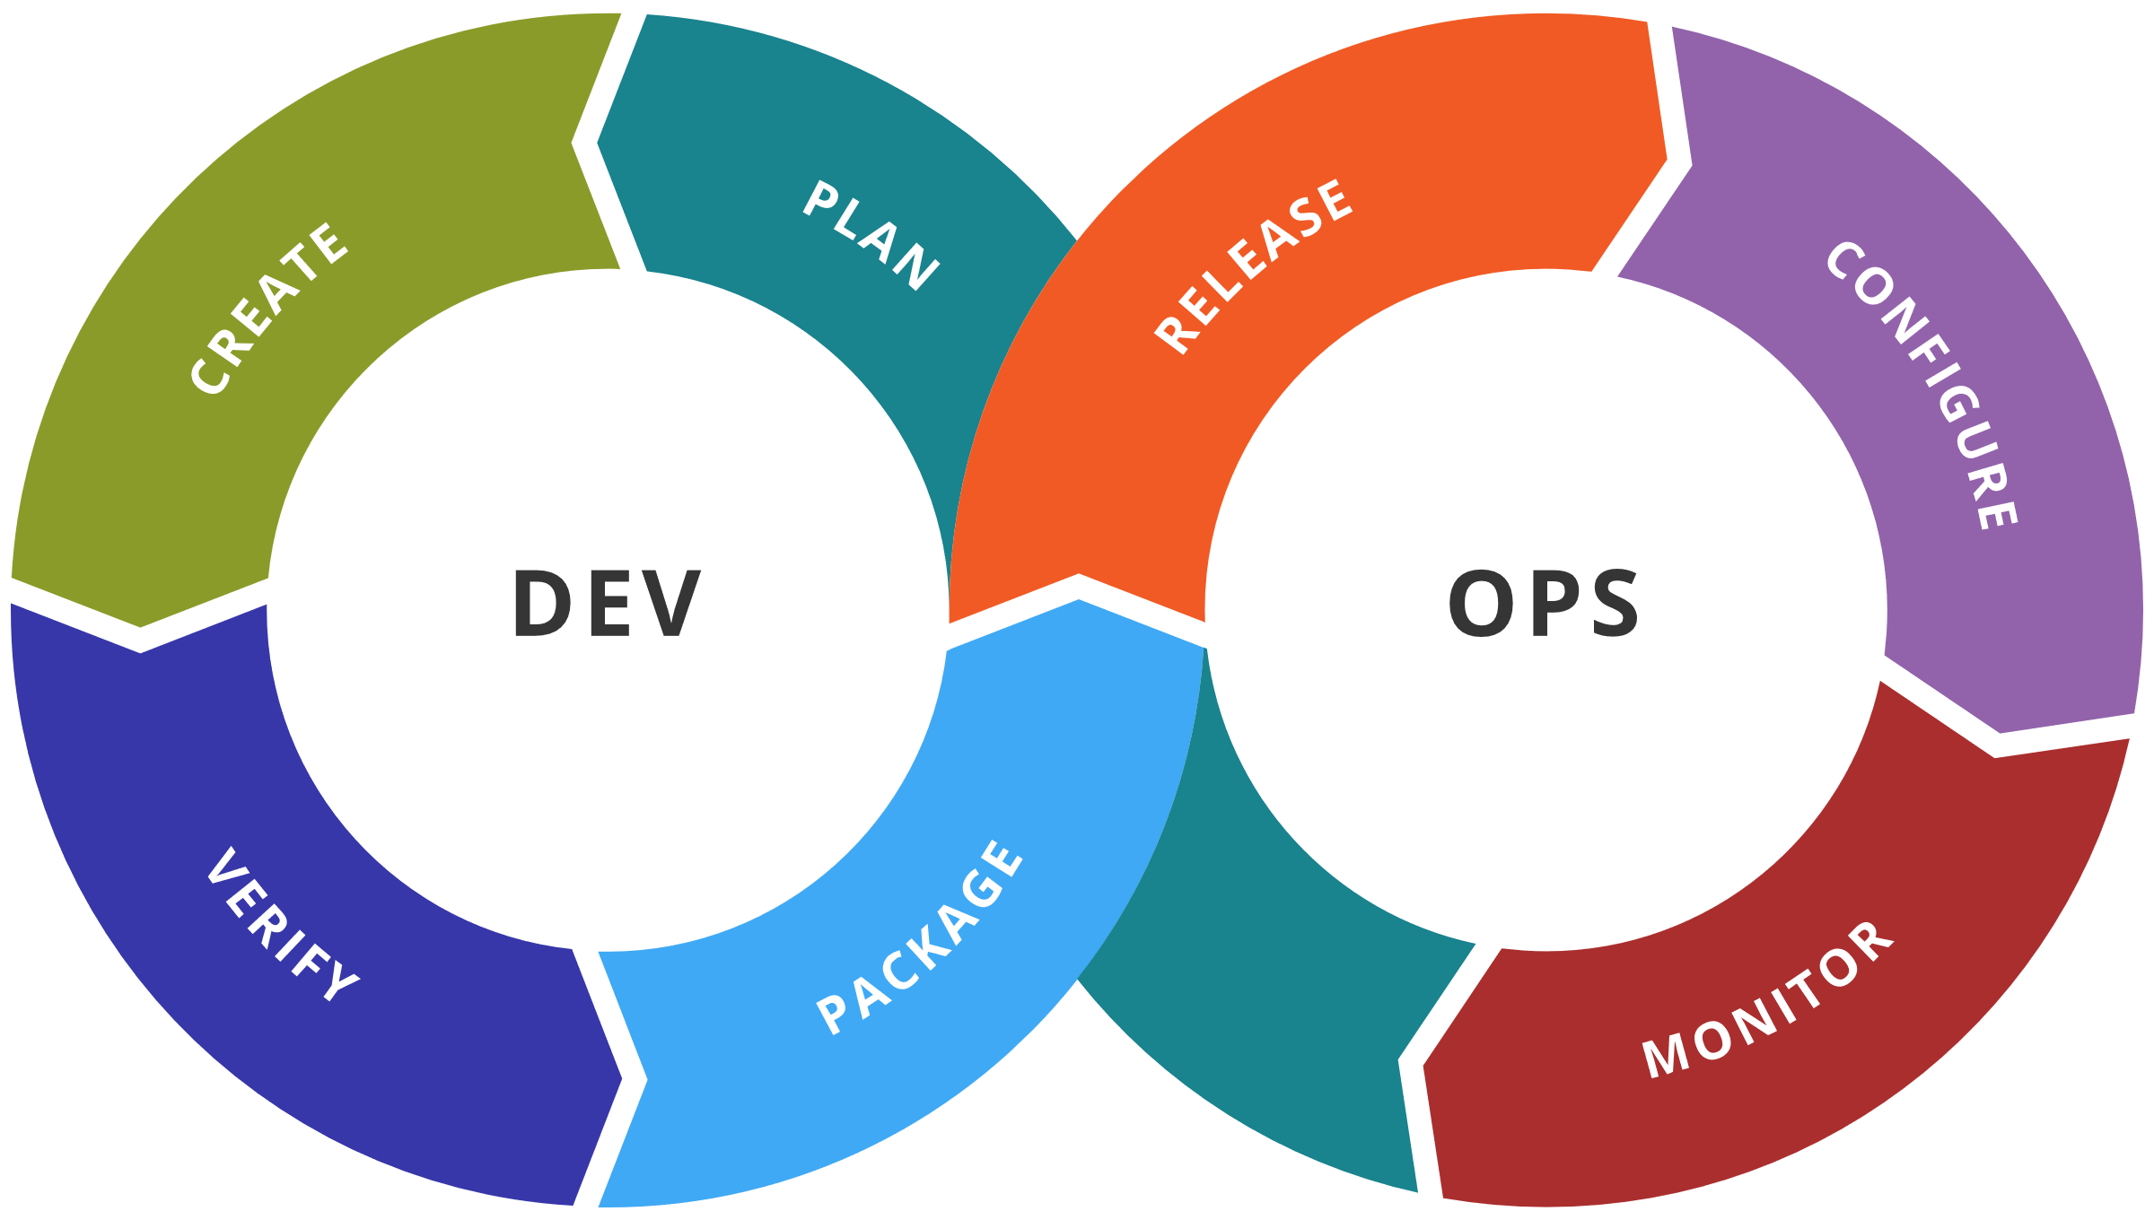
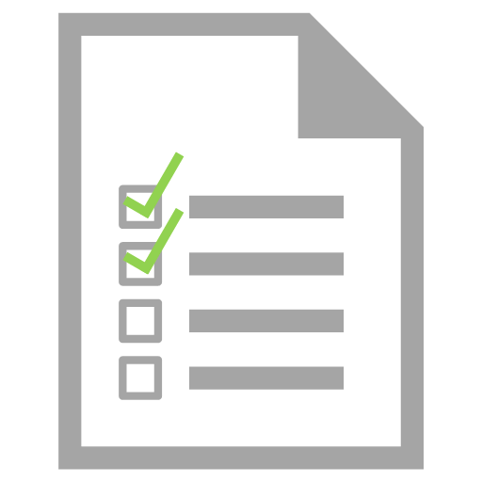
DevOps Dictionary
Development team members integrate their work frequently, usually daily. Each integration is verified by an automated build / test to detect integration errors quickly
Continuous
Integration (CI)
Automated tests are invoked as a crucial step to any automated build process. If tests fail, so does the build
Continuous
Testing

Slide 5
DevOps Dictionary
The full software delivery lifecycle is automated up until the last environment before production
Continuous
Delivery (CD)
One step further from Continuous Delivery, where deployment to production is also automated
Continuous
Deployment (CD)

Slide 6
Azure DevOps
Azure Boards
Azure Pipelines
Azure Repos
Deliver value to your users faster using proven agile tools to plan, track, and discuss work across your teams.
Build, test, and deploy with CI/CD that works with any language, platform, and cloud. Connect to GitHub or any other Git provider and deploy continuously.
Get unlimited, cloud-hosted private Git repos and collaborate to build better code with pull requests and advanced file management.
Azure Test Plans
Azure Artifacts
➔
Test and ship with confidence using manual and exploratory testing tools.
Create, host, and share packages with your team, and add artifacts to your CI/CD pipelines with a single click.
https://azure.com/devops
Notes:
So does TFS

Slide 7
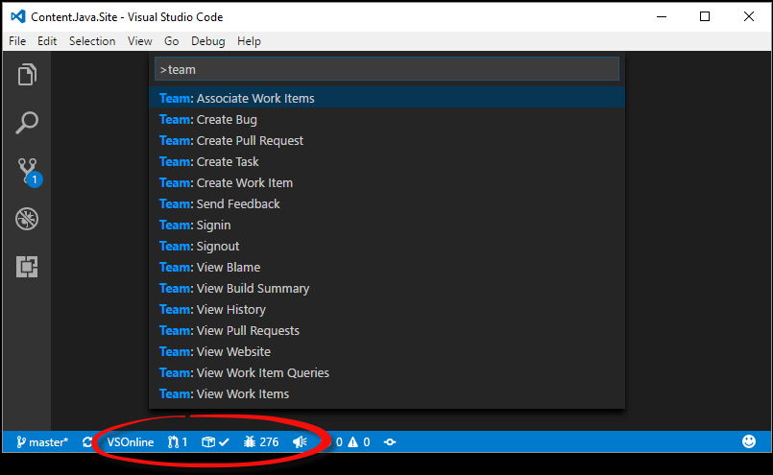
Azure Repos Extension for Visual Studio Code
Connect to Azure DevOps Services and TFS
Monitor builds and manage your pull requests and work items

Slide 8
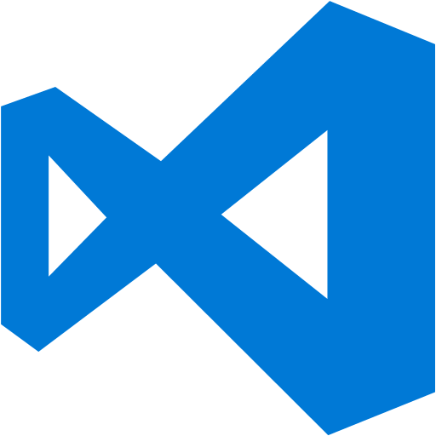
Tooling for Azure Resource Manager
Azure Management Portal
Visual Studio & Visual Studio Code
PowerShell or Azure CLI
Customer Code calling ARM API

Slide 9
Built In DevOps options

Slide 10
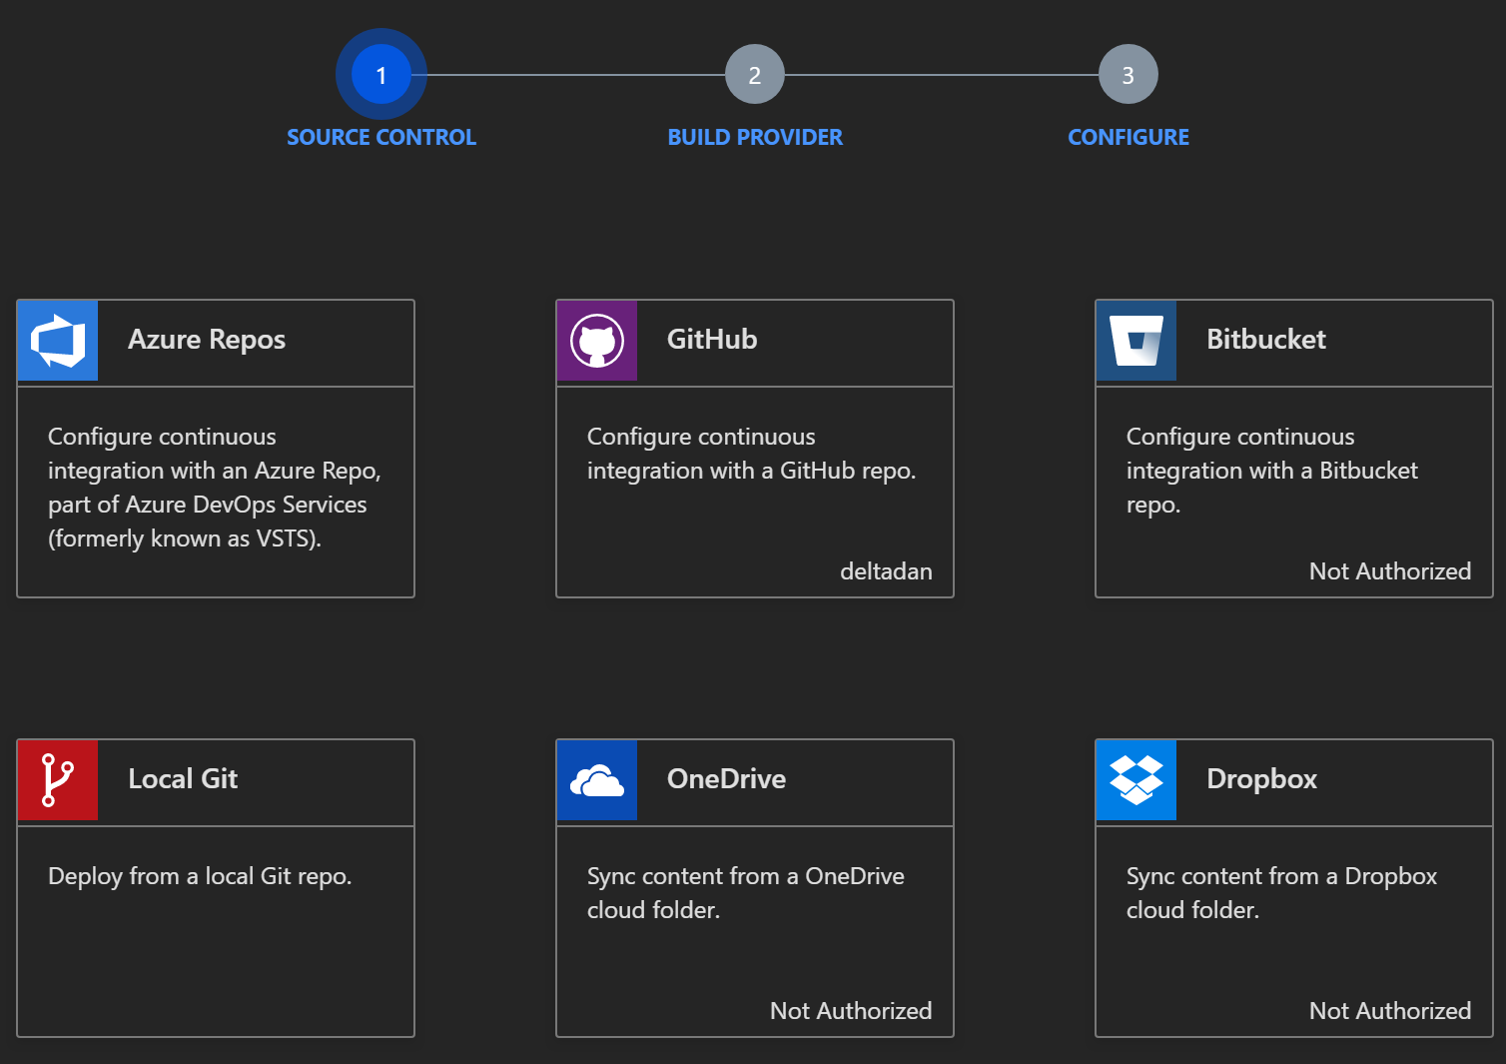
Deployment options
Source Control
Azure DevOps
OneDrive
Local Git Repository
GitHub
Bitbucket
Dropbox
External Repository
Notes:
LINKS:
https://docs.microsoft.com/en-us/azure/app-service-web/app-service-continuous-deployment

Slide 11
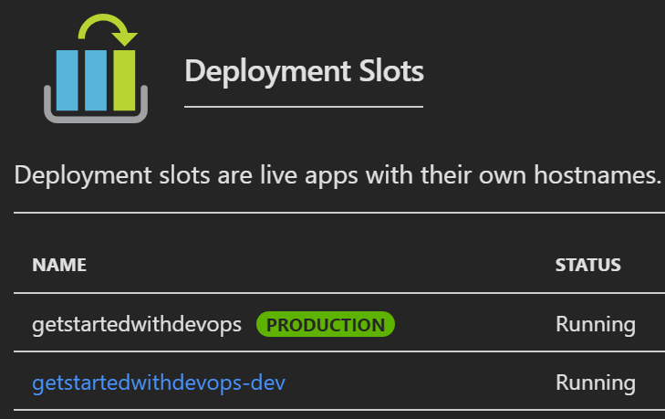
Deployment Slots
Each Deployment Slot is a separate Web App linked to primary Web App
Separate Runtime Environments & URLs
Supports A/B Traffic
PROD: http://getstartedwithdevops.azurewebsites.net
DEV: http://getstartedwithdevops-dev.azurewebsites.net
Notes:
Each Web App allows you to add multiple Deployment Slots. The number of deployment slots that can be created is dependent on the App Service pricing tier. Each Deployment Slot will have it’s own URL and runtime environment. However, all Deployment Slots are linked to the Production or Primary Web App Deployment Slot, and is hosted on the same underlying, managed VM.

Slide 12
Update web apps with Minimal Downtime
http://contoso-dev.azurewebsites.net
http://contoso-staging.azurewebsites.net
http://www.contoso.com
4. Swap to Staging (Production Environment) for final validation
5. Swap to production web site
2. Code is built and deployed to deployment slot
Dev/Test
Staging
Production
1. Developer checks code in
3. Test validates quality using test environment
Notes:
Using deployment slots we are able to update web apps with minimal downtime. Deployment slots are live web apps with their own hostnames. Web app content and configurations elements can be swapped between two deployment slots, including the production slot.

Slide 13
Update web apps with Minimal Downtime
http://contoso-staging.azureweb apps.net
http://www.contoso.com
1. Swap back to previously working code!
Users
HTTP 500
Page Request
Staging
Production
Notes:
Performing a rollback is a simple swap back to the prior site.

Slide 14
Demo Azure App Services
Notes:
https://gettingstarteddevops.azurewebsites.net/
https://github.com/Azure-Samples/app-service-web-html-get-started
Show deployment options
Create slot
Fork to your repo
Pull into

Slide 15
Infrastructure as Code using Azure DevOps Release Pipelines

Slide 16
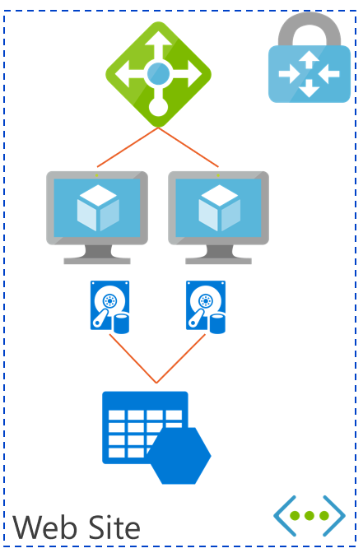
ARM Templates, Infrastructure as Code (IAC)
Used by Admins to provision an Azure Infrastructure using a Programing Language
The Code tells Azure “What to Build”

Slide 17
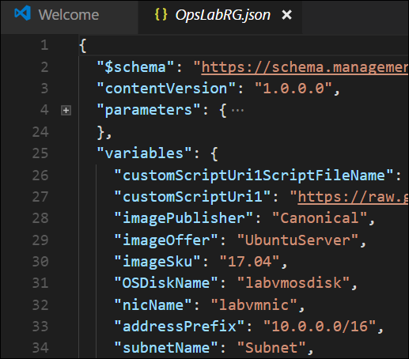
Visual Studio Code
Work with ARM Templates using the Azure Resources Manager Tools with IntelliSense
Function Names
Parameter References
Properties
Provides language support for Azure Resource Manager deployment templates and template language expressions
Integrated Terminal for PowerShell or Azure CLI deployments

Slide 18
One ARM template to rule them all…
azure-deploy.json
Used to store settings specific to an environment
Could be used to document different types of environments details, but identical resources
Use Variable Groups instead of parameters files to build environments
VG - dev
VG - test
VG - prod
dev
test
prod

Slide 19
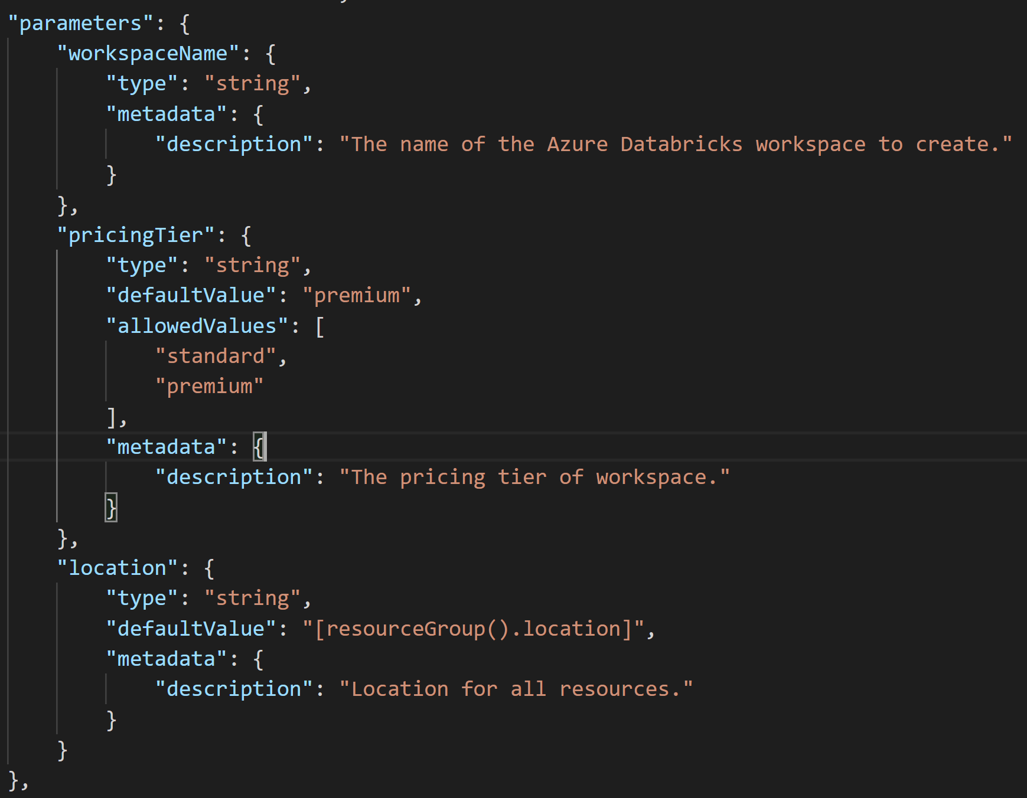
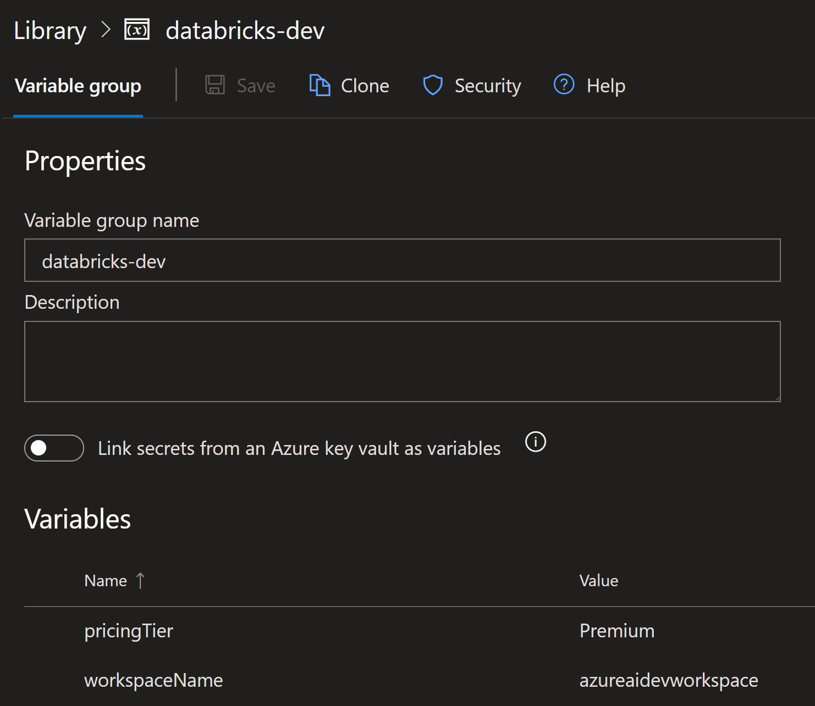
Azure DevOps Variable Groups

Slide 20
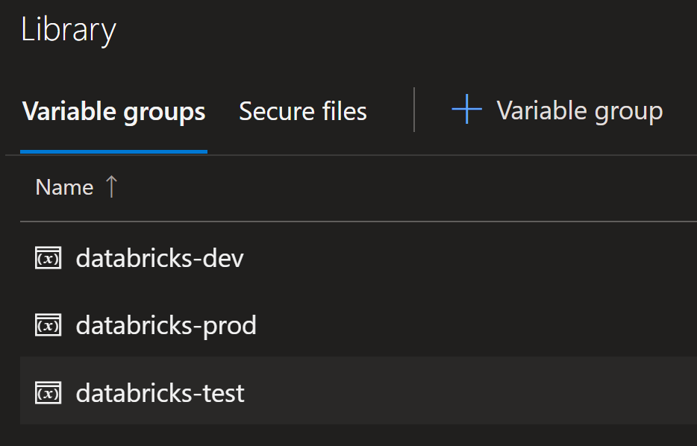
Using Azure DevOps to deploy Azure Infrastructure
Create Variable Groups to match each release
Tweak the values for each

Slide 21
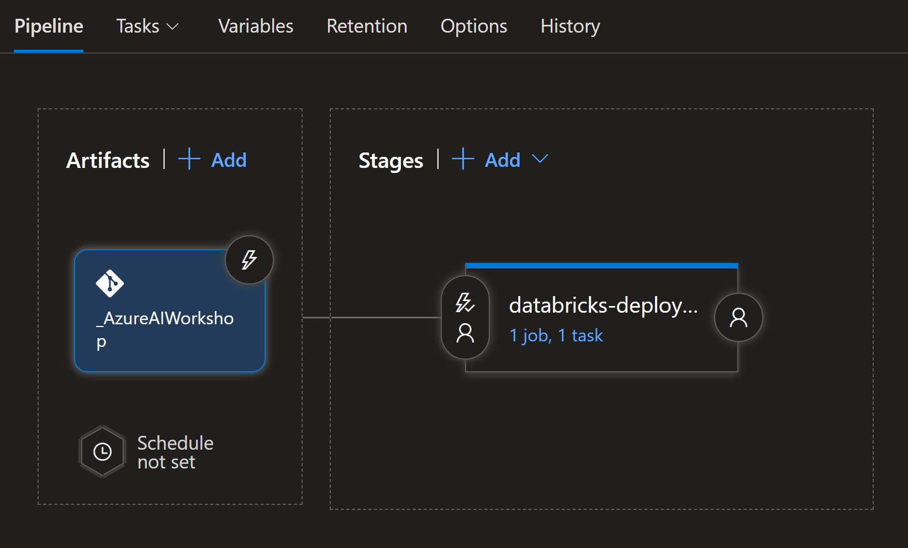
Using Azure DevOps to deploy Azure Infrastructure
Create Releases for each environment
Attach Repo as Artifact

Slide 22
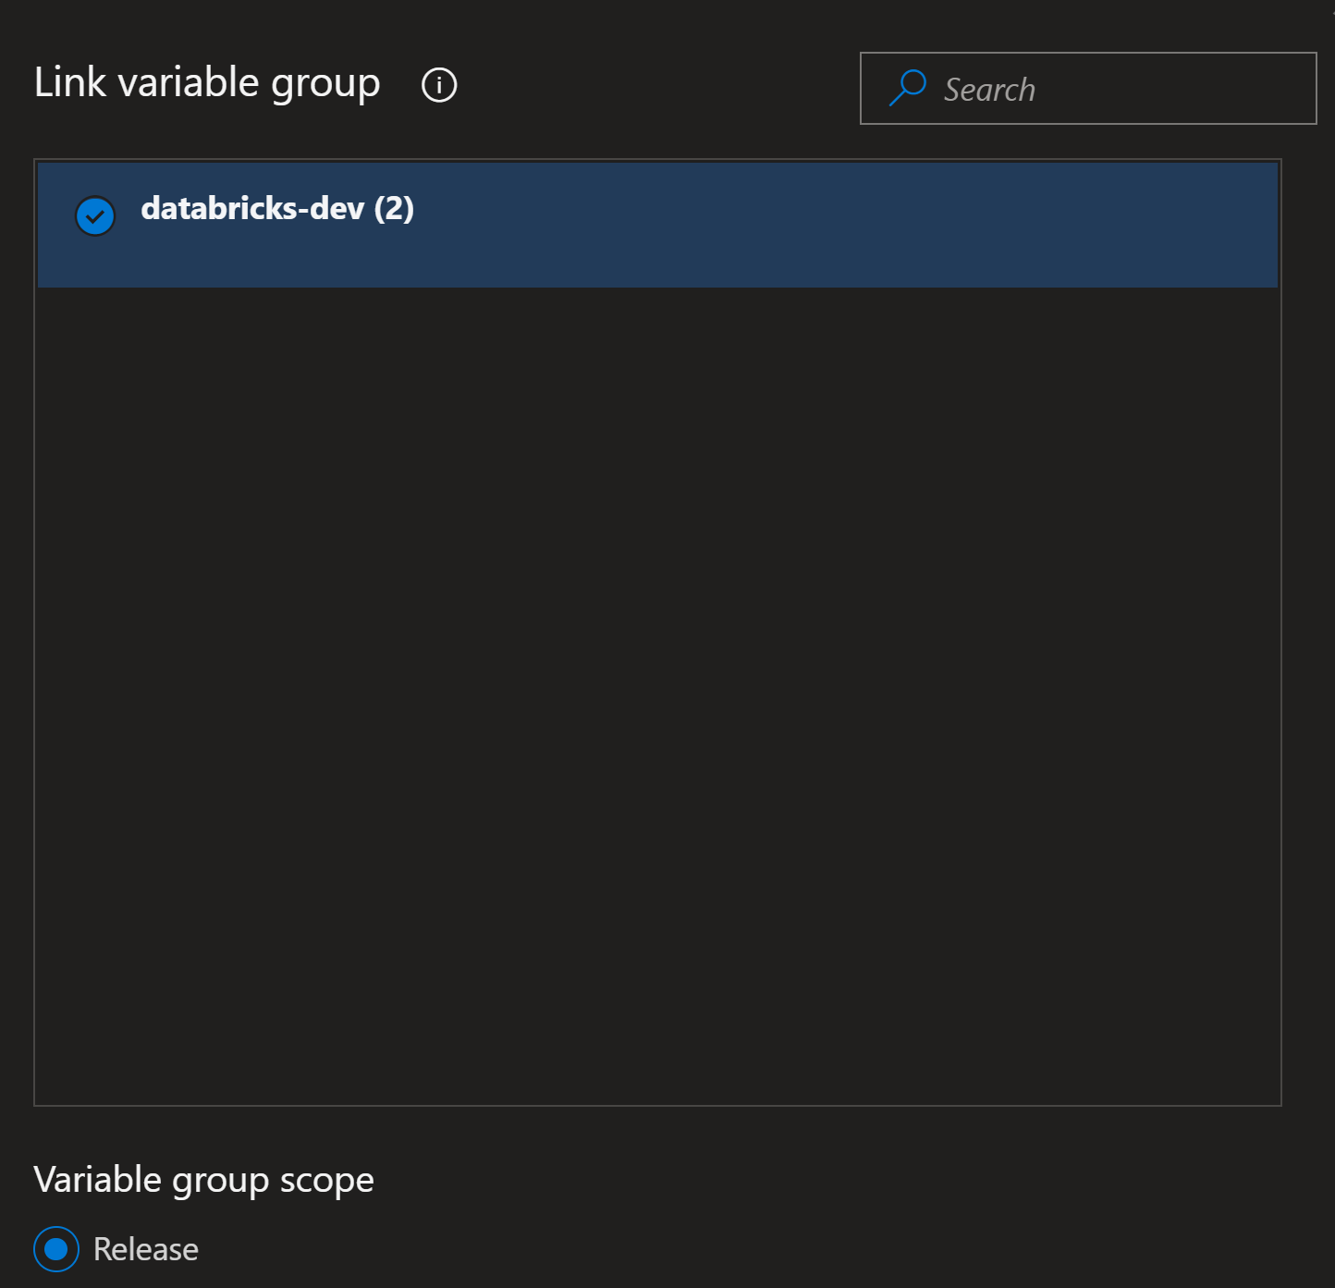
Using Azure DevOps to deploy Azure Infrastructure
Link Variable Group to Release

Slide 23
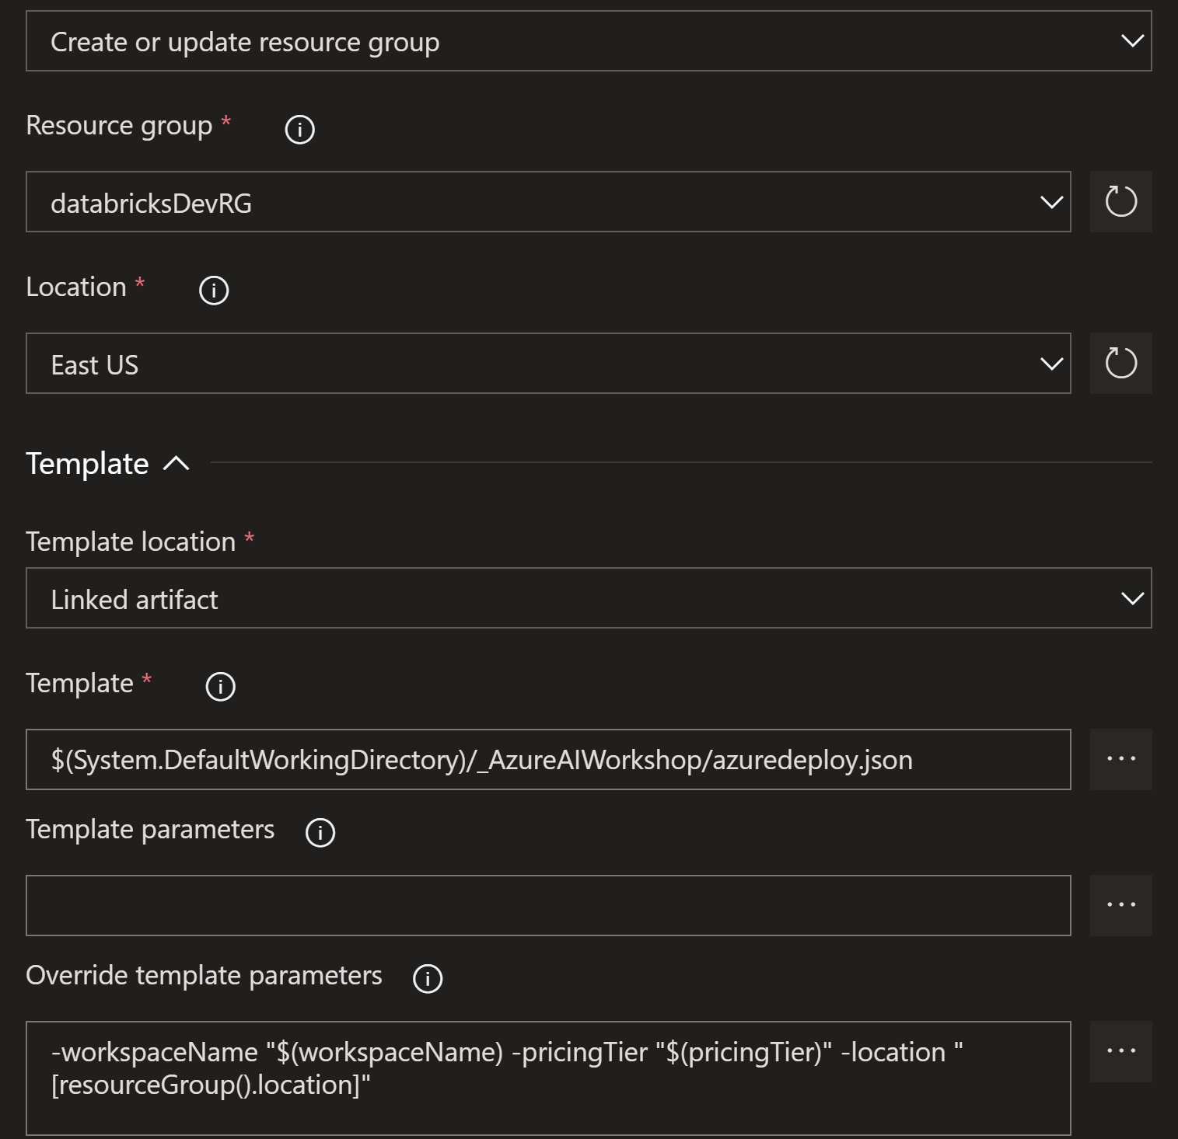
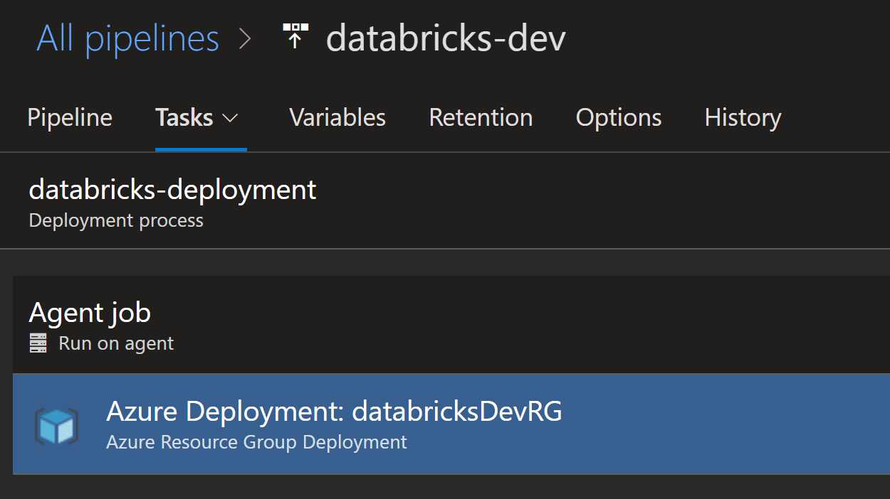
Using Azure DevOps to deploy Azure Infrastructure
Resource Group Deployment Task

Slide 24
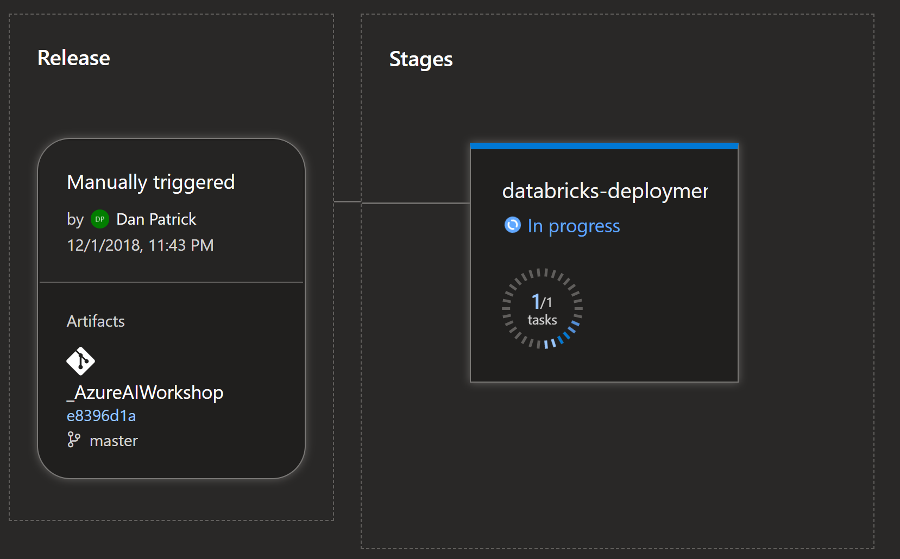
Deployment triggered from here, not portal
Deployments are Triggered from Azure DevOps, not from the Azure Portal

Slide 25
Demo Infrastructure as Code
Notes:
https://dev.azure.com/AzureAIConf
Show Repos
Show ARM template
Show Build PROD based on Dev

Slide 26
Host deployment using Azure DevOps Build & Release Pipelines

Slide 27
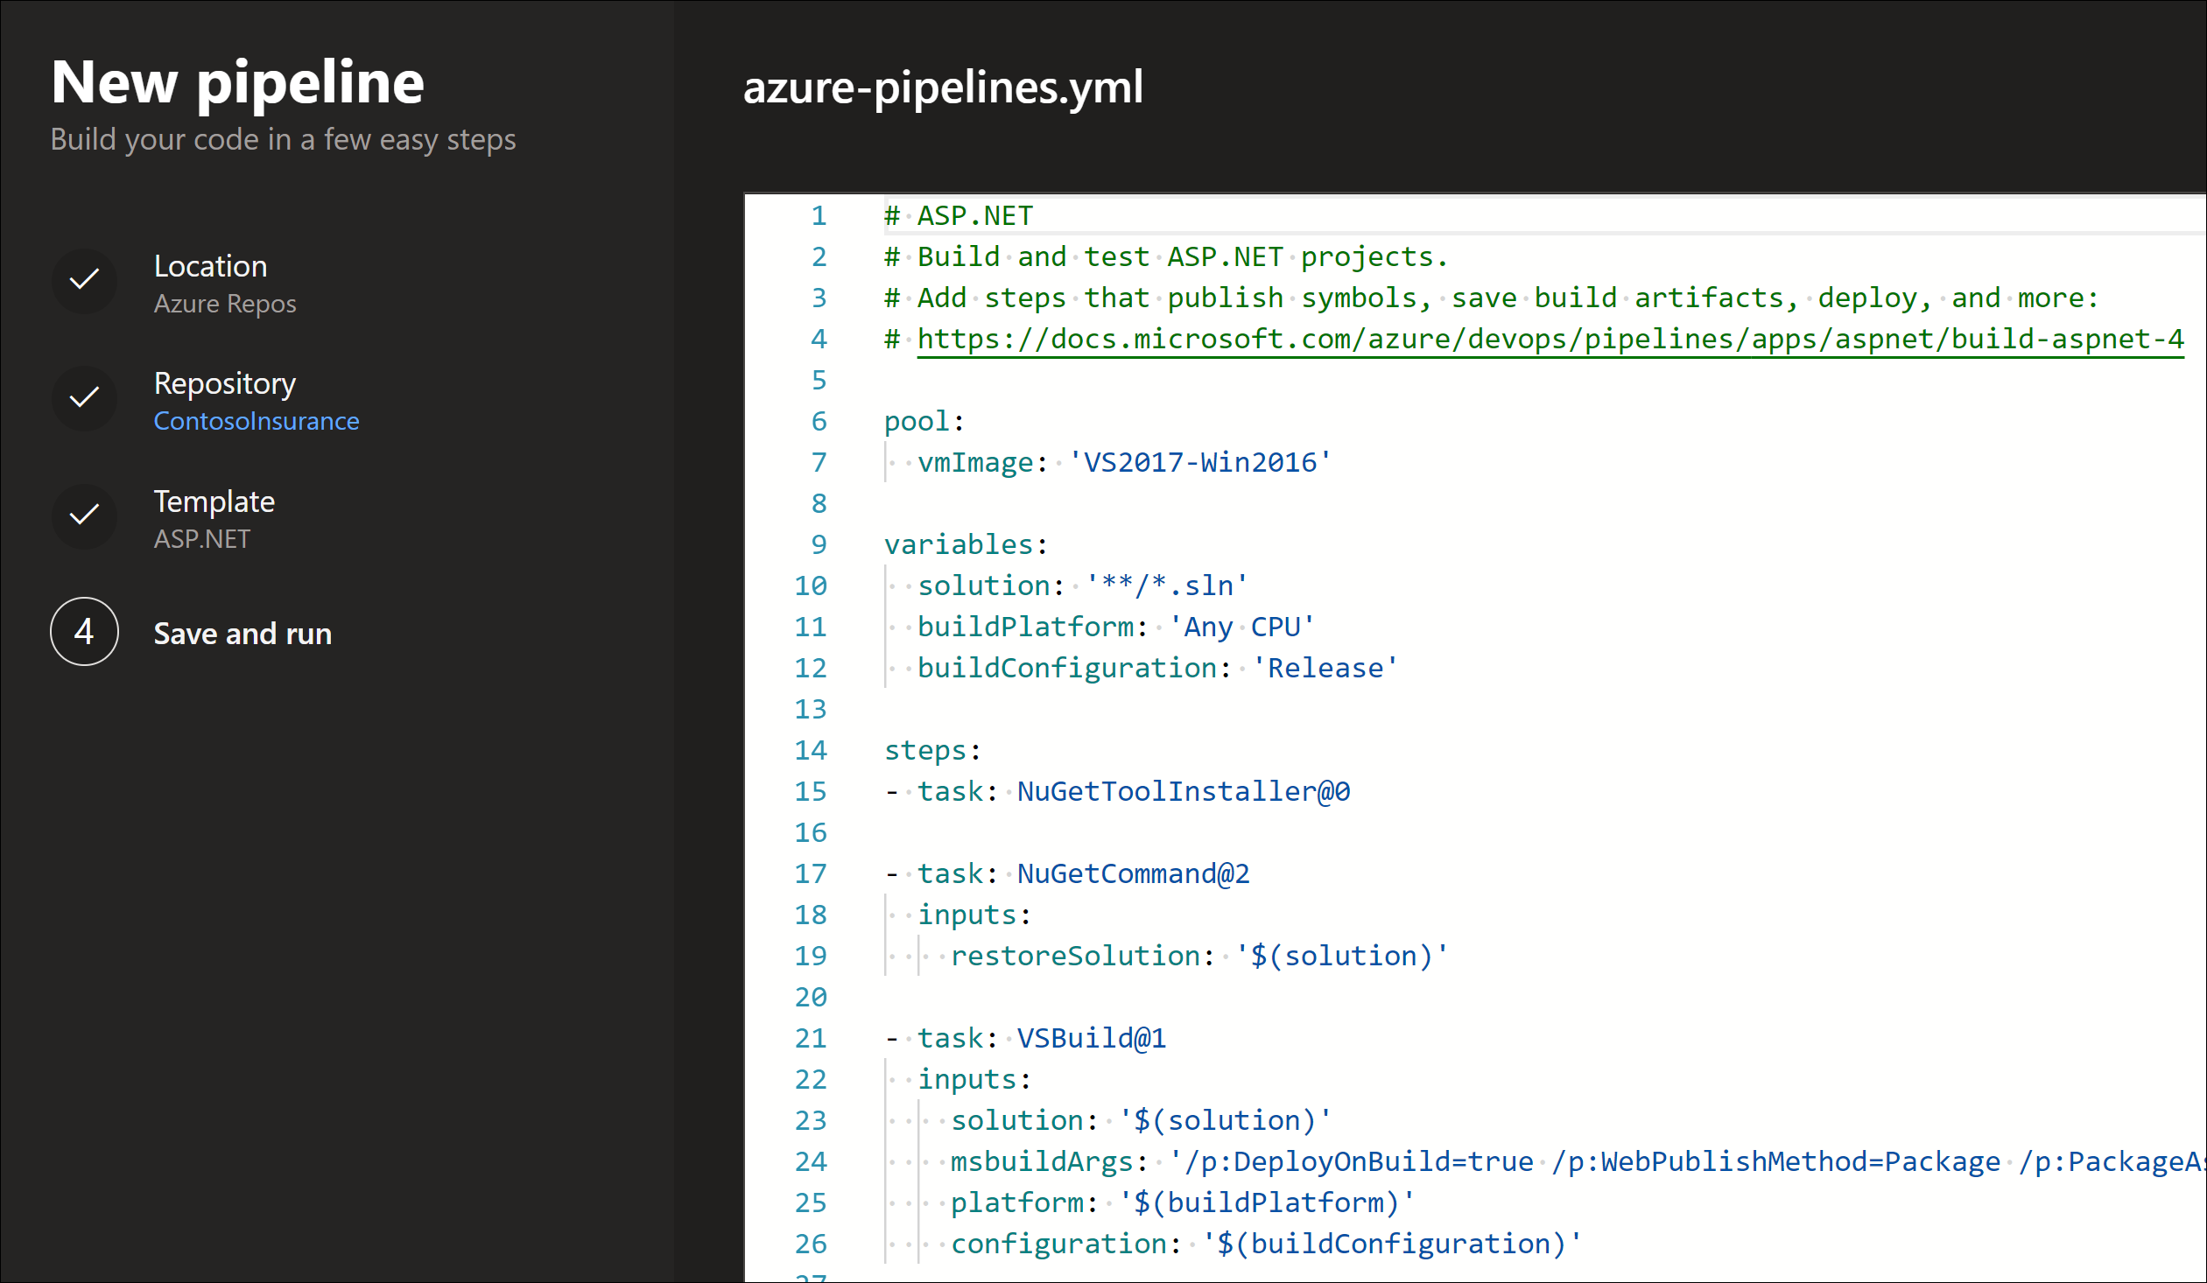
Azure Build Pipelines
Builds are used to package the software for deployment
Variable Groups again should be used for providing in puts to the Build
Can be triggered automatically or with push to repo
Gates can be created with simple or more complex criteria

Slide 28
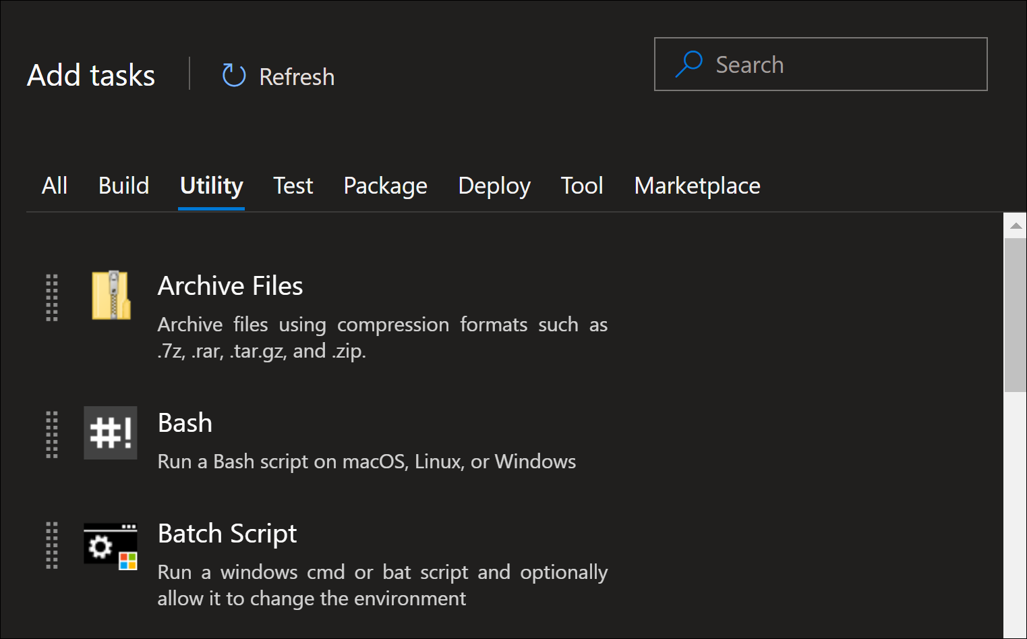
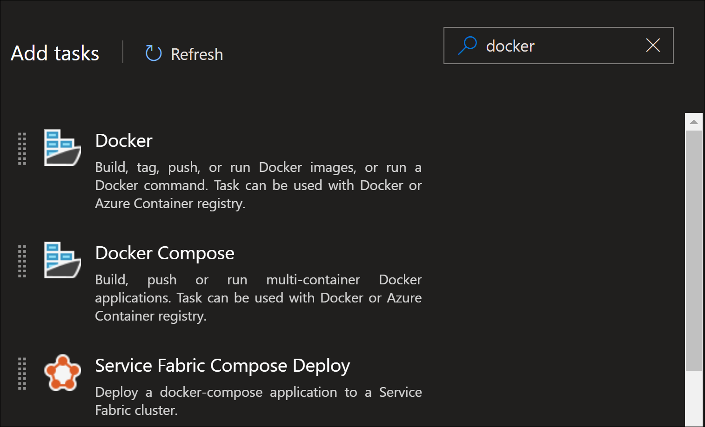
Build Task Templates
Used for Common Tasks
Open Source
Support Many types of Technologies
Searchable for your needs within the UI

Slide 29
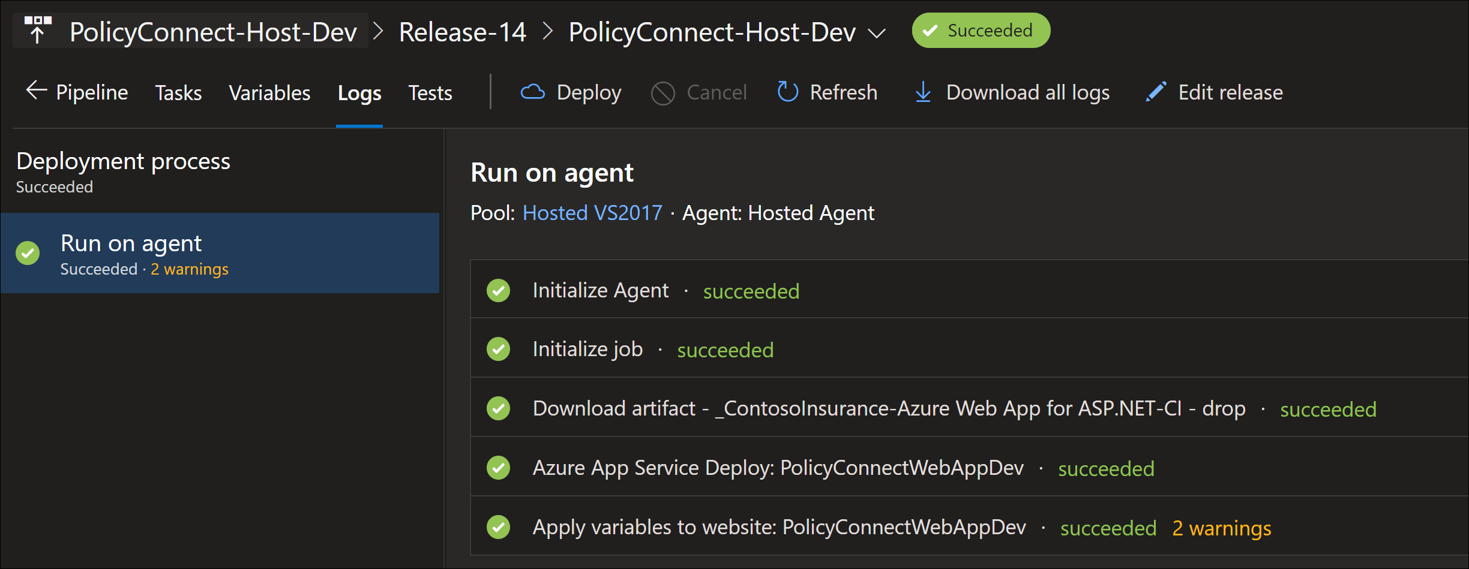
Releases
Used deploy software
Variable Groups again should be used for providing in puts
Can be triggered manually or with a completed build
Gates can be created with simple or more complex criteria

Slide 30
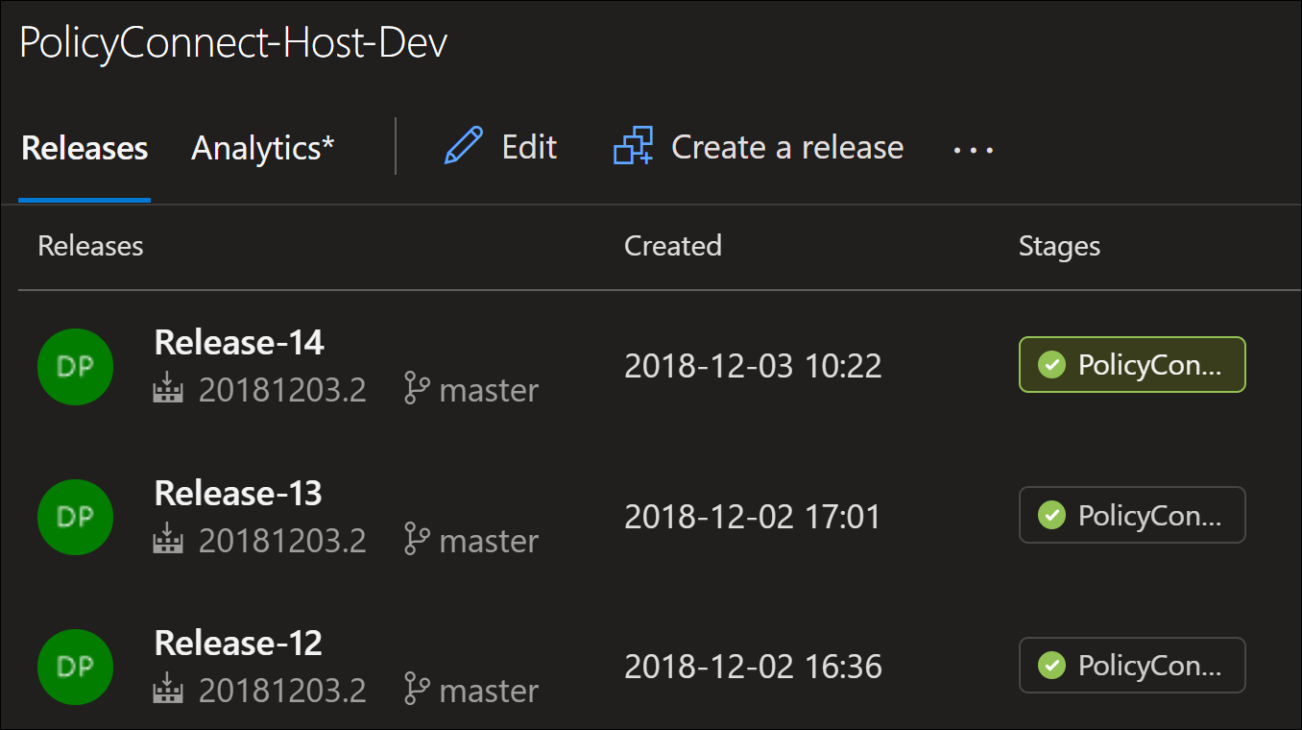
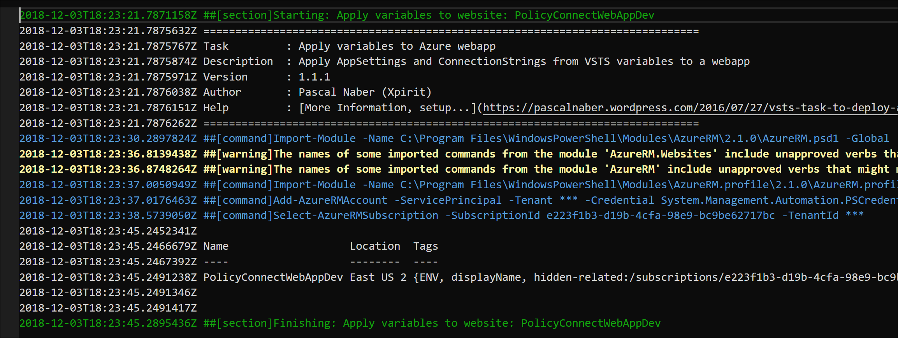
Releases
History is retrained for Releases, and be rerun based on the commits attached
Logs available for each Release for review/troubleshooting
Clone and Tweak to Support multiple environments

Slide 31
Demo – Build & Release for ASP.NET
Notes:
https://dev.azure.com/AzureAIConf

Slide 32
Azure DevOps
#AzureDevOps
https://azure.com/devops
@AzureDevOps
https://aka.ms/AzureDevOpsForum
https://aka.ms/DevOpsBlog/
Notes:
Join the conversation.
Potentially replace for speaker contact details / intro.

Slide 33
Questions?
Please use EventsXD to fill out a session evaluation.
Thank you!

